Slide 1
AssetWorks AiM 9.1 Work Management Training
Notes:
AssetWorks AiM version 9.1 is an Integrated Work Management System (IWMS) software designed to provide facilities management solutions. This training is an overview of some of the most used functions and functionalities that AssetWorks AiM has to offer relating to Work Management processes.
For more details or help, reference the AiM 9.1 Reference Guide Operations and Maintenance manual.

Slide 2
Agenda
Part 1
Goals of Training
Core Concepts
Work Management Data Standards
Basic Information (Contact and Location)
Classifying Types of Maintenance
Priority and Status Codes
Asset Standards
Navigating AssetWorks AiM
Notes:
Part 1 of this training will cover basic work management and maintenance concepts, data standards and general navigation of the AiM system.

Slide 3
Agenda
Part 2
Work Management Module (Work order, phase, daily assignments, purchase requests, shop stock transactions)
Customer Service Module (Customer request and approval)
Finance Module (Work order financing)
Fire O&M Application
Time and Attendance Module (Timecard entry and approval)
Pre-Defined Screen Queries (Report listing)
Notes:
Part 2 of this training will cover individual processes related to Work Management.
The processes will cover how to enter work requests into the system, the approval and assignment process, time keeping procedures, as well as reporting capabilities for monitoring and managing work.

Slide 4
Process Breakdown
Section | Technician | Supervisor/ Director | Finance | Work Order Control
Core Concepts and Standards | ✓ | ✓ | ✓ | ✓
Work Order/Phase | ✓ | ✓ |  | ✓
Daily Assignments | ✓ | ✓ |  | include
Purchase Request | ✓ | ✓ | ✓
Shop Stock | ✓ | ✓
Customer Request | ✓ | ✓ |  | ✓
Customer Request Approval |  | ✓ |  | ✓
Work Order Invoicing | ✓ | ✓ | ✓ | ✓
Fire O&M App | ✓ | ✓ |  | include
Timecard Entry | ✓ | ✓ |  | include
Timecard Approval |  | ✓ |  | include
Pre-Defined Queries | ✓ | ✓ |  | ✓
Notes:
The processes covered in this training will apply to certain roles and responsibilities in the Uconn Facilities Operations and Building Services group.
The process breakdown shows a high-level summary of the processes that relate to each role between Technicians, Supervisors or Directors, Finance, and Work Order Control (WOC) Operations to highlight areas of interest for each group.

Slide 5
Part 1: Core Concepts and Data Standards
Notes:
Part 1 reviews the core concepts and the data standards for the AiM Work Management training.
The core concepts section includes details on:
Classifying Types of Maintenance
Prioritizing Work
Evaluating Statuses
Linking to Assets
General Navigation of AiM

Slide 6
Goals of Training
Emphasize Workflow of Information
Align Use of AiM with Workflow Processes
Improve Accuracy of Data
Improve Consistency of Workflow of Information
…to make strategic data-driven facilities decisions…
Notes:
We are here today because the University has made an investment in an Integrated Work Management System (IWMS) that can help make strategic data-driven facilities decisions.
In order to make these decisions, the information within the system has to not only be accurate, but also configured in a way that provides the information needed to generate the reports necessary for making these decisions.
While this system can hold a lot of information, the intent is not to collect as much as possible, but to limit the data collection to the right information, information that is valuable to facilities decision making.
The following page gives an overview of your role in achieving these goals.

Slide 7
Achievement of Goals
Pride in Facilities and Your Job
Contribute to the Mission
Opportunities for Advancement
Help Attract and Retain Quality Peers
Make Your Life Easier
Notes:
WIIFM? (What’s in it for me?)
Why take time out of your busy day to learn (or validate what you already know) about your mission, vision, values, maintenance philosophy and processes?
Pride in Facilities and Your Job – Few facilities organizations can claim maintenance programs and robust and effective programs.
Contribute to the Mission – Each employee directly contributes to the mission.
Opportunities for Advancement – There are many opportunities for advancement and those who understand the maintenance philosophy and program requirements are sought after individuals. If you want to advance your career, this is the place to start!
Help Attract and Retain Quality Peers – A well developed maintenance program with comprehensive, effective and detailed processes is very attractive to the best candidates for your organization. If you like working with competent peers, again, the investment in staff through this training is a great way to attract and retain them.
Make Your Life Easier – By getting everyone rowing in the same direction with respect to maintenance philosophy and activities. Minimize frustration of redoing work or the perception of mismanaged work tasks.

Slide 8
Core Concepts
Improve AiM’s Information to Drive Decisions
Classify Types of Maintenance
Prioritize Work
Evaluate Statuses
Link to Assets
Notes:
In this section, we will review the data standards that have been established for use in the AiM system. We will also go over the meaning of the different types of maintenance in order to correctly identify work and prioritize work within AiM.

Slide 9
Work Management Data Standards List of Standard Data Fields in AiM
Contact Information: Organization and Requestor
Location Information: Region, Campus and Property
Work Management: Work Type, Work Category, Job Priority, Work Order Status, Work Phase Status, Problem Code, Action Taken Code
Asset Management: Asset Classification, Asset Type, Asset Groups, Asset Status, Asset Failure Code, Manufacturers, Unit of Measure
Notes:
Uconn has developed data standards for input fields in AiM related to Work Management and Asset Management. These standards define the configuration of data for the contact person, location of work, impacted assets, and type of work for maintenance tasks to help you select a value from a provided list, rather than free text fields.
Why use data standards?
Provide Guidance on Naming Conventions
Increase Quality of Data
Optimize System Performance
Enables Better Reporting
The use of standard lists discourages unnecessary variation in the data that occurs when free text fields are used. Having a defined list of options for input fields allows queries to run successfully and ultimately generate meaningful reports.

Slide 10
Contact and Location Standards
Notes:
What are these fields?
AiM allows users to track the contact information of personnel entering work requests in case more information or follow-up is required. The location fields allow users to track the area where the work being requested is located for efficiency in resource planning.
Where will you find these fields?
These fields are found in screens under the Work Management module (work orders, purchase request, work scheduler, etc.)

Slide 11
Contact and Location Standards Requestor Hierarchy
The Requestor field is used to document the contact information of the personnel requesting the work.
The example below shows the hierarchy for a contact from the Athletics group
Institution
UCONN
Department
President
Organization
Athletics
Requestor
Requestor Net ID
Notes:
The organizational hierarchy setup determines who is requesting the work and is based on the organizational structure of UConn. The institution code is first set up, which has departments associated to it. Organizations are then associated to departments and finally requestors are associated to organizations.
UConn has set up the fields as follows:
Institution – The University of Connecticut is the Institution in each scenario
Department – The Departments are divided into the groups of President, Provost Academic Affairs, Exec VP Admin, and CFO
Organization – The Organizations are divided into groups under each of the Departments (i.e. Athletics, Academic Affairs, Accounting)
Requestor – The Requestor options are linked to the Organization selected and are shown by NetID

Slide 12
Contact and Location Standards Property Hierarchy
The Property field is a required when entering a work order to document the area where the work is requested.
The example below shows the hierarchy for work located in Beach Hall.
Region
Connecticut
Facility
Storrs Campus
Property
Beach Hall
Location
104A
Notes:
The property hierarchy setup determines where the work is being done. The region code is first set up and then facilities are associated to regions. Properties are then associated to facilities and finally locations are associated to properties.
Uconn has set up the fields as follows:
Region – Connecticut is the Region in each scenario
Campus – The Facility standards are divided by Campus (Storrs, Hartford, Stamford, etc.)
Property – The Property options are divided into buildings or areas under each Campus (i.e. Storrs Hall, Hawley Armory, Softball Dugout)
Location – The Location information is identified in each Phase and is linked to the Property selected for the parent work order. The locations are listed by room number (100, 100A, 110B)

Slide 13
Classifying Types of Maintenance
Notes:
What are these fields?
The work classification (work types) and category codes are important to organize the data in the IWMS to enable consistent reporting of metrics. The work types and category codes provide a complete and organized accounting of work performed; as long as it is recorded and entered into the IWMS.
Where will you find these fields?
These fields are found in screens under the Work Management module (work orders, purchase request, work scheduler, etc.)

Slide 14
Work Classification Standards Hierarchy
Work Type
Maintenance
Work Category
Corrective
Problem Code
Leak/Flood Problem
(and Failure Cause Code if applicable)
Action Taken
HVAC Equipment Leak Repair
Notes:
The work classification hierarchy setup determines what kind of work is to be completed. This classification is based on an organization’s business processes. Types of work (e.g., maintenance, construction, administrative, etc.) are first defined and then categories are associated to those types (e.g., within the maintenance type, categories could include preventive, deferred, service/demand, grounds, contract work, etc.). The work is defined further by associating work order statuses, phase statuses, and work codes to the categories. This classification enables the flexibility to map to any business process.

Slide 15
Work Classification Standards Work Type
Work Types
Maintenance
Operations
Recapitalization
Administrative
One of the biggest challenges is getting everyone thinking the same way about maintenance because everyone has different backgrounds and exposure to different maintenance activities. They’ve learned things in a different manner, worked in different places, and have a different way of doing things as part of their skill set.
Notes:
The different Work Types within AiM include the following:
Maintenance – includes preventive, predictive, proactive, and corrective maintenance tasks
Operations – includes access control, custodial services, event support, grounds services, moves, room setups, security, and waste management
Recapitalization – includes energy conservation, estimating, fixed rate improvements, alterations, programmatic upgrades, renewal and replacement projects
Administrative – includes improvement projects, leave time, shop time, and training hours
The focus of this training will be on the Maintenance Work Type only.
The best maintenance is a mix of the optimum combination of corrective, interval-based (preventive maintenance), condition-based monitoring (predictive maintenance), proactive maintenance and run-to-failure approaches in order to maximize equipment reliability while minimizing life-cycle costs. This optimum mix is what we call reliability centered maintenance.

Slide 16
Work Classification Standards Work Type
Work Types
Maintenance
Operations
Recapitalization
Administrative
Maintenance Work Categories
Preventive Maintenance (PM)
Predictive Maintenance (PdM)
Proactive Maintenance (PrM)
Corrective Maintenance (CM)
Notes:
The different types of Maintenance Work Codes including the following:
Preventive Maintenance (PM): Preventive Maintenance includes planned actions undertaken to retain an item at a specified level of performance by providing repetitive scheduled tasks that prolong system operation and useful life:. This can include inspections, cleaning, lubrication, and part replacement.
Predictive Maintenance (PdM): Predictive maintenance (PdM) is maintenance performed when empirical data that is collected and reviewed indicate that maintenance is required. Predictive Testing & Inspection (PT&I) is another term often used interchangeably to more clearly describe PdM processes. PT&I includes non-destructive and non-intrusive methods of investigation and analysis.
Proactive Maintenance (PrM): Proactive maintenance is the sum of all maintenance work that is completed to avoid failures.
Corrective Maintenance (CM): Maintenance activities performed because of equipment or system failure. Activities are directed toward the restoration of an item to a specified level of performance. Corrective maintenance is also referred to as demand maintenance, reactive maintenance, breakdown maintenance, etc.

Slide 17
Defining Maintenance
Preventive
Predictive
Proactive
Corrective
Notes:
What is your organization’s philosophy on maintenance?
Your organization’s optimum mix depends on your mission. It is important to understand the difference between each of these maintenance types in order to document work correctly, and gain an accurate understanding of your current mix to be able to identify gaps between where you are now and where you would like to be.
Benefits of categorizing: Reporting abilities, accurate analysis, resource allocation, and telling your story.
Why must we not only categorize maintenance, but be consistent about it?
Categorizing work accurately brings data for reporting, analysis, resource allocation decisions and also the ability to tell your story. Have you ever been asked if you have enough people to complete your work? A labor needs analysis using information generated from an IWMS can help you answer that question. Analyzing data that categorizes the maintenance types correctly can help identify potential challenges and opportunities to determine the mix that works successfully for UConn.

Slide 18
Defining Maintenance
Maintenance activities performed because of equipment or system failure. Activities are directed toward the restoration of an item to a specified level of performance. Corrective Maintenance (CM) is sometimes also called…
Corrective
Reactive Maintenance
Breakdown Maintenance
Demand Maintenance
Trouble Call
Notes:
Things will break, fail, and/or deteriorate to the point where they do not perform their function to a specific standard. No one can prevent ALL failures, nor should they try. There is a place for corrective maintenance and run-to-failure philosophies.
This type of work is typically addressed as service calls. When equipment is broken or failed and it was reported in need of repair or replacement, the work required is corrective.

Slide 19
Defining Maintenance
Preventive Maintenance (PM) includes planned actions undertaken to retain an item at a specified level of performance by providing repetitive scheduled tasks that prolong system operation and useful life: inspection, cleaning, lubrication, and part replacement.
Preventive
Notes:
PM is frequency-based maintenance:
Calendar Based (W, M, Q, SA, A)
Example – Annual testing (life safety systems, backflow preventers, elevators)
Example – Monthly PM tasks (cleaning and alignment, etc.)
Usage Based (miles, hours, strokes, start/stops).
Example – Oil change in vehicles every 3,000 miles.
Condition Based (condition monitoring to be discussed in more detail = PdM)
Example – Airflow reduction across filters
Care must be taken in performing PM as to not introduce failures into equipment and systems. Several publications and experts state, “human contact and improper PM is a primary cause of equipment failure”.
Example: Over-packing bearings with grease can clog air-intakes, causing overheating of equipment and burn-out.

Slide 20
Preventive Maintenance Sample PM Tasks
PREVENTIVE MAINTENANCE COMPONENTS |  |  |  |  |  |  | LH | W | M | Q | S | A
DUPLEX AIR COMPRESSOR
 | 1. | Replace compressor oil |  |  |  |  | .341 |  |  | ✓ | ✓ | ✓
 | 2. | Perform operation check of compressor system and adjust as required |  |  |  |  | .221 |  |  | ✓ | ✓ | ✓
 | 3. | Check motor operation for excessive vibration, noise and overheating |  |  |  |  | .042 |  |  | ✓ | ✓ | ✓
 | 4. | Lubricate motor |  |  |  |  | .047 |  |  | ✓ | ✓ | ✓
 | 5. | Check operation of pressure release valve |  |  |  |  | .030 |  |  | ✓ | ✓ | ✓
 | 6. | Check tension, condition, and alignment of V-belts; adjust as needed. |  |  |  |  | .030 |  |  | ✓ | ✓ | ✓
 | 7. | Drain moisture from air storage tank and check low pressure cut-in. |  |  |  |  | .046 |  |  | ✓ | ✓ | ✓
 | 8. | Clean air intake filter on compressor. |  |  |  |  | .177 |  |  | ✓ | ✓ | ✓
 | 9. | Clean oil and water tap. |  |  |  |  | .177 |  |  | ✓ | ✓ | ✓
 | 10. | Clean exterior of compressor, motor and surrounding area. |  |  |  |  | .066 |  |  | ✓ | ✓ | ✓
 | 11. | Fill out maintenance, checklist and report deficiencies. |  |  |  |  | .022 |  |  | ✓ | ✓ | ✓
 |  |  |  |  | Total Labor-Hours / period |  |  |  |  | 1.19 | 1.19 | 1.19
 |  |  |  |  | Total Labor-Hours / year |  |  |  |  | 2.39 | 1.19 | 1.19
 |  |  |  |  | Total Annual Hours |  |  |  |  |  |  | 4.79
Excerpted from R.S. Means Facility Maintenance and Repair Costs Manual.
Notes:
Sources of PM tasks such as the one shown include:
R.S. Means publications
Manufacturer’s O&M literature
Other published references (e.g., Whitestone, trade publications)
Legend for the above table:
LH – Labor Hours
W – Weekly
M – Monthly
Q – Quarterly
S – Semi-Annual
A – Annual

Slide 21
Defining Maintenance
Predictive maintenance (PdM) is performed when empirical data that is collected and reviewed indicates that maintenance is required. Also called…
Predictive
Predictive Testing & Inspection (PT&I)
Condition Monitoring
Condition-based Maintenance
Notes:
Some use the term PT&I, which include non-destructive and non-intrusive methods of investigation. Most PT&I can be conducted safely without de-energizing equipment. PT&I data obtained allows for planning and scheduling predictive maintenance or repairs in advance of failure. Predictive testing aims to:
Eliminate the majority of unscheduled equipment repairs
Engineer problems out of equipment and machinery
Determine root cause of problems and failures
The benefits of Predictive Maintenance result from the fact that:
Predictive maintenance is based on usage, not calendar. That is, you would not be replacing air filters on a quarterly basis (the recommended calendar replacement schedule), but only when it is actually needed by testing pressure difference across the filter.
It eliminates the majority of unscheduled equipment repairs. If you are being proactive by performing predictive testing, then you will likely find issues prior to them becoming a breakdown, which results in more correct maintenance (unscheduled repairs).
It engineers problems out of equipment and machinery.
It helps determine root cause of problems and failures.

Slide 22
Predictive Maintenance Examples
PT&I Type | What is it? | Why use it? | What equipment?
Vibration Monitoring and Analysis | Measures vibration | ID rotor imbalance, misalignment, and bearing wear | Motors, pumps, fans (rotating equipment)
Infrared Thermography (IRT) | Photo of heat/temp. | ID hot/cold spots caused by loose or dirty connections or leaks | Electrical equipment, roofs, facades
Oil Analyses | Sampling and analyzing lubricating oil | Evaluate lubricant degradation, contamination, and ID machine wear | Generators, chillers, elevators
Airborne Ultrasonics | Detects sounds beyond human hearing | Detect leaks | Compressed air, gas, steam, and vacuum systems
Motor Circuit Analysis (MCA) | Tests electrical attributes of motors | Determine condition of motors | New and rebuilt motors
Laser Alignment | Measure alignment of shafts and pulleys | ID misalignment | Pumps, motors, fans, shafts and pulleys
Notes:
These are examples of some of the most commonly used predictive technologies. For each, we have illustrated what it is, why you would use it, and on what type of equipment it would typically be performed. Infrared thermography is possibly the most used predictive technology today. It helps identify hot and cold spots on electrical equipment without having to open the equipment (such as electrical panels or transformers). This process avoids exposure to potential failures and issues that can result from opening the equipment.
The benefits of Predictive Maintenance include:
Increased Equipment Uptime / Reliability
Greater Safety and Environmental Integrity
Improved Operating Performance
Improved Energy Performance
Cost-effective Maintenance
Extended Useful Life of Assets
Comprehensive Maintenance Database

Slide 23
Defining Maintenance
Proactive Maintenance (PrM) is the sum of all maintenance work that is completed to avoid failures or to identify defects that could lead to failures. It includes routine PM and PT&I activities, as well as corrective tasks identified from them.
Proactive
Notes:
PrM = Preventive Maintenance + Predictive Maintenance + Corrective (from PT&I or PM)
Proactive maintenance is not as commonly used as a maintenance term, however it is a valuable metric to measure by collecting the Preventive and Predictive Maintenance information.
Most organizations will measure Proactive versus Corrective Maintenance to understand how effective they are in planning work versus being reactive.

Slide 24
UCONN Adopted Classification for Building Systems
Level I | Level II | Level III
A Substructure | A10 Foundations | A1010 Standard Foundations
 |  | A1020 Special Foundations
 |  | A1030 Slab on Grade
 | A20 Basement Construction | A2010 Basement Excavation
 |  | A2020 Basement Walls
B Shell | B10 Superstructure | B1010 Floor Construction
 |  | B1020 Roof Construction
 | B20 Exterior Enclosure | B2010 Exterior Walls
 |  | B2020 Exterior Windows
 |  | B2030 Exterior Doors
 | B30 Roofing | B3010 Roof Coverings
 |  | B3020 Roof Openings
C Interiors | C10 Interior Construction | C1010 Partitions
 |  | C1020 Interior Doors
 |  | C1030 Fittings
 | C20 Stairs | C2010 Stair Construction
 |  | C2020 Stair Finishes
 | C30 Interior Finishes | C3010 Wall Finishes
 |  | C3020 Floor Finishes
 |  | C3030 Ceiling Finishes
ASTM/ANSI UNIFORMAT II
Notes:
UCONN has established Uniformat II as the standard for building system classifications. These levels are used to identify components as follows:
Level I – High-level Element Classification
Level II – System-Level Group Elements
Level III – Individual Elements
These standards have been used as the base for the Problem and Action Taken codes.

Slide 25
Work Classification Standards Problem Codes
The list of Problem Codes are linked to the Uniformat II classification.
The Problem Codes are also linked to certain Work Types and Categories.
Problem Code | Problem Description | Uniformat II | Uniformat Description
D20-1 | Plumbing inspection | D20 | Plumbing
D20-2 | Leak/flood problem | D2030 | Sanitary Waste
 |  | D2030 | Sanitary Waste
 |  | D30 | HVAC
 |  | B20 | Exterior Enclosure
 |  | D2020 | Domestic Water Distribution
 |  | D2020 | Domestic Water Distribution
 |  | D2020 | Domestic Water Distribution
D20-3 | Plumbing fixture/equipment problem | D2030 | Sanitary Waste
 |  | D2030 | Sanitary Waste
 |  | D2020 | Domestic Water Distribution
 |  | D2020 | Domestic Water Distribution
 |  | D2020 | Domestic Water Distribution
 |  | D2010 | Plumbing Fixtures
 |  | D2010 | Plumbing Fixtures
 |  | D2010 | Plumbing Fixtures
 |  | D2020 | Domestic Water Distribution
 |  | D2020 | Domestic Water Distribution
Notes:
Once the Work Type and Work Classification are defined, the maintenance tasks can be identified at an additional level by selecting a problem code. The problem codes are developed from the Uniformat II classification.
For example, a leak would be classified as follows:
Work Type – Maintenance
Work Category – Corrective
Problem Code – D20-2 (Leak/flood problem)

Slide 26
Work Classification Standards Action Taken Codes
The list of Action Taken Codes are linked to the Uniformat II classification.
The Action Taken Codes are also linked to certain Work Types and Categories.
Problem Code | Problem Description | Action Taken | Action Taken Description | Uniformat II | Uniformat Description
D20-1 | Plumbing inspection | D20-1 | Plumbing inspection | D20 | Plumbing
D20-2 | Leak/flood problem | D2030-1 | Toilet unclogged | D2030 | Sanitary Waste
 |  | D2030-2 | Urinal unstopped | D2030 | Sanitary Waste
 |  | D30-1 | HVAC equipment leak repair | D30 | HVAC
 |  | B20-2 | Roof/window leak repair | B20 | Exterior Enclosure
 |  | D2020-1 | Repair/Replace water closet flanges | D2020 | Domestic Water Distribution
 |  | D2020-2 | P-Trap replacement | D2020 | Domestic Water Distribution
 |  | D2020-3 | Frozen Pipe | D2020 | Domestic Water Distribution
D20-3 | Plumbing fixture/equipment problem | D2030-3 | Urinal flush valve replaced | D2030 | Sanitary Waste
 |  | D2030-4 | Toilet flush valve replaced | D2030 | Sanitary Waste
 |  | D2020-4 | Faucet repaired/replaced | D2020 | Domestic Water Distribution
 |  | D2020-5 | Valve(s) repaired/replaced | D2020 | Domestic Water Distribution
 |  | D2020-6 | Shower handle/valve repaired | D2020 | Domestic Water Distribution
 |  | D2010-1 | Toilet seat repaired/replaced | D2010 | Plumbing Fixtures
 |  | D2010-2 | Disposal repaired/replaced | D2010 | Plumbing Fixtures
 |  | D2020-7 | Relief valve replacement | D2010 | Plumbing Fixtures
 |  | D2020-8 | Domestic water heater replaced | D2020 | Domestic Water Distribution
 |  | D2020-9 | Domestic water heater repair | D2020 | Domestic Water Distribution
Notes:
Once the work has been completed, an Action Taken code should be documented to identify the response take to the Problem Code. The action taken codes are developed from the Uniformat II classification.
For example, the a leak repair would be classified as follows:
Work Type – Maintenance
Work Category – Corrective
Problem Code – D20-2
Action Taken Code – B20-2

Slide 27
Priority and Status Codes
Notes:
Priority Codes
It is common for organizations to treat everything as urgent, with the sense of urgency that it needs to be handled within the same work shift. This mindset can create conflicts in the work that is being scheduled, overriding certain work orders for new ones that have been coded to a higher priority (but that could have perhaps waited another day to be resolved and not disrupted other scheduled work).
The benefits of prioritizing work include:
Helps Staff Allocate Resources
Maintains Safety
Allows Response Time Analysis
Status Codes
The ability to view status codes also helps staff prioritize and schedule work, and provides the ability to pull reports on numbers of open and closed work orders.

Slide 28
Prioritizing Work
Priority Code | Priority Name | Response Time
1 | Emergency | Immediately
2 | Urgent | 24 Hours
3 | Moderate | 72 Hours
4 | Routine | 1 Week
5 | Scheduled | Varies
Notes:
What are these fields?
Assigning priority codes to work requests helps staff work through requests that come in at the same time, focusing on the most urgent requests first. The most important benefit of using priority codes is the ability to maintain safety. Emergency requests must be identified as a high priority.
Where will you find these fields?
These fields are found in screens under the Work Management module (work orders, purchase request, work scheduler, etc.). When creating a work order or service request, the system allows you to set up a priority for addressing it.
There are five priority codes to choose from during the work order creation process. Each priority code is linked with a response time.
The following are examples or each level of priority:
Emergency – Faucet leak in a restroom
Urgent – Fix lock on storage closet
Moderate – No hot water in classroom
Routine – Repaint walls
Scheduled – Scheduled PM to change a filter

Slide 29
Prioritizing Work
Scheduling Based on Priorities
What are the priorities at your facilities?
Consider the following scenarios. Each request comes in at the same time. Determine which you would consider a high priority:
A professor requests an inspection in a classroom because its too hot
A student requests a leak repair in a residence hall restroom
The Dean requests an inspection in his office because its too cold
Notes:
Considering the scenarios, answer the following:
Which priority code would you assign to each of the scenarios?
Should any of these take priority over the other?
What should happen versus might realistically happen?

Slide 30
Work Order Data Standards Work Order Status
Work Order Status Codes | Description
Open | Work order is active.
Hold | Work order has been put on hold while materials, parts, and/or supplies are ordered and delivered. Or it has been put on hold while access is confirmed or while coordination with other trades is scheduled.
Deferred | Work order has been deferred.
Complete | Fulfiller has reported that the work has been completed and submitted labor and materials information. No new transactions can be entered against the work order.
Canceled | Work order has been canceled because it is a duplicate request or no longer needed. No further edits are allowed.
Closed | Reviewer has confirmed that the work has been completed and all necessary information is entered. Not further edits are allowed.
Reopened | Work order has been reopened to add/change information.
Notes:
What are these fields?
Work Order Status Codes are used to document the progress of work as it is completed and are linked to a work order.
Where will you find these fields?
These fields are found in screens under the Work Management module under individual work orders.
Technicians will be able to see work orders with a status of Open, Hold, Reopened.
Supervisors will be able to update work orders to the status of Open, Hold, Deferred, Complete, or Canceled.
Work Order Control will be able to update work order phases to Closed or Reopened.
The process to viewing and updating Work Order Phase statuses are outlined in detail in the Work Management Module – Work Order Phase section.
The process to viewing and updating Work Order statuses are outlined in detail in the Work Management Module – Work Order section.

Slide 31
Work Order Data Standards Work Order Phase Status
Phase Status Codes | Description
Open | Work order phase is active.
Assigned | Work order phase is assigned.
Pending Approval | Transactions are not yet allowed until the work order phase is approved.
On Hold | Phase is on hold while access is confirmed or coordination with other trades is established.
Awaiting Parts | Phase is on hold while parts are procured.
Work Complete | Fulfiller has reported that the work has been completed and submitted labor and materials information. No new transactions can be entered against the phase.
Canceled | Work order phase has been canceled because it is a duplicate request or no longer needed. No further edits are allowed.
Closed | Reviewer has confirmed that the phase has been completed and all necessary information is entered. Not further edits are allowed. If additional work or fixes are needed, an additional phase will be added to the work order.
Notes:
What are these fields?
Phase Status Codes are used to document the progress of work as it is completed and are linked to a parent work order, and individual phase within that work order.
Where will you find these fields?
These fields are found in screens under the Work Management module under a parent work order and individual phase number.
Technicians will be able to see work order phases with a status of Open, Assigned, Awaiting Parts, On Hold. Technicians will be able to update work order phases to the status of Awaiting Parts, or Work Complete.
Supervisors will be able to update work order phases to the status of Open, Assigned, Awaiting Parts, Pending Approval, On Hold, Canceled, or Work Complete.
Work Order Control will be able to update work order phases to Closed.
The process to viewing and updating Work Order Phase statuses are outlined in detail in the Work Management Module – Work Order Phase section.

Slide 32
Asset Standards
Notes:
UConn has also established asset standards based on Uniformat II. This training will only focus on covering the asset standards at a high level. The asset standards are only needed for Work Management tasks to identify affected pieces of equipment. For example, if a PM task is scheduled for completion on a specific air handling unit, the PM work order can be linked to that air handler.

Slide 33
Asset Standards Hierarchy
Asset Type
Property Component
Asset Group
C1021 – Interior Doors
Asset Status
Active
Failure Code**
004 – Operator Error
** If applicable
Notes:
The asset standard hierarchy identifies the classification of the equipment that is affected by the maintenance task.
The different Work Types within AiM include the following:
Asset Type – includes groups for Durable, Property, Property Component, Serialized, System, and Vehicle equipment
Asset Group – includes the Uniformat II classification and a linked description (i.e. B2021, Windows)
Asset Status – includes statuses of Active, Available, Decommissioned, Offline, and Validation
Failure Code – includes a list of codes intended to document the identified cause of equipment failures, when applicable

Slide 34
Asset Data Standards Failure Cause Codes
The list of Failure Cause Codes are intended to document the identified cause of equipment failures.
The list is not linked to any other standard as they may apply to a variety of equipment classifications.
Cause Code | Failure Cause Description
001 | Dirt or Foreign Matter Problem
002 | Membrane or Sealant Damaged
003 | Shingle or Slate Damaged
004 | Operator Error
005 | Blockage
006 | Excessive Lubrication
007 | Lack of Lubrication
008 | Equipment Jammed
009 | Equipment Cutting Out
010 | Will Not Start
011 | Oil Leak
012 | Excessive Noise
013 | Excessive Vibration
014 | Part of Equipment is Physically Broken
015 | Overheating or Smoking
Notes:
What are these fields?
Failure Cause Codes are used to document cause of equipment failures to identify problem areas and allow staff to conduct root cause failure analysis (RCFM).
Where will you find these fields?
These fields are found in screens under the Asset Management module under a parent work order and individual asset page.
Additional failure codes can be added to AiM over time.

Slide 35
Navigating AssetWorks AiM
Notes:
This module covers select modules within the AiM WorkDesk. The following slides present a general introduction to the main WorkDesk screen as well as the location of the modules covered in this training.

Slide 36
Log in to AiM Using Net ID
Notes:
Staff will log in to the Assetworks AiM system through the NetID Single Sign On screen. Staff should use their NetID and password to access the Main WorkDesk.

Slide 37
The Main WorkDesk Menu
Clicking the AiM button will bring you back to the WorkDesk Menu
** Fire O&M is a tablet application not included on the Main WorkDesk Menu
Notes:
The main WorkDesk menu contains links to each of the modules that are referenced in this training:
Work Management – used for generating work orders, purchase requests, schedule work, manage shop stock
Customer Service – used for submitting and approval customer service work requests
Finance – used for documenting work order invoices and billing transactions for maintenance tasks
Time and Attendance – used for generating and approving, and viewing, and correcting employee labor entries, and work availability information
The Report Listing section is used to provide links to pre-defined reporting queries. The full list will differ based on staff rights within the system and can be edited.
The gray AiM button can be used to return to the main WorkDesk menu from any other page in the system.

Slide 38
Work Order Generation
Customer Request
Planned Work Order
PM Work Order
Project Management Module
Preventive Maintenance Module
Customer Request Approval
Customer Service Module
Work Order
Phase
Work Management Module
Notes:
Work Orders can be created in different modules depending on the origin and type of work:
Customer Request Module – work orders originating from customers are entered in this location and approved by staff in this location
Project Management Module – work orders originating from projects are entered in this location
Preventive Maintenance Module – work orders originating from preventive maintenance templates are entered in this location
Work Management Module – work orders originating from staff are entered in this location, all work orders can be searched and schedule from this module
Part 2 of this training is divided into sections by module.
This training will focus only on work order entries originating from customers in the Customer Service module and from staff in the Work Management module.

Slide 39
Part 2: Work Management Processes
Notes:
Part 2 reviews work management processes within each of the following modules:
Work Management Module – Work order, phase, daily assignments, purchase requests, shop stock transactions
Customer Service Module – Customer request and approval)
Finance Module – Work order financing
Fire O&M Application
Time and Attendance Module – Timecard entry and approval
Pre-Defined Screen Queries – Report Listing

Slide 40
Work Management Module
Notes:
The majority of the processes involved in this training are covered in the Work Management module.
The module covers processes located in the following tabs:

Slide 41
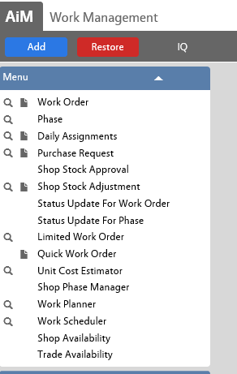
Work Management Module Links to All Tabs
Select the Work Management link from the Main WorkDesk
The links to the Work Management tabs will appear
Notes:
When logged in, you’ll be able to see the links to each tab in the Work Management module. The WorkDesk is configurable and will be built out for specific roles.

Slide 42
Work Management Module Work Order and Phase Tab
Work Order tab:
Enter a new work order/phase
Search for existing work orders/phases
Notes:
Found in the Work Management Module, the Work Order Screen is the primary screen for tracking work in AiM. It defines how work is classified, who requested the work, where the work is to be performed, by whom, the amount of time to accomplish the job, and the amount of money the job required.

Slide 43
Work Order Data Standards Must Have Information
Initial ENTRY
Upon Completion
Request Description
Organization, Requestor
Region, Facility, Property
Work Type
Work Category
Status
Problem Code (if applicable)
Equipment Impacted
Failure Cause Code (if applicable)
Action Taken
Status
Notes:
Filling out the work order with as much information is critical for assigning of work as well as reporting. The fields listed above follow specific data standards and hierarchical relationships.

Slide 44
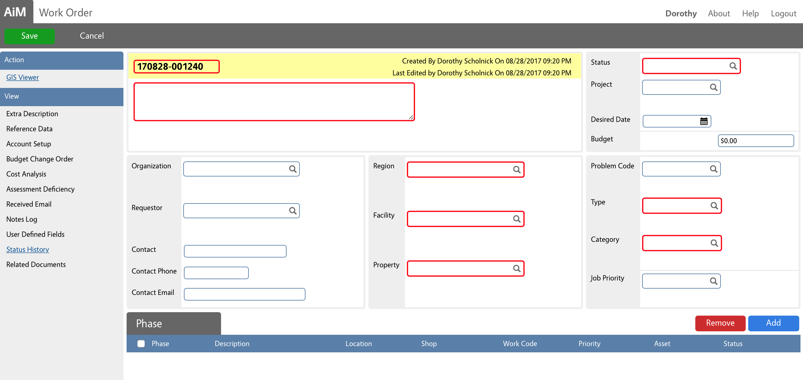
Enter a New Work Order Work Order Tab
Navigate to the Work Management Module
Click the link to the Work Order tab
Click New
The new work order form will appear
Notes:
The work order number will automatically populate.
Note that the red highlighted cells are required fields.
Required fields include:
Request Description
Organization
Requestor
Region
Facility
Property
Status
Work Type
Work Category
Problem Code (if applicable)

Slide 45
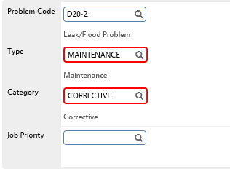
Enter a New Work Order In Response to a Problem or Inspection
If the work is requested in response to a problem or inspection:
Select the magnifying glass next to the Problem Code field to open the list of Problem Codes.
Use the Previous and Next options at the bottom of the page to scroll through additional pages of the list.
The Work Type and Category will be populated based on the Problem Code entered.
The Description will be populated based on the Problem Code entered. The Description can be edited to include additional details if necessary.
Uniformat Level II | Description
A10 | Foundations
B20 | Exterior Enclosures
B30 | Roofing
C10 | Interior Construction
C20 | Stairs
C30 | Interior Finishes
D10 | Conveying
D20 | Plumbing
D30 | HVAC
D40 | Fire Protection
D50 | Electrical
E10 | Equipment
E20 | Furnishings
F20 | Selective Building Demolitions
G10 | Site Preparation
G20 | Site Improvements
G30 | Site Mechanical Utilities
Notes:
The list of Problem Codes cover the following areas:

Slide 46
Enter A New Work Order No Applicable Problem Code
If the work is not requested in response to a problem or inspection:
Leave the Problem Code field blank
Select the magnifying glass next to the Category field and choose the correct Maintenance Category from the list. The Type field will automatically default to Maintenance
Fill in the Description with the appropriate description of work
Notes:
Corrective Maintenance (CM): Maintenance activities performed because of equipment or system failure. Activities are directed toward the restoration of an item to a specified level of performance. Corrective maintenance is also referred to as demand maintenance, reactive maintenance, breakdown maintenance, etc.
Predictive Maintenance (PdM): Predictive maintenance (PdM) is maintenance performed when empirical data that is collected and reviewed indicate that maintenance is required. Predictive Testing & Inspection (PT&I) is another term often used interchangeably to more clearly describe PdM processes. PT&I includes non-destructive and non-intrusive methods of investigation and analysis.
Preventive Maintenance (PM): Preventive Maintenance includes planned actions undertaken to retain an item at a specified level of performance by providing repetitive scheduled tasks that prolong system operation and useful life: inspection, cleaning, lubrication, and part replacement.
Proactive Maintenance (PrM): Proactive maintenance is the sum of all maintenance work that is completed to avoid failures.

Slide 47
Enter a New Work Order Requestor Information
If the Net ID of the requestor is known:
Enter the Net ID of the requestor in the Requestor field
Click on the magnifying glass
The requestors contact information will be populated based on the Net ID entered.
Notes:
If the Net ID of the requestor is not known:
Click the magnifying glass next to the Organization field
Select the Institution, Department, and Organization of the Requestor

Slide 48
Enter a New Work Order Location Information
If the property number is known:
Enter the property number in the box.
Click on the magnifying glass
The Region and Facility will be populated based on the Property number entered.
Notes:
If the property number is not known:
The Search function can also be used when the property number is not known. Search for the property name in the Description box after selecting the Region and Facility.

Slide 49
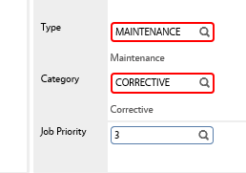
Enter a New Work Order Job Priority
Enter the priority assigned to the work
Click on the magnifying glass
Notes:
If the property number is not known:
The Search function can also be used when the property number is not known. Search for the property name in the Description box after selecting the Region and Facility.

Slide 50
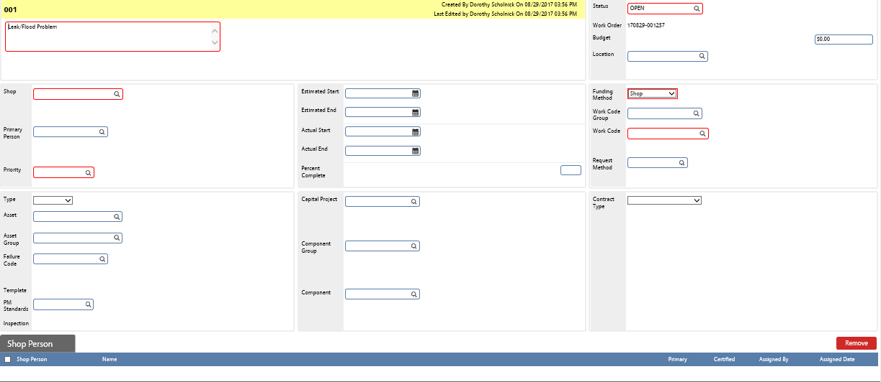
Enter A New Work Order Phase Information
To enter the work order phase details:
Click on the phase number (001) towards the bottom of the work order
Notes:
The phase tracks the task(s) that comprise the work order. The work order must support at least one phase, but more than one is a common practice.
The user defines the specific task details including the work required, the location of the work, who will perform the work, which asset or equipment is worked on, and when to perform the work.

Slide 51
Work Order Phase Data Standards Must Have Information
Initial ENTRY
Upon Completion
Phase Description
Shop
Location
Phase Priority
Funding Method
Work Code
Status
Equipment Impacted
Failure Cause Code (if applicable)
Action Taken
Status
Notes:
Filling out the work order phase screen with as much information is critical for assigning of work as well as reporting. The fields listed above follow specific data standards and hierarchical relationships.
The phase will be linked to the parent work order, therefore the Description will be populated based on the work order Problem Code. The Location options will be limited by the Property value selected from the parent work order.

Slide 52
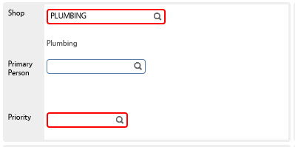
Enter A New Work Order Phase Shop
If the name of the shop for the phase is known:
Enter the name of the shop that will be responsible for the request/problem in the Shop field and then click on the magnifying glass.
Notes:
If the name of the shop for the phase is not known:
Click on the magnifying glass next to the Shop field and select the shop from the available list.

Slide 53
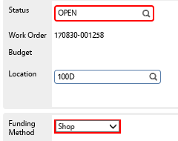
Enter A New Work Order Phase Work Location
If the location (room number) for the phase work is known:
Enter the location into the Location field and select the magnifying glass.
c
Notes:
If the location (room number) for the phase work is not known:
Browse through the list of locations by clicking on the magnifying glass next to location.
The Search function can also be used when the location number is not known. Search for the location in the Description box.
The list of options will appear based on the Property selected within the work order.

Slide 54
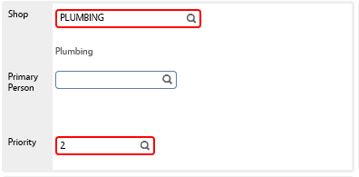
Enter A New Work Order Phase Priority
If the priority of the phase is known:
Enter the priority of the Phase (1-5) in the Priority field.
Priority Code | Priority Name | Response Time
1 | Emergency | Immediately
2 | Urgent | 24 Hours
3 | Moderate | 72 Hours
4 | Routine | 1 Week
5 | Scheduled | Varies
Notes:
Click on the magnifying glass next to the Priority field to view descriptions of each priority rating and select the corresponding rating.
For more information on priority codes, refer to the data standards section.

Slide 55
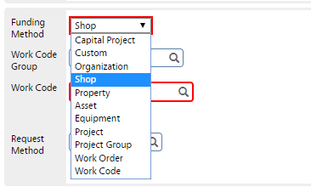
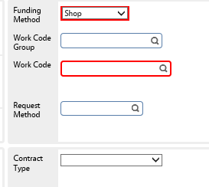
Enter A New Work Order Phase Funding Method
The Funding Method field will default to Shop.
If another method of funding is required, click on the drop down menu and select the appropriate funding method.
Notes:
All maintenance work will use the Funding Method of Shop.
Improvement work will use Organization as the funding method.

Slide 56
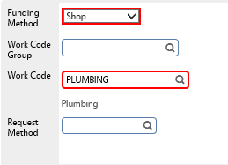
Enter A New Work Order Phase Work Code
If the work code for the phase work is known:
Enter the code relative to the request/problem in the Work Code field and select the magnifying glass.
Notes:
If the work code for the phase work is not known:
Click the magnifying glass next to the Work Code field.
Select the code relative to the request/problem from the provided list.

Slide 57
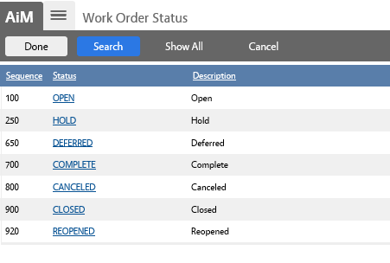
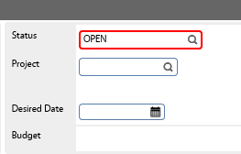
Enter a New Work Order Work Order Status
Once you have selected Edit, and the work order is open, update the status as needed
The fields cannot be edited once the work order is flagged as Canceled, or Closed
Notes:
The work order will default to Open.
Technicians will be able to see work orders with a status of Open, Hold, Reopened.
Supervisors will be able to update work orders to the status of Open, Hold, Deferred, Complete, or Canceled.
Work Order Control will be able to update work order phases to Closed or Reopened.

Slide 58
Enter a New Work Order Phase Status
If the work is requested in response to a problem or inspection:
A Phase will automatically be created based on the Problem Code entered.
If the work is not requested in response to a problem or inspection:
Leave the Problem Code field blank
Add a phase to the work order by selecting the blue Add button on the bottom of the work order screen
Notes:
Phase numbers are automatically generated in consecutive order beginning with “001” for each work order. The Phase Status will automatically be set to Open.

Slide 59
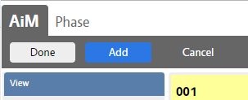
Enter A New Work Order Add Additional Phase
If this is the only phase needed for this work order:
Click the Done button.
If additional phases needed for this work order:
Click on the Add button and repeat the process of inputting the Phase information for all necessary phases. Once all phases have been entered, click on the Done button in the upper left corner.
Notes:
Multiple phases may result from the following scenarios:
An initial task was completed and additional work is needed to fix the original problem
The work is broken into phases based on resource and scheduling limitations
Blanket work orders or reoccurring inspections
Examples:
Rework- A work order is entered for a smoke detector problem. A technician inspects the smoke detector and replaces the batteries. The initial phase is complete. A few hours later, a customer calls to report additional issues with the same smoke detector. In this scenario, an additional phase on the original work order will be issued, rather than a new work order.
Resourcing- A work order is entered for a problem with a shower flow and control. A technician inspects the shower and fixes the plumbing. A new phase is entered for the IT (use another not IT) department to inspect the shower control connection.
Blanket Work Order- A work order is created to capture shop stock for each department. One phase is created for each shop.

Slide 60
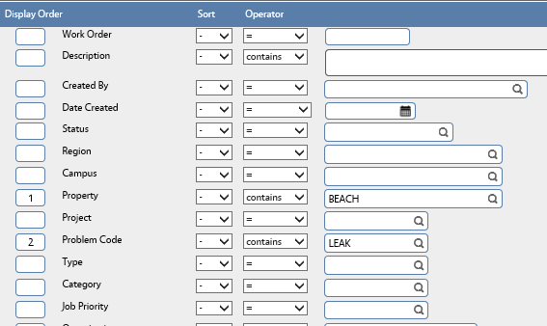
Update A Work Order/Phase Work Order and Phase Searching Function
Select Search within the Work Order or Phase tab
The Search function allows you to narrow the search for work orders or phases by field contents (such as work order number, property, work category or priority)
Notes:
To use the Search function, go through the options and enter a number under Display Order for any fields you would like to search by (displayed as columns left to right).
Choose the options from the Sort and Operator drop down lists and enter the descriptor in the input field.
Select Execute
Based on the Search options selected, the work orders will appear as a list, sorted by the display columns selected

Slide 61
Try it Out! Work Order/Phase Search
Under the Phase tab, search for a work order phase with the following characteristics:
Located on Storrs Campus
Priority 2
Plumbing shop
Notes:
An Advanced Search (can configure to always see) adds the ability to complete a search by additional fields such as Phase Costs, Property Zones, Unit Costs, and Work Order Dependencies

Slide 62
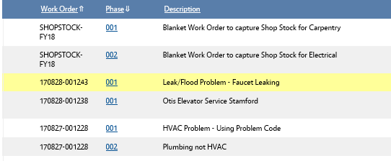
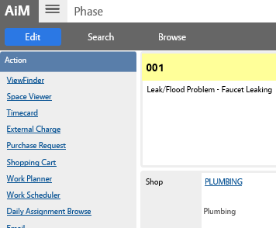
Update A Work Order/Phase Editing Work Order/Phase
Once the appropriate work order phase is found, to edit the entry, select the Phase number
Select Edit
The fields cannot be edited once the Phase is flagged as Canceled, or Closed
Notes:
To note additional work required for work relating to a closed or canceled phase, enter an additional phase under the parent work order.

Slide 63
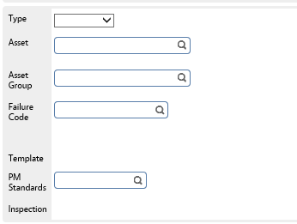
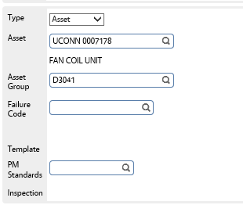
Update A Work Order/Phase Linking to Equipment
Once you have selected Edit, and the Phase is open, link the work order to any impacted equipment
From the drop down list in the Type field, select Asset or Equipment depending on the type
If the asset name is known:
Enter the asset name in the Asset field and click on the magnifying glass
The Asset Group field will automatically populate based on the asset selected
Notes:
For Uconn, the asset name will match the bar code.
If the asset name is not known:
Click on the magnifying glass next to the Asset field
Select the asset from the provided list using the Previous and Next buttons to scroll through the pages
The Search function can also be used to search for the appropriate asset
Enter a description of the asset in the Description field and select Execute
The Region, Campus, and Property will automatically populate to limit the search to the location of the linked phase
The Asset Group will automatically populate based on the asset selected

Slide 64
Update A Work Order/Phase Selecting Failure Code
Once you have selected Edit, and the Phase is open, enter the corresponding Failure Code if applicable
Click the magnifying glass next to the Failure Code field
Select the code from the provided list
* Note that Failure codes have not been populated as of the time of this training, but that the Uconn team is working on finalizing this function.
Notes:
A sample list of Failure Codes is provided below: (ADD HERE WHEN READY)

Slide 65
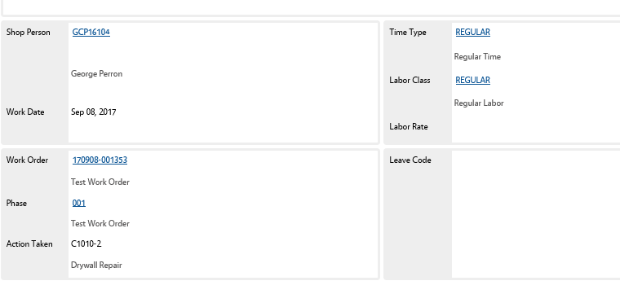
Update A Work Order/Phase Selecting Repair Code
Once you have selected Edit, and the Phase is open, enter the corresponding Action Taken Code if applicable
The Action Taken code goes onto the Technician’s timecard.
Notes:
The Repair Codes are important for documenting the specific actions taken to complete the work. For more information on the Action Taken codes, refer to the standards section.

Slide 66
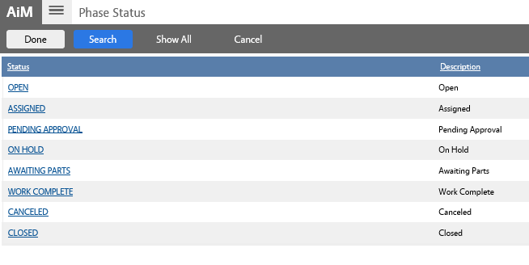
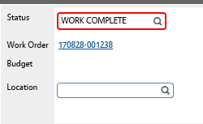
Update A Work Order/Phase Editing Status
Once you have selected Edit, and the Phase is open, update the phase status as needed
The fields cannot be edited once the Phase is flagged as Canceled, or Closed
Notes:
To note additional work required for work relating to a closed or canceled phase, enter an additional phase under the parent work order.
Technicians will be able to see work order phases with a status of Open, Assigned, Awaiting Parts, On Hold. Technicians will be able to update work order phases to the status of Awaiting Parts, or Work Complete.
Supervisors will be able to update work order phases to the status of Open, Assigned, Awaiting Parts, Pending Approval, On Hold, Canceled, or Work Complete.
Work Order Control Operations will be able to update work order phases to Closed.

Slide 67
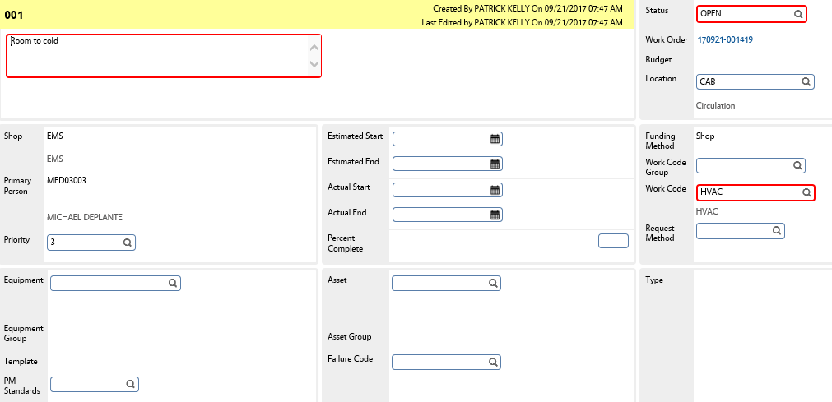
Work Management Module Limited Work Order
Limited Work Order:
Enables users to make changes related to tracking the phase work without editing access to the work order header
Notes:
The Limited Work Order Screen is a view of an existing work order that provides limited edit ability. The Limited Work Order Screen is for users such as shop supervisors, maintenance technicians, etc. It enables them to make changes related to tracking the phase work without editing access to the work order header.
The phase allows edits to phase description, estimated start and end dates, work code group, work code, priority, assets/equipment, PM basic and request method.

Slide 68
Work Management Module Quick Work Order
Quick Work Order:
Enter a new work order with the work order and phase information on the same screen
Notes:
The Quick Work Order Screen performs much of the same functionality as the Work Order and Phase Screens but with both on the same screen. There are significantly fewer views available on this screen than are found on the standard work order or phase. It is designed to reduce the amount of time required to create work orders and phases by placing both on the same screen.

Slide 69
Work Management Module Daily Assignments
Daily Assignments:
Assign work to shop personnel
Search for assigned work
Notes:
Daily assignments are one of two primary means of pushing Work Order Phases to technicians. Daily assignments are specific to a singular day, while the Queue retains the Work Order Phases indefinitely (until the assignment is removed or the phase status is changed to a non-active status).
Daily assignments can be printed out, downloaded to a mobile unit, or published on a WorkDesk channel. Timecards for assigned work can also be quickly entered clicking the Timecard hyperlink.

Slide 70
Work Management Module Daily Assignments
For adding to an existing record:
From the Daily Assignments screen, Search (for editing or adding to an existing daily assignments record).
Choose your search criteria (recommend searching by technician name). Choose Execute to perform the search.
The search results will be shown in the next screen. Select the day that you wish to add Work Order Phases to.
Notes:
If the work date is in the past, the screen will not have an option to edit (only “New”, “Search”, and “Browse” will be available). If the date is today or in the future, you will be able to edit and remove Phases from the shop person’s assignment.
To remove Phases from a shop person’s assignment, simply click the check box next to the phase and then select the red “remove” button on the right hand side of the page. This action will not affect the Phase information or the parent work order.

Slide 71
Work Management Module Daily Assignments
Choose the Load Previous Assignment option in order to transfer over any active Work Order Phases from previous Daily Assignments.
To choose Work Order Phases, select Load Work Orders. This will take you to the search screen.
Execute the search with your desired criteria and then select the Work Order Phases that you would like to add by checking the associated check boxes
Click Done when complete.
Notes:
The Load Previous Assignments hyperlink will retrieve previous assignments for the specified employee enabling modifications to prior assignments.
All work orders/phases can be selected by checking the Select All checkbox. The work order/phase selection for assignment to a shop person's daily assignment record does not remove it from the candidate list or prevent other shop people from being assigned on their daily assignment sheet.
Once you have populated the Daily Assignments, click Save in the top left hand corner.

Slide 72
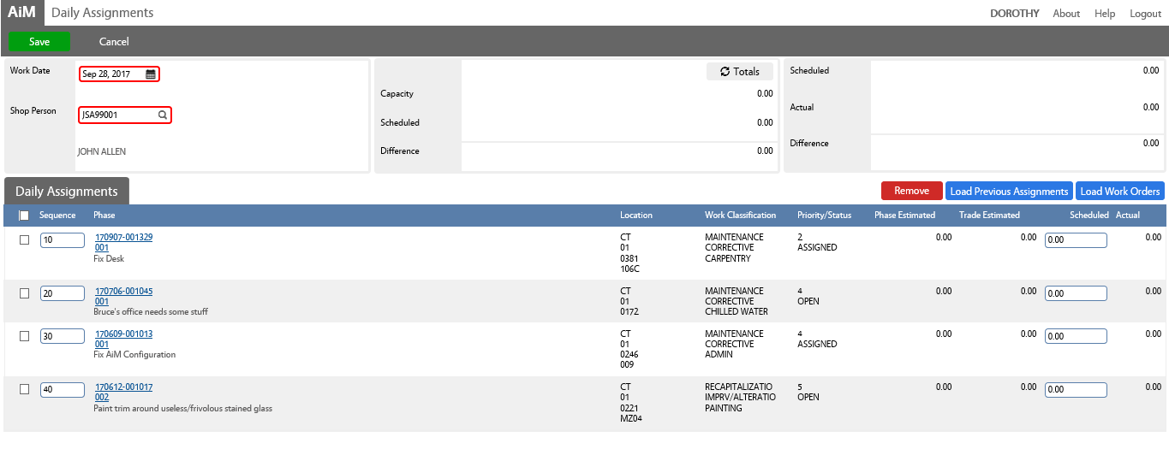
Work Management Module Daily Assignments
For creating a new daily assignment:
From the Daily Assignments screen, select New at the top of the page.
Choose a work date and a shop person.
Add previous assignments and Work Order Phases and click Save.
Notes:
Work priorities are established and managed by sequencing the work order/phases for each employee selected for assignment.
The Scheduled Hours field displays the shop person’s capacity, the number of hours scheduled for this day and a computed difference between the two. The capacity field in this block refers to a shop person’s trade capacity (hours per day available to perform specific skills, or trades) and is set up on the Employee Profile Screen, Trade Capacity View.
The Daily Assignment Screen enables users to pre-populate the Rapid Timecard Entry Screen with the shop person’s scheduled hours.
Rather than filling in the specific search criteria for an employee every time, a supervisor can also load the employee and work date into a stored query to complete the search criteria.

Slide 73
Purchase of Materials and/or Services

Slide 74
Ways to Purchase Materials and/or Services
Service Contract: To request service from an existing Service Maintenance Agreement or Blanket Purchase Order
Central Warehouse: If Central Warehouse generally stocks this item continue to use this process
HuskyBuy: When materials are needed from a vendor that participates in HuskyBuy
Non-HuskyBuy: When materials and/or service are needed from a vendor that does not participate in HuskyBuy
We will go through the steps involved in each process and when to choose each process
Notes:
There are many different ways to purchase materials for a job. The options are presented in the order that they should be followed.
Identify if work requires outside service
Look to see if the materials are in the shop
Consider if the materials are being stored at Central Warehouse
Consider if the materials can be purchased at Central Warehouse
Order from a UConn Catalogue (HuskyBuy)
Get a quote for non-catalogue items
Use a ProCard
Go to Mansfield Supply

Slide 75
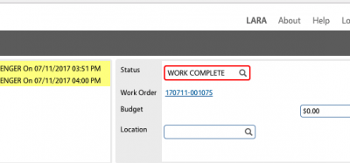
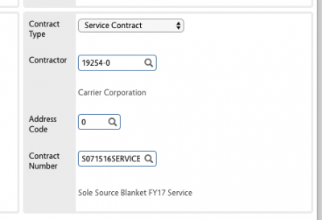
Service Contract
In the lower right section of the Work Order Phase screen, select Service Contract from the Contract Type dropdown. Then enter the Vendor Id (e.g. 11377-0) or search for the contractor. The address code is always Zero.
Verify the correct contract number populates or update to the correct contract number
Enter the estimated invoice amount in the Budget field.
When the contractor has completed the work, the Supervising FOBS employee sets the work order phase to Work Complete in order for the associated costs of the work to be applied.
Remind the contractor that the work order and phase must be included on the invoice for the service
Notes:
When to Go Through This Process: The need to use outside service to complete the work will need to be approved by a Supervisor. Once it has been decided to use a contractor to perform work, the contract needs to be associated with the phase of a work order.
Note: If there is only one active contract associated with the selected contractor this will auto-populate, otherwise type or select the contract number

Slide 76
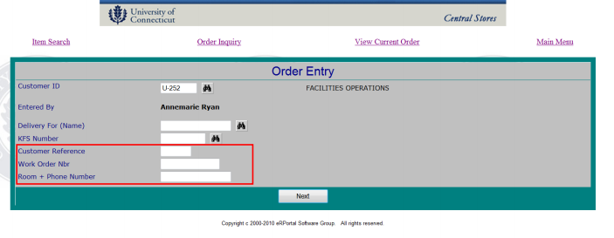
Purchase Material from Central Warehouse
Give AiM Work Order and Phase number to attendant at Central Warehouse when ordering in person, or
Provide the Work Order and Phase for every Purchase in eRPortal using workOrder || phase (e.g. 171003-001489||001)
Notes:
When to Go Through This Process: Central Warehouse has a supply of this item

Slide 77
Purchasing Through HuskyBuy
With the Work Order and Phase numbers in hand, follow the standard procedure for making a HuskyBuy purchase.
KFS now has new fields for AiM Work Order and Aim Phase. Please complete these fields
Notes:
When to Go Through This Process: A HuskyBuy purchase request is created whenever materials or service are required to support work and are not located in shop stock or Central Warehouse stock, and the vendor participates in HuskyBuy. As a result it is necessary to navigate to the particular work order and phase to which the work applies.
Initial steps for submitting a HuskyBuy purchase:
Open Webpage HuskyBuy (http://purchasing.uconn.edu/huskybuy/)
Click Login
JobAid access by Shop: JOBAID

Slide 78
Purchase Request Non-HuskyBuy Requests
Obtain a quote from vendor (done in advance)
Within the Work Order Phase Select Purchase Request
Notes:
The Purchase Request Screen requests materials or services for a specific work order/phase. The use of this function is to purchase from a Non-HuskyBuy vendor

Slide 79
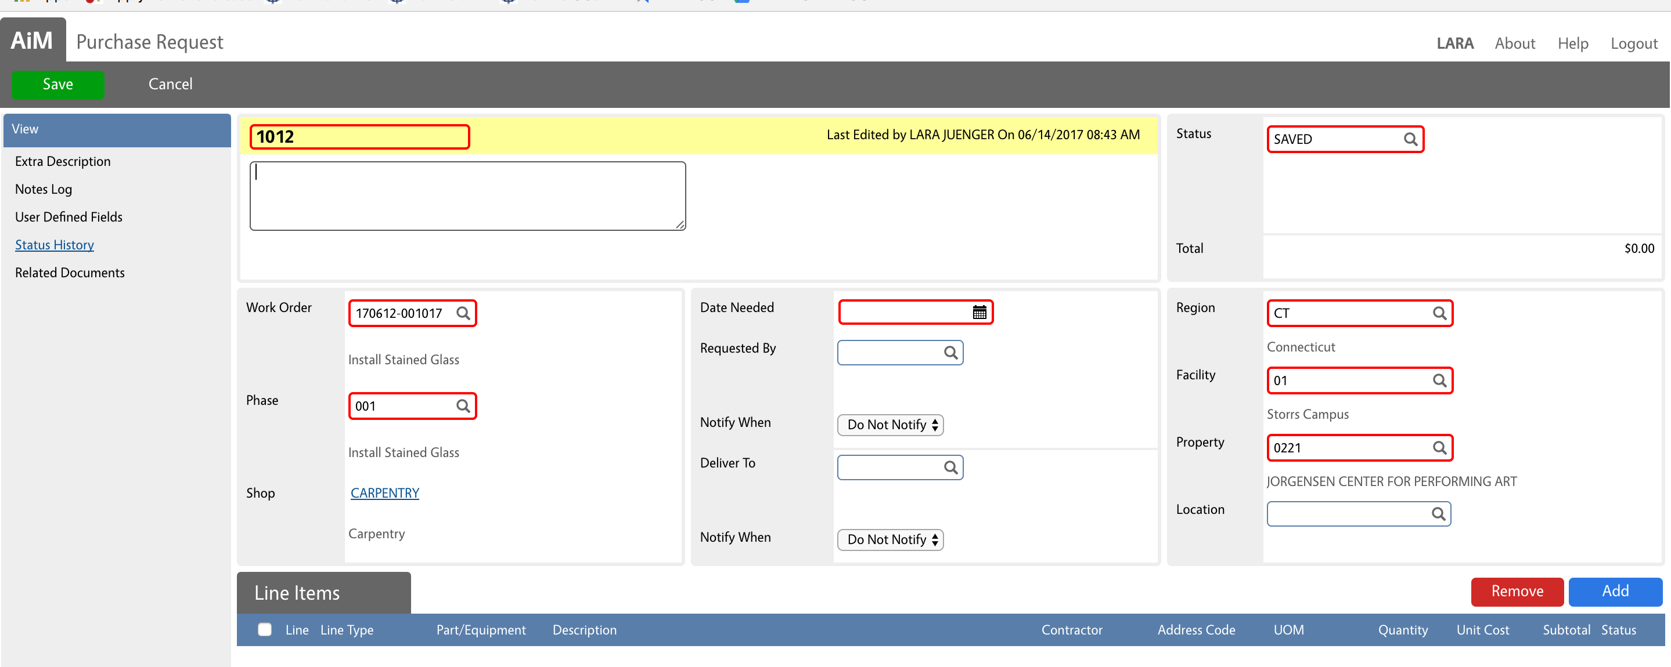
Purchase Request Non-HuskyBuy Requests
In the Purchase Request Screen:
Enter Description, Date Needed (choose following day as default)
Some of the information will be pre-filled based on the linked work order (Work Order, Phase, Location, Status = Saved)

Slide 80
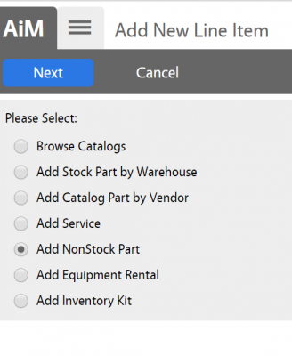
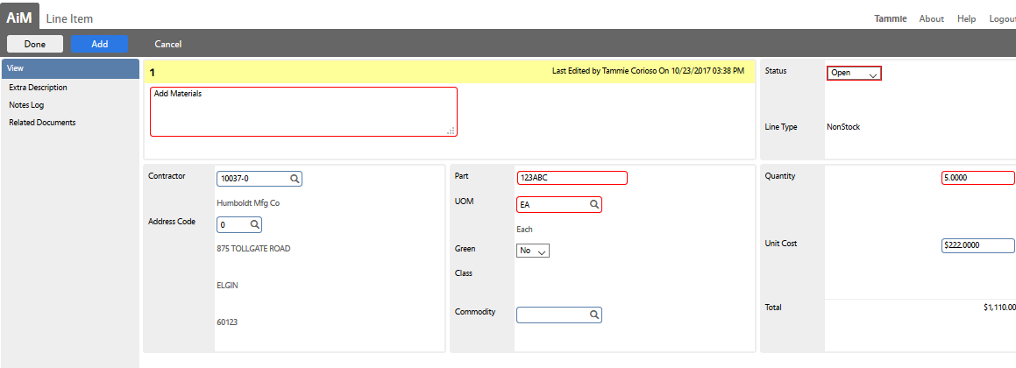
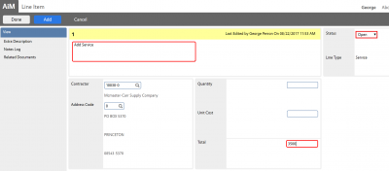
Purchase Request Non-HuskyBuy Requests
To add a line for material to the Purchase Request, select Add New Line Item, Add NonStock Part
Notes:
Enter the information for new parts including:
Description
Contractor
Part Number
Unit of Measure (UOM)
Quantity
Unit Cost
Click ADD if additional lines
Click DONE if all lines have been added
Enter the information for any new service including:
Vendor
Total
Click ADD if additional lines
Click DONE if all lines have been added
When ready for approval, change the status to Open, and Save the entry

Slide 81
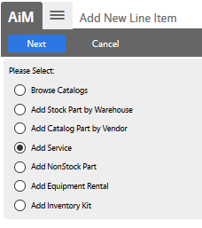
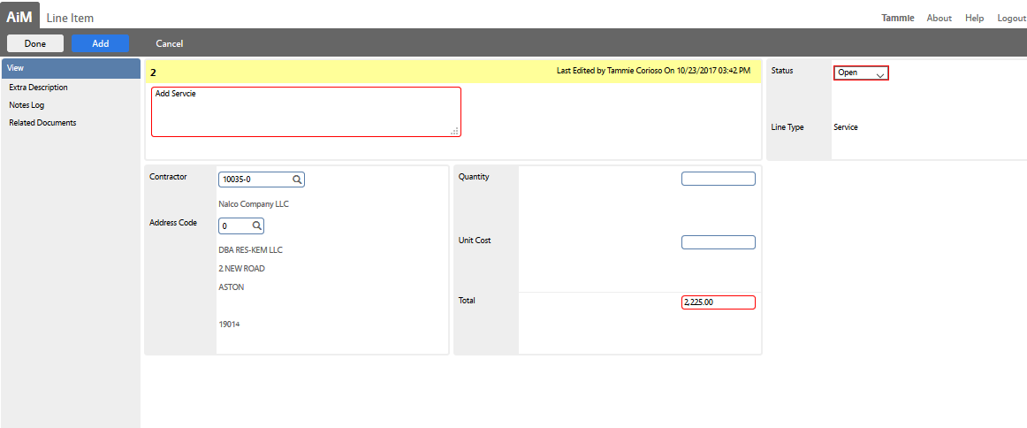
Purchase Request Non-HuskyBuy Requests
To add a line for service, select Add New Line Item, Add Service
Choose the contractor, enter the Total
Notes:
Enter the information for new parts including:
Description
Contractor
Part Number
Unit of Measure (UOM)
Quantity
Unit Cost
Click ADD if additional lines
Click DONE if all lines have been added
Enter the information for any new service including:
Vendor
Total
Click ADD if additional lines
Click DONE if all lines have been added
When ready for approval, change the status to Open, and Save the entry

Slide 82
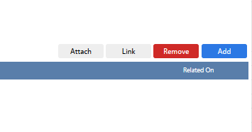
Purchase Request Attach Quote
Select Related Documents
Select Edit
Select Add
Notes:
Note: For each purchase request a quote must be attached (for service, material, or service and material)
To attach a quote:
Select Related Documents
Select Add
Select Choose Files
Select the file
Click Next
Select the document type (use General)
Select Next
Add Roles for access: Supervisor, Finance, choose Read Only

Slide 83
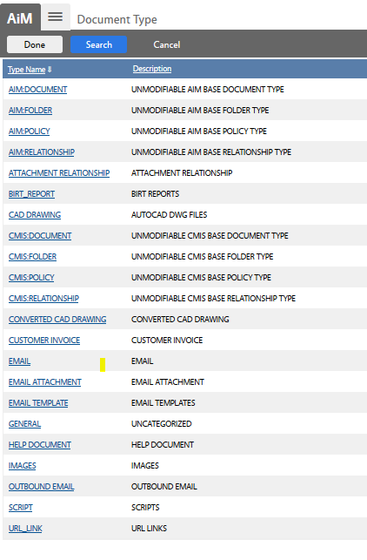
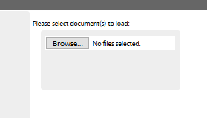
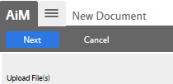
Purchase Request Attach Quote
Select Browse
Select the file
Click Next
Select the document type (use General)
Notes:
Note: For each purchase request a quote must be attached (for service, material, or service and material)
To attach a quote:
Select Related Documents
Select Add
Select Choose Files
Select the file
Click Next
Select the document type (use General)
Select Next
Add Roles for access: Supervisor, Finance, choose Read Only

Slide 84
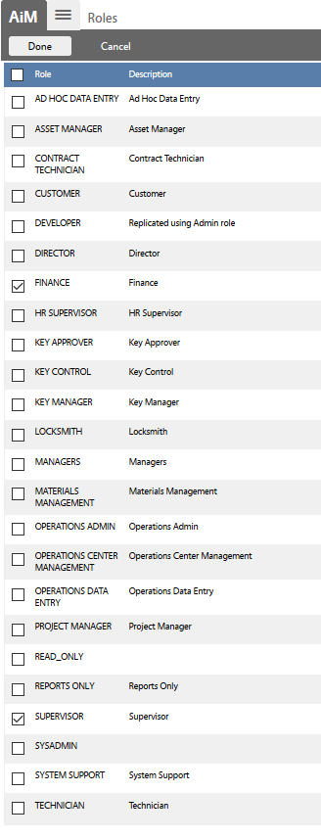
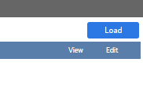
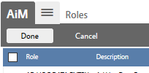
Purchase Request Attach Quote
Select Next
Select Load
Add Roles for access: Supervisor, Finance
Select Done
Notes:
Note: For each purchase request a quote must be attached (for service, material, or service and material)
To attach a quote:
Select Related Documents
Select Add
Select Choose Files
Select the file
Click Next
Select the document type (use General)
Select Next
Add Roles for access: Supervisor, Finance, choose Read Only

Slide 85
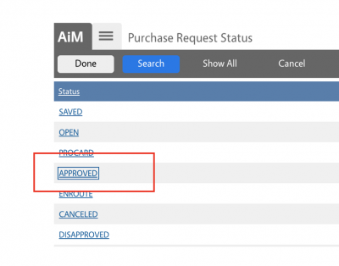
Approval of Purchase Request by Supervisor
Once the request is ready for Supervisor Approval, change the Status to Open. This will trigger the request for approval by the Shop Supervisor.
The Supervisor will review and approve the request:
Select the transaction
Click Edit
Review
Select status as Approved
Save the entry
Notes:
The supervisor sees a list of Purchase Requests and clicks on the Transaction Number associated with this shop stock purchase in their WorkDesk query.
The Supervisor chooses from the available Purchase Request Statuses (Approved)
This step needs to be tied to an action taken code that triggers the creation of the requisition in KFS.

Slide 86
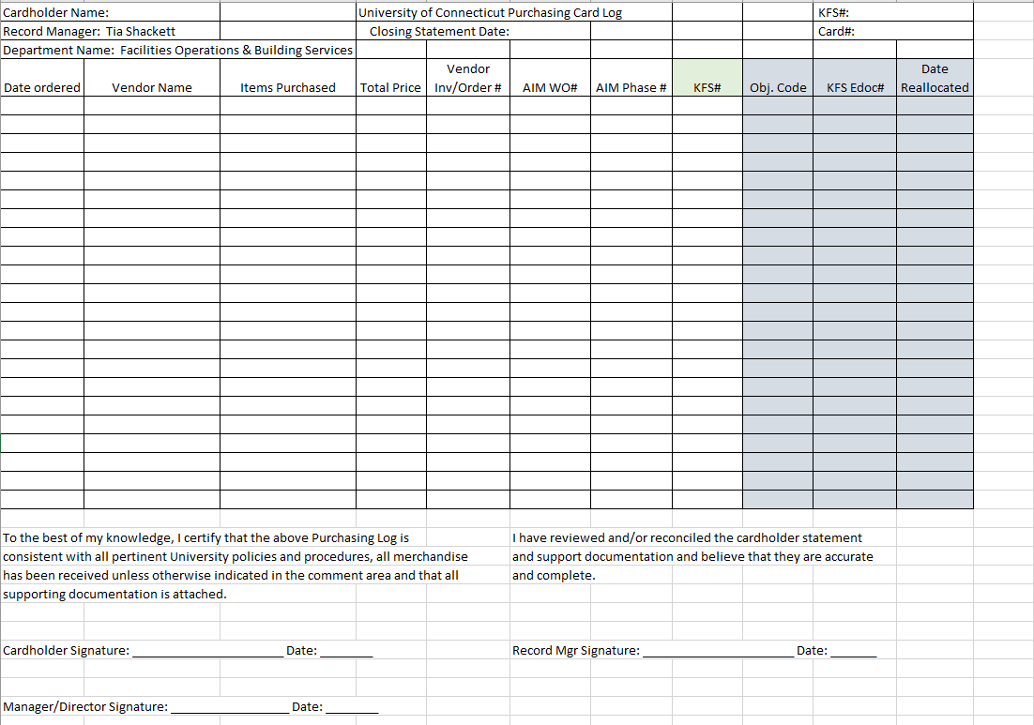
Purchasing Job Materials Other Processes - ProCards
As a last resort, a ProCard can be used for purchasing materials
The AiM Work Order and Phase Number must be entered on the ProCard Reallocation form

Slide 87
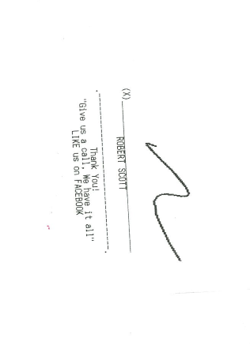
Purchasing Job Materials Other Processes – Mansfield Supply
If no other processes can be applied, including the use of a ProCard, purchase the supplies at Mansfield Supply
Write the Work Order and Phase number on the receipt underneath your signature:
Notes:
Refer to the Quote SOP for details on obtaining and documenting quotes for non

Slide 88
Customer Service Module
Notes:
The Customer Service module provides links to screens for entering customer requests and approving customer requests.
The links within this module are used in the following scenarios which will be described in detail in the following sections.
When a customer makes a request for a work order via phone call or walk in, a work order must be created in the Customer Service Module and sent for approval (Work Order Control, Technicians)
The process of creating a Work Order originating from a customer by authorized staff, does not require approval (Supervisors)
A customer request approval is completed by authorized staff after a Customer Request has been entered in the system (Supervisors)

Slide 89
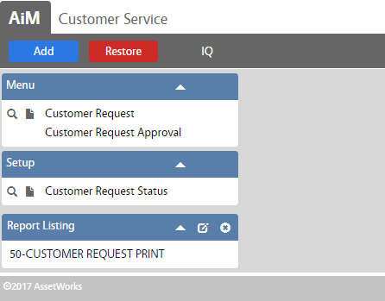
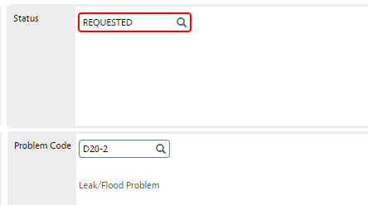
Customer Request Process Entering a Customer Request
When a customer makes a request for a work order via phone call or walk in, a work order must be created in the Customer Service Module
Navigate to the Customer Service screen and click the link to Customer Request
Click on the New button
Fill in the following information:
Organization, Requestor and Contact information
Region, Facility, Property and Location
Problem Code (if applicable)
Description
Status
When a Problem Code is selected, the status of
the request will default to “Requested”
Notes:
The process of instantaneously creating a Work Order is only for authorized staff and does not require the approval process necessary to complete a Customer Request.
For additional information on entering the fields listed above, refer to the data standards section.
When a Problem Code is selected, the status of the request will default to “Requested”
The description will also default to the Problem Code when one is selected, the description can be edited to include additional text if necessary
When all the information is entered, click the green Save button

Slide 90
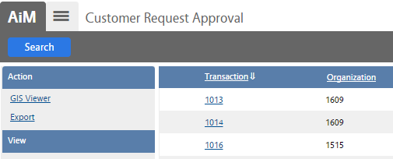
Customer Request Process Approving a Customer Request
A customer request approval is completed by authorized staff after a Customer Request has been entered in the system.
Navigate to the Customer Service Screen and click the link to the Customer Request Approval, Click on the Execute button
Select the desired Customer Request by clicking on the respective number in the Transaction column, Click on the Edit button
The Funding Method box will default to Shop.
Notes:
Supervisors will be able to view an updated list of work orders pending approval in their main WorkDesk personal query screen.
If another method of funding is required, click on the drop down menu and select the appropriate funding method.

Slide 91
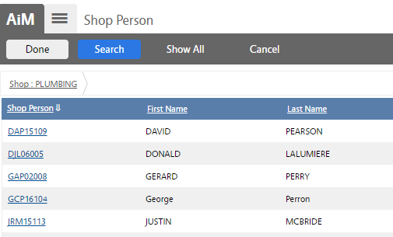
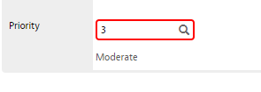
Customer Request Process Approving a Customer Request
Enter the name of the shop that will be responding to the request/problem in the Shop field and then click on magnifying glass.
Selecting the Shop will automatically bring up the option to assign a Shop Person. Select the Shop Person who will be assigned to the work order.
If no Shop Person needs to be assigned at this point, click on the Done button to exit.
Enter the priority of the Phase
Update the status to Approved
Notes:
If the name of the shop is unknown, click on the magnifying glass and select the shop from the available list.
Enter the priority of the Phase (1-5) in the phase field and click on the magnifying glass. Leaving the Phase field blank and clicking on the magnifying glass will provide a description of the options.
Update the Status field by clicking on the magnifying glass icon and click on “APPROVED” in the status column.
The system will generate a work order and the work order number will now be visible in the work order field.
The system will also generate a Phase with all needed information populated. If additional phases are needed for the completion of the work order, please refer to the “Enter a New Work Order – Phase Information” section.

Slide 92
Finance Module
Notes:
The AiM Finance module provides links to information on billing and invoicing related to maintenance tasks. The module also includes information on funding groups, work order allocation and capital project funding.
The financial processes that relate to the work management processes covered in this training include:
Account Management
Billing
Contract Administration
Purchase Order/Purchase Request
Invoicing

Slide 93
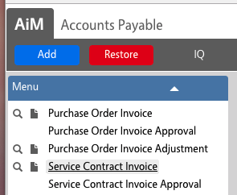
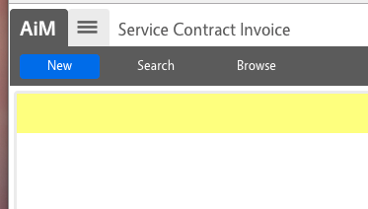
Associating Invoices For Work Completed With Service Contracts
The receiving and paying of invoices is all tracked in KFS. In order to properly associate these costs with the work performed, an integration between KFS and AiM performs the data entry steps below. It is also possible (but not advisable) to populate this information manually
Navigate to the Service Contract Invoice Screen, Click New
Notes:
The Service Contract Invoice information will be entered in KFS. Once the process is complete, the information will populate into AiM under the Service Contract Invoice screen.

Slide 94
Associating Invoices For Work Completed With Service Contracts
A completed Service Contract Invoice is shown here.
For costs to be applied the invoice needs to be set to Department-Approved status
Notes:
The Service Contract invoice includes information on the following fields:
Contractor- the contractor number linked to the Contract Administration account in the system
Contract- the contract number linked to the Contract Administration account in the system
Terms- the terms of the contract linked to the Contract Administration account in the system
Invoice Number
Invoice Date
Invoice Received Date
Line Items- details of the labor/materials covered in the contract

Slide 95
Associating Invoices For Work Completed With Service Contracts
The proper application of the costs against the work order can be confirmed by going to the work order and clicking the Cost Analysis link in the View pane
Notes:
The Cost Analysis link provides information on the costs to complete the work order in the follow categories:
Labor Hours- linked to the work order and timecard of the shop personnel involved in the work order
Labor Cost- linked to the work order and timecard of the shop personnel involved in the work order
Material Cost- linked to the work order and any approved purchases (HuskyBuy, Central Warehouse order, etc.)
Equipment Cost- linked to the work order and equipment selected
Contract Cost- linked to the work order and contracts selected

Slide 96
Fire O&M Module
Notes:
The AiMFire App will be used for access to Work Management modules in the field through the use of tablets. The App will allow technicians and Supervisors to view and modify work orders and phases, as well as view Daily Assignments.

Slide 97
Fire O&M Application Log in Screen
Log in screen
Notes:
Select the AiMFire App and logon using your UConn NetID and Password

Slide 98
Fire O&M Application Main Page
AiM Fire Main page
Notes:
After logging into application you will land on the AimFire Main page. Select Work Management in order to view your Daily Assignments as well as your work queue.

Slide 99
Fire O&M Application Daily Assignments
Technician assignment queue
Notes:
Once you have selected Work Management, you will see this page. If you have Daily Assignments, they will appear here. They are color coded based on priority, reference the table below for the color codes.
If you do not have Daily Assignments loaded, the list will be blank and you should navigate to your Queue by selecting the Queue icon at the bottom of the page.

Slide 100
Fire O&M Application Queue
Technician phase queue
Notes:
The Queue is all of the work that has been assigned to you, but not specifically scheduled for you to do today. From this page, you will select the Work Order Phase that you are going to work on.

Slide 101
Fire O&M Application Work order screen
Phase work order screen
Start the clock
Notes:
Once you have selected your Phase, you will see this screen. Once you are on site, start your labor clock by selecting the clock icon at the bottom of the screen. It is important to select the asset that you are working on whenever possible.
If the work is preventative, the asset will likely already be populated.

Slide 102
Fire O&M Application Linking to an Asset
Select an asset tag
Barcode scan
Notes:
To select the asset, touch the asset field. The AIM will display all of the assets that are located at the property which is assigned to your phase.
If there is a UCONN barcode present, you can scan that by selecting the barcode icon at the bottom of the screen. Once you see your asset, select it and Fire will return to the phase view.

Slide 103
Fire O&M Application Work Order Phase Screen
View of Phase information on the app
Notes:
The work order Phase screen will appear will the same information as the screen in the Work Management, Phase module in AiM.

Slide 104
Fire O&M Application Work Order Phase Status
Change phase status
Notes:
Technicians can change the Phase status by selecting the status field.
The options available for technicians are shown above.
Once a status is selected, Fire will return to the Phase screen.

Slide 105
Fire O&M Application Failure Code
Adding a failure code to the work order when applicable
Notes:
Select the appropriate failure code by touching the failure code field.
The options will be populated according to Asset Group. If the list does not contain the appropriate code, further information can be entered in the notes. The notes icon is located on the bottom right side of the screen.

Slide 106
Fire O&M Application Work Order Notes
Add notes to the entry
Speech to
text
Notes:
Notes can be entered by selecting the Notes Log from the Phase screen.
Notes can be typed in or technicians can use the speech to text feature by selecting the microphone to the left of the space bar.
When notes are finished, touch Save in the upper, right hand corner.

Slide 107
Fire O&M Application Closing a Labor Entry
Enter labor type
Stop the clock
Notes:
Once you are finished working on the phase, end your labor entry by touching the clock icon and choosing the labor type (Regular/Overtime) as well as choosing the action taken from the list. These options are associated with the Work Code on the Phase. If none of the action codes are representative of the work performed, choose “Other” and enter a more detailed explanation in the notes.

Slide 108
Time and Attendance
Notes:
The Time and Attendance module in AiM provides links to screens for managing and approving labor documentation. The module includes links to timecard entry, timecard approval, as well as attendance and leave tracking.
This module is linked to the work management processes covered in this training because the timecard information can be populated based on the shop person selected in work order phases.

Slide 109
Time Card Navigation in AiM
Navigate to the Time and Attendance Module
Click the Timecard link
Notes:
The Time and Attendance module in AiM provides links to screens for entering timecards and approving timecards. The timecard link enables entry of employee work hours and/or non-leave hours for a shop person on a given date.

Slide 110
Time Card Time Card Must Have Information
Enter information for the following:
Shop Person
Work Date
Total Hours
Notes:
Shop Person: The Shop Person identifies the employee identification code and name for which the timecard is being entered on a specific work date. There may only be one timecard record per employee per day.
Total Hours: This field represents a roll up of labor hours from the timecard line items associated to the timecard parent record.
Total Cost: This field represents a roll up of the total costs from the timecard line items associated to the timecard parent record.
The timecards will be populated with information for each shop person based on work orders they have completed throughout the day.

Slide 111
Time Card Time Card Status Descriptions
The Timecard Line Item Screen enters new timecards, or to edit existing timecards that have not yet been approved. Detailed timecard fields are provided for data entry including the shop person, work order, phase, time type and labor hours.
Time Card Status | Description
Not Posted | The parent timecard is still being processed and has not yet been approved. No labor charges have been placed against a phase.
Posted | The timecard transaction has been approved and posted. Labor charges are placed against a phase.
Rejected | This status indicates that the parent timecard was not allowed (approved) by the timecard approver as a valid timecard transaction. Rejected timecards do not create financial transactions. Rejected timecards can be corrected and then approved.

Slide 112
Time Card Labor Rate
The Work Order identifies the work order and phase for which the timecard line item is being entered. This phase will be charged the labor cost of the line item. The work order and phase are required when a labor rate is specified and when a labor rate is specified, a work order phase must exist.
If a leave code is populated to indicate the line item is for leave taken, then neither work order nor labor rate are required. The optional action taken may be entered to communicate what steps were taken while working on the job. Reword. Enter action taken to communicate what steps were taken
Notes:
Labor Rate: identifies the combination of time type and labor class, which determines the billing rate for this particular timecard line item. The line item requires either labor rate information or a leave code to specify leave (but not both; only one can be entered). The time type and labor class can default from the employee profile header if populated.
Line Totals: identifies total hours of work (or leave) for the line item. If the time either type or leave code specify start/stop time validation, then a start time and a stop time appear and are required. The calculated difference between the start time and stop time populate the required hours field.
Timecard Totals: identifies the sum of non-leave (work) hours and leave hours for all line items on the timecard. This is useful to identify quickly whether or not the timecard line item details total a full and complete workday. The totals are calculated when the record is saved.

Slide 113
Time Card Rapid Timecard Entry
Enters multiple timecards quickly from a template based on a combination of work date, shop person, time type, leave code, and work order/phase.
Action taken and hours fields are also included on each template line.
Whenever the Add Icon is clicked, the template combination is replicated as detail records below the gray template portion of the screen.
Notes:
The Rapid Timecard Entry Screen enters multiple timecard records quickly in a single entry screen. A simple template loader is provided to enter additional timecards based on a combination of work date, shop person, and work order/phase number.
A popular template combination is to enter a single work date and a single shop person and then add lines to the timecard to complete the 8-hours (or a full workday) for that day, for that worker. The work order/phase numbers (or leave code) on each line, are then quickly modified (or entered using the zoom feature) as necessary.

Slide 114
Time Card Timecard Approval
Approves or rejects individual timecard records.
An approved timecard record creates a financial transaction, applying a labor charge to the work order phase.
Timecards can be approved by selecting all timecards, all timecards per shop person, or individual timecards per shop person.
Notes:
Timecard details are available through the timecard transaction identification code hyperlink.
Use the Refresh Icon to reset the returned search results after eligible timecards are approved.
Users can select the Approve or Reject buttons to approve or reject line items, and the Error Log hyperlink to view an error log should a transaction fail.

Slide 115
Time Card Timecard Adjustments
Timecard Adjustment Screen corrects, updates, or otherwise modifies the line item details of an approved timecard.
Timecards, once approved, cannot be edited. The only option to correct posted quantities with an adjustment on the line item is to decrease the number of hours, which can be adjusted to zero. To add hours to a timecard, create a new timecard line item entry.
Timecard adjustments only modify posted (approved) records
Notes:
Each line item is auto populated directly from the original timecard. The only field that is available for update on the existing transaction is the Adjust Hours field. The only option available in the Adjust Hours field is to decrease hours from the existing number.
If a user wants to add hours or subtract more hours, the Add Icon must be clicked. This will create a new line item record where the work order/phase is required and added or subtracted transactions are allowed.
The totals of all line item adjustments roll up to the timecard adjustment header record in the Adjusted Cost and Total Hours fields.

Slide 116
Time Card Timecard Generator
The Timecard Generator Screen makes it possible to support the fast creation of timecards for employees who perform the same job week after week.
For instance, a custodian may clean the same building or a grounds keeper would mow the lawns weekly, etc. A standing work order for this work over a period is typically the vehicle for collecting time.
Notes:
The generator can use the Organization Block criteria, the shop or shop person criteria, both, or neither to generate for all eligible employees.
The Timecard Generator, when run, will look for the setup values in the Human Resources Module for an employee and if all the conditions are met, will automatically generate a daily timecard for that employee.
However, the system does not know if the employee’s daily routine may have changed, so there should be a review process prior to the approval process.

Slide 117
Pre-Defined Screen Queries
Notes:
Supervisors and Technicians have the ability to pull reports from pre-defined screen queries located in the main WorkDesk under Report Listing. The reports will be available based on the role of the staff, and can be configured to pull specific reports.

Slide 118
Pre-Defined Screen Queries Report Listing
Notes:
The reports from the Report Listing tab can be exported to excel or printed. Run the report by clicking on the link and choosing the parameters. The icons in the upper left side of the analysis screen allows users to print or export reports.
Additional Report Listing options are included under each separated module in AiM
Examples of the most used reports include the following depending on the employee’s role:
Work Order Aging
Work Order Completion Dashboard
Phases Open by Priority
Past Due Phase
Past Due Projects
Asset Performance
Labor Breakdown
Budget Analysis
Backlog Aging
Past Due Purchase Order

Slide 119
Pre-Defined Screen Queries Top Ten Potential Reports
Each report can be filtered based on the corresponding prompts.
For example, the Asset Performance report can be filtered by Asset Type, Order Type, Category, Shop, and Zone. The report can also be filtered for a specific timeframe of performance (i.e. three months).
Notes:
The filtering functions allow Supervisors to narrow down the queries based on the metrics and factors they use for reporting and managing work.

