Slide 1


KEY & ACCESS CONTROL
TRAINING

Slide 2
CONTENTS:
New Key or Card Access Request
  Key Request
    Create
    Approve
    Assign
  Key Ticket
    Create
    Update Status
  Key Release
  Key Return/Renewal
    Return
    Renewal
  Key Ring
  Key Ring Release
  Key Ring Return
Add Access Points
Add Cores
Add New Key
New Schedule
New Key Copy
Inactivating Key Original & Copy

Slide 3
New Key or Card Access Request
*Key Request*

Slide 4
Step 1: Create a Key Request

Slide 5
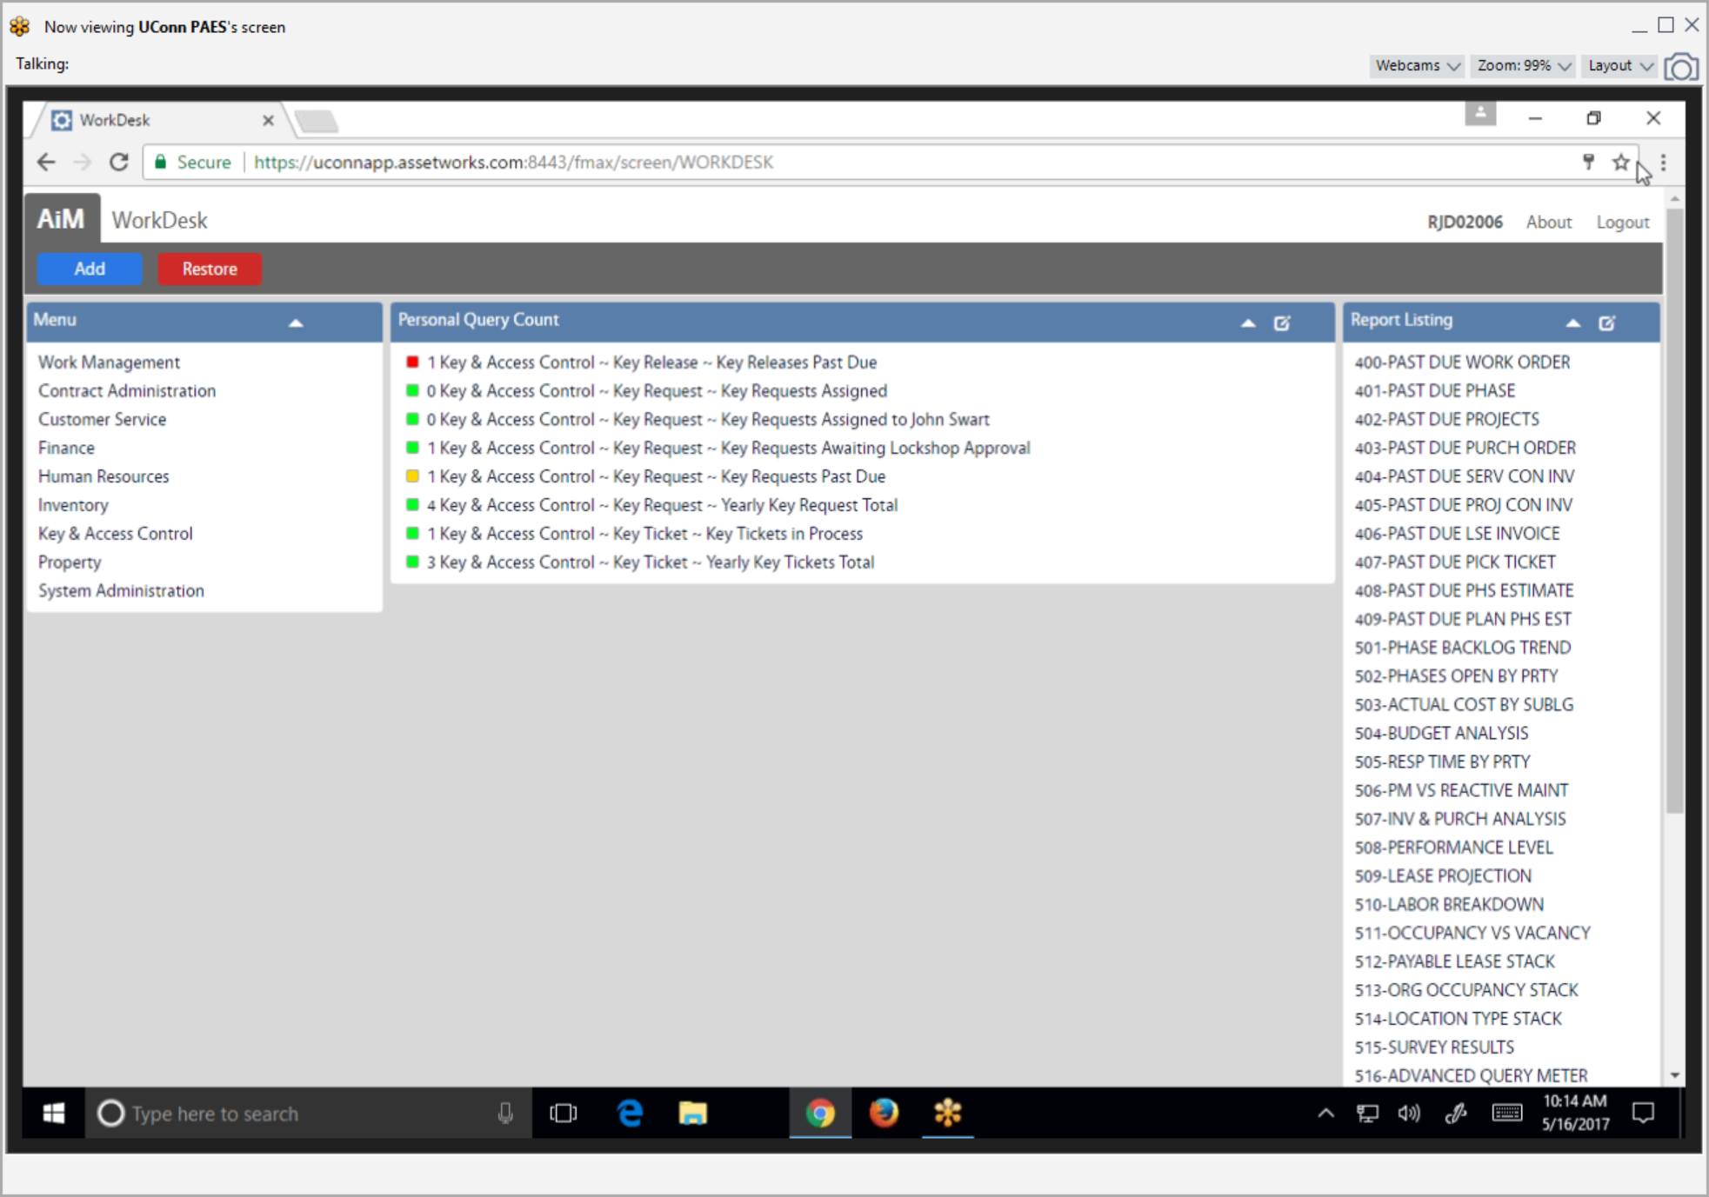
On WorkDesk click Key & Access Control module
New Key or Card Access Request – Create a Key Request
Facilities and Operations

Slide 6
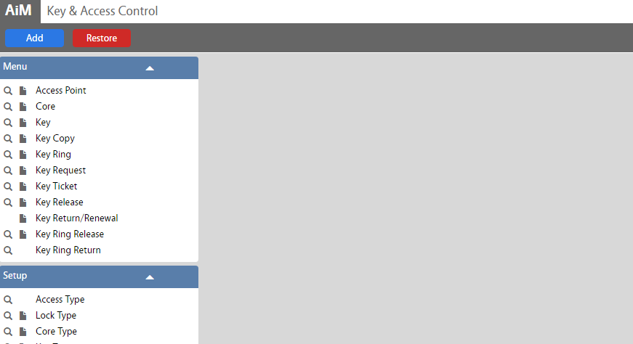
Click Key Request
New Key or Card Access Request – Create a Key Request

Slide 7
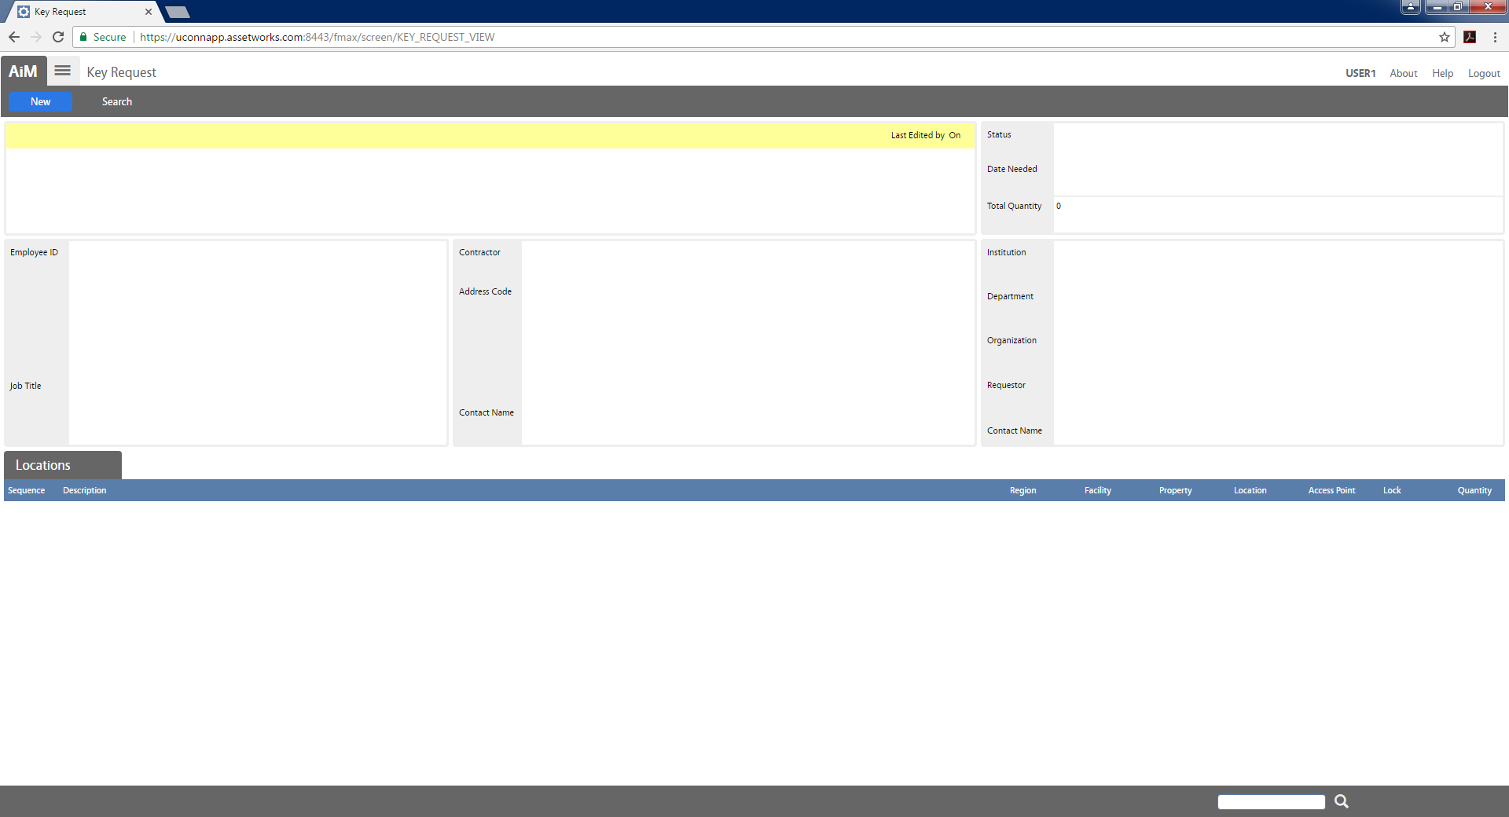
Click New
New Key or Card Access Request – Create a Key Request
Facilities and Operations

Slide 8
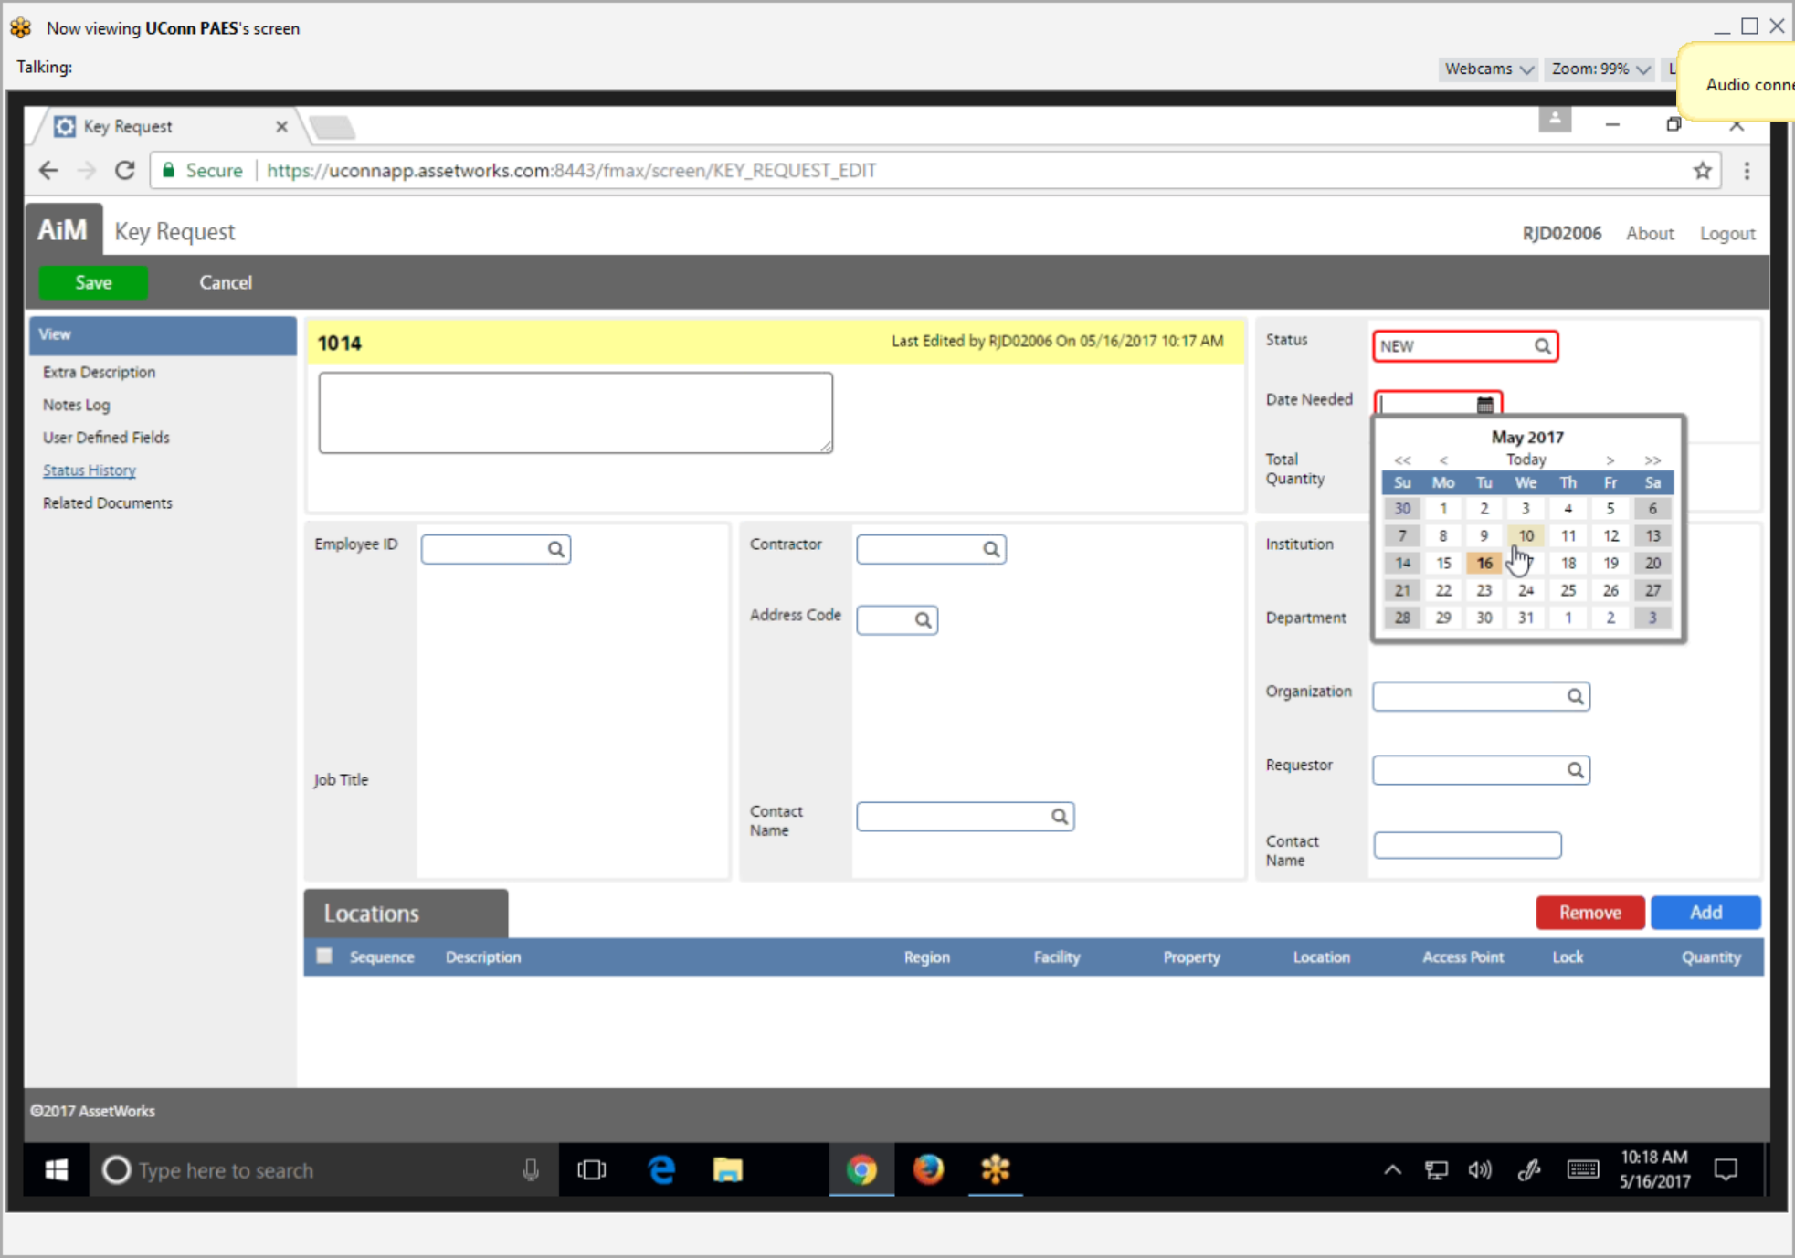
Enter Date Needed, then search Requestor
New Key or Card Access Request – Create a Key Request
Notes:
If requestor’s Net ID is known, simply enter it into the Requestor field and click the spyglass icon beside the Requestor field, this will populate the organization information.

Slide 9
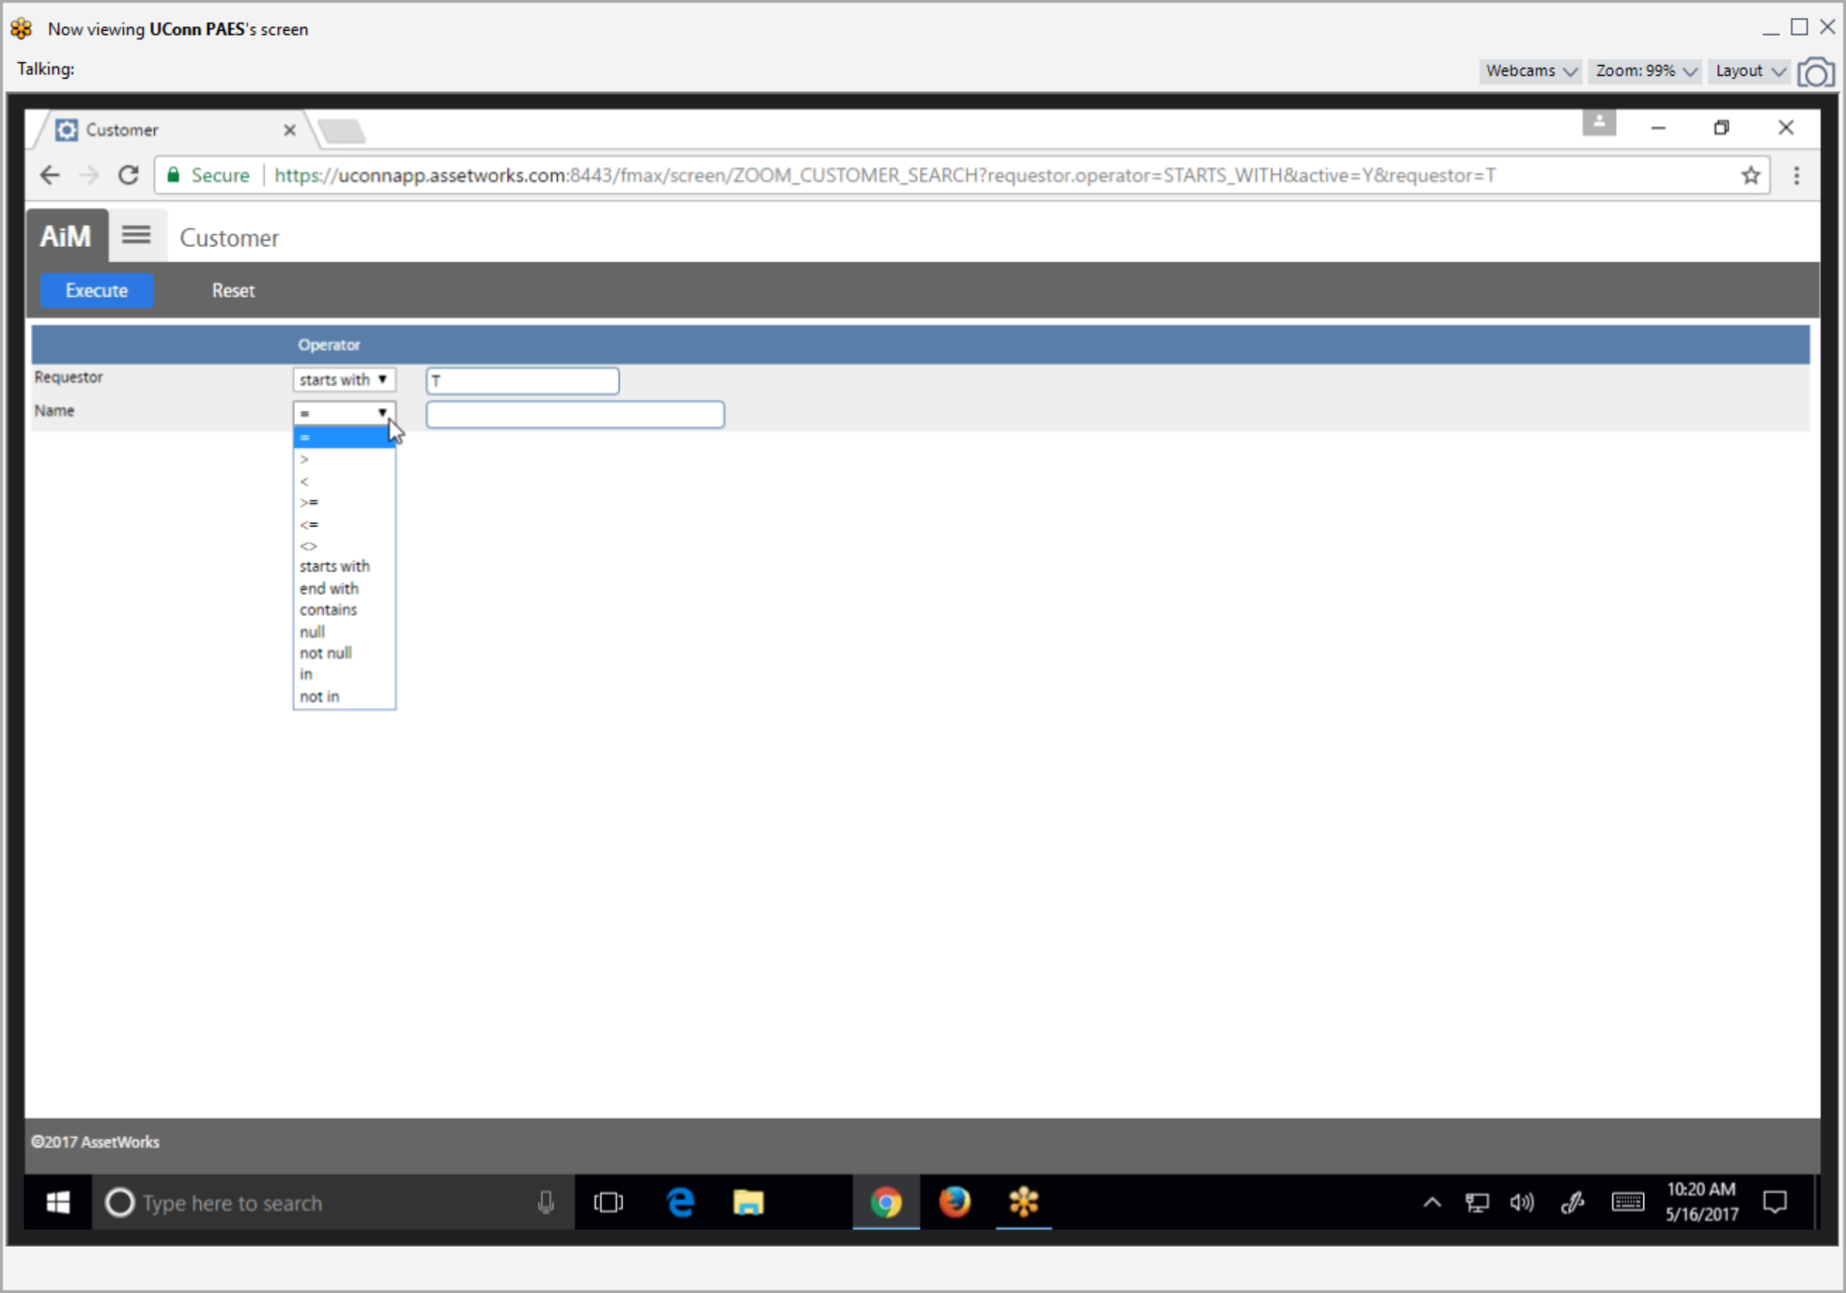
Select the appropriate search operator to search by Requestor & Name, then click Execute.
New Key or Card Access Request – Create a Key Request

Slide 10
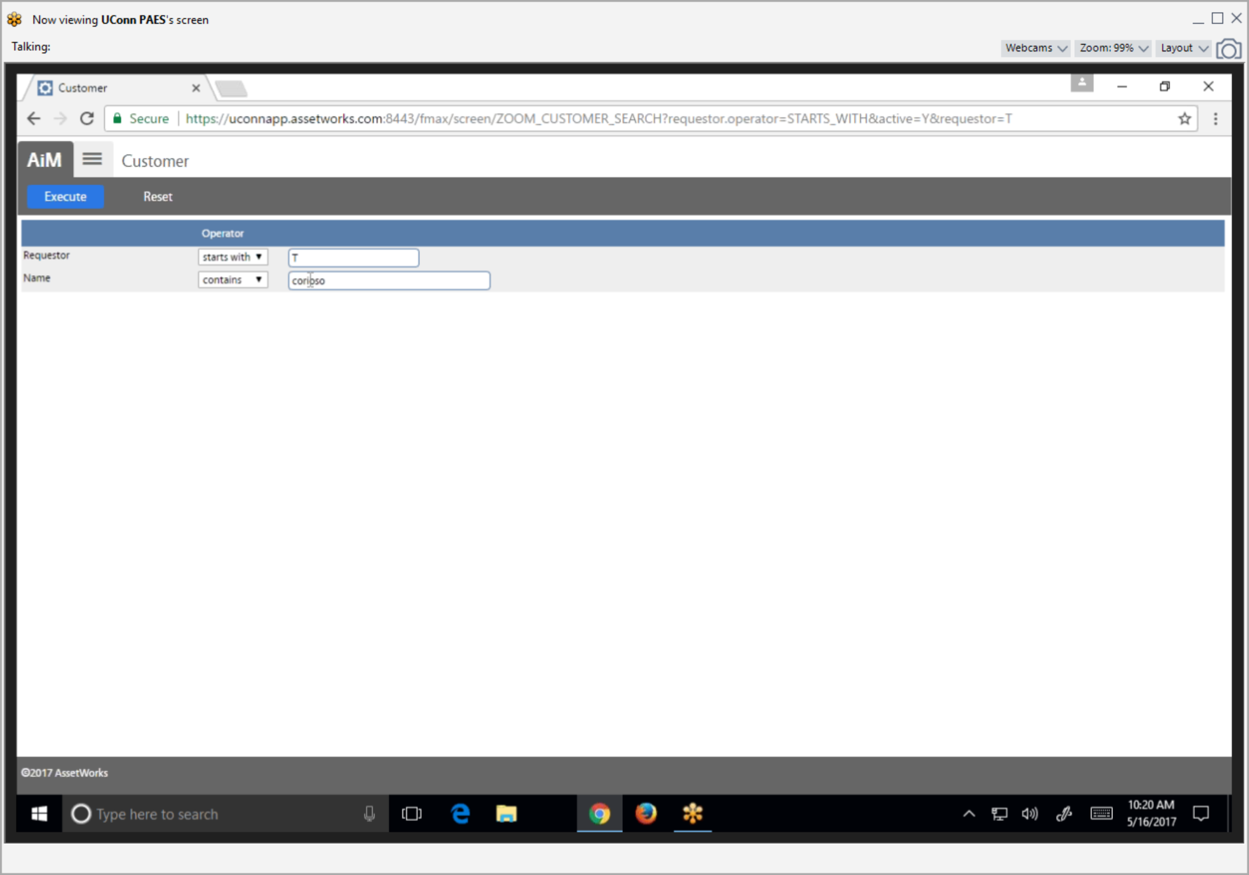
Enter Requestor & Name search criteria, then click Execute.
New Key or Card Access Request – Create a Key Request

Slide 11
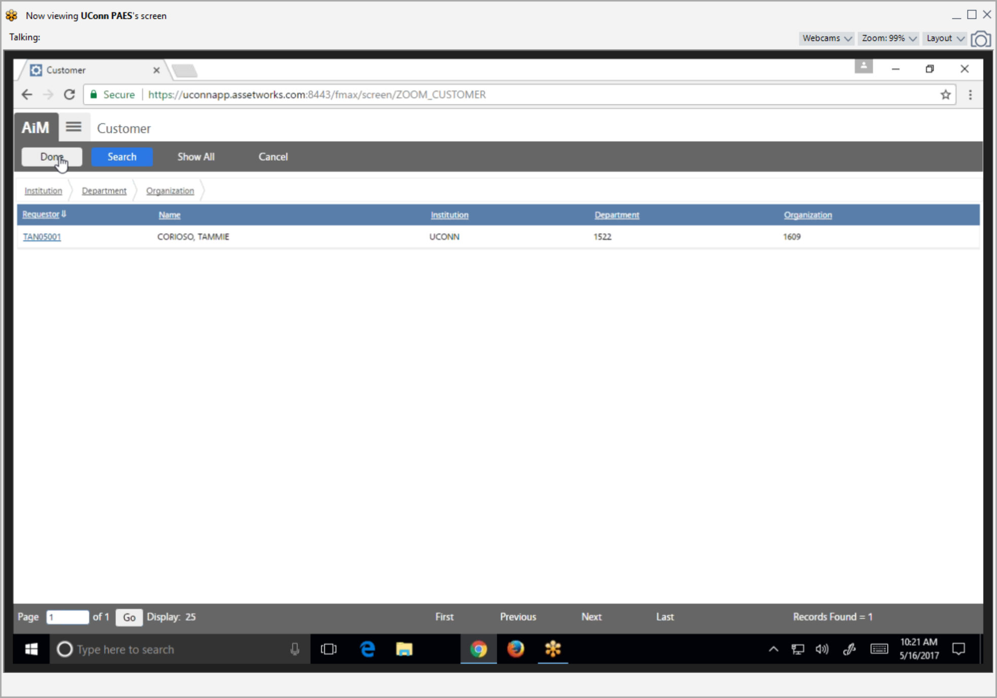
Select Requestor’s Net ID
New Key or Card Access Request – Create a Key Request

Slide 12
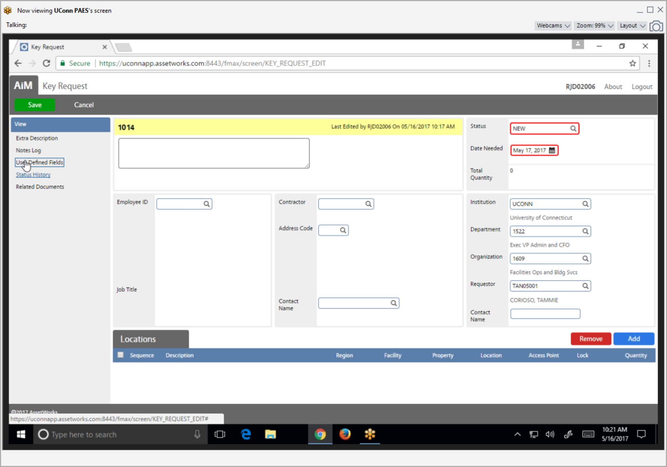
Note: Institution, Department, Organization information is automatically populated
Click Add button to add locations
New Key or Card Access Request – Create a Key Request

Slide 13
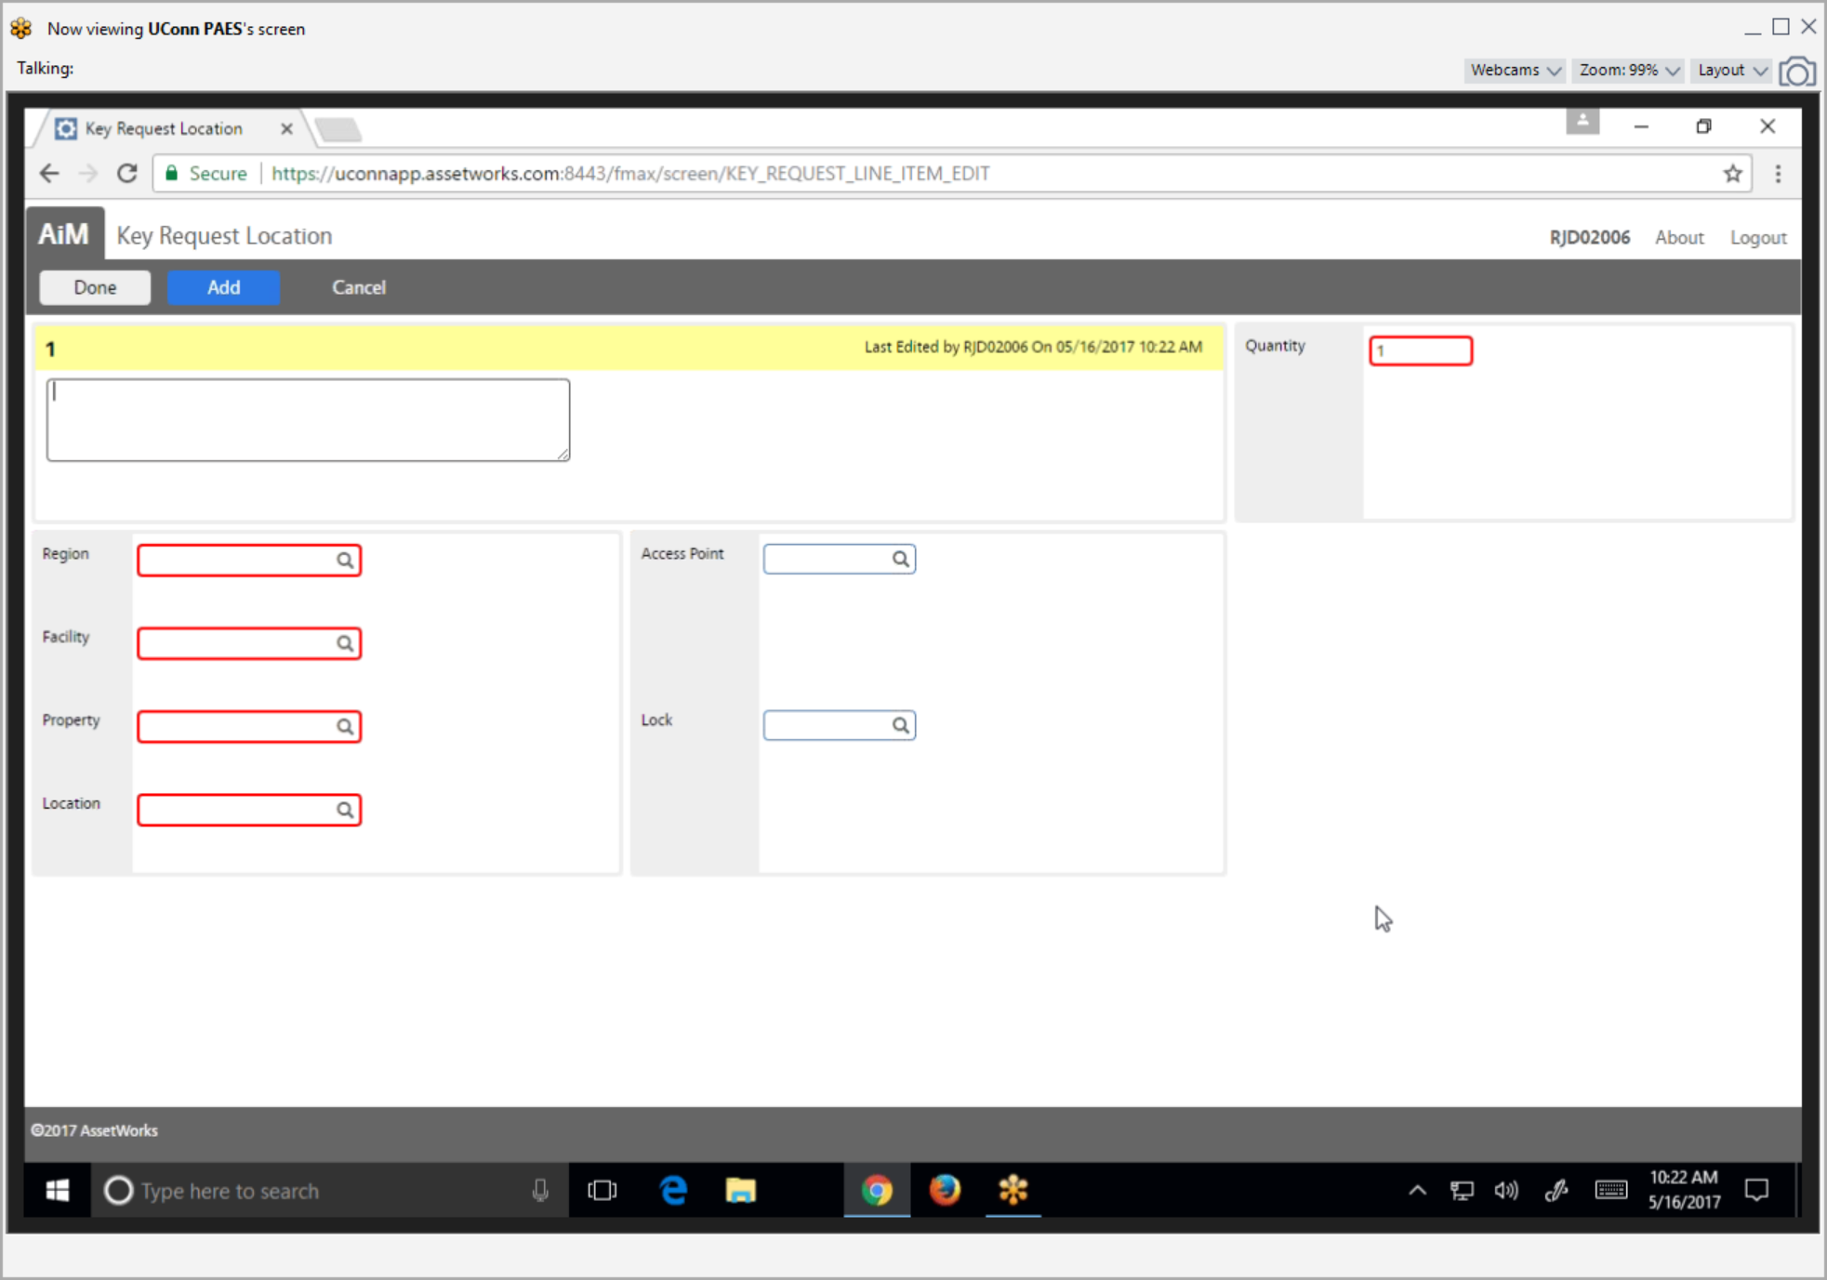
Search Region, Facility and Property information
New Key or Card Access Request – Create a Key Request
Notes:
If property number is known, simply enter it into the Property field and click the spyglass icon beside the Property field, this will populate the organization information.

Slide 14
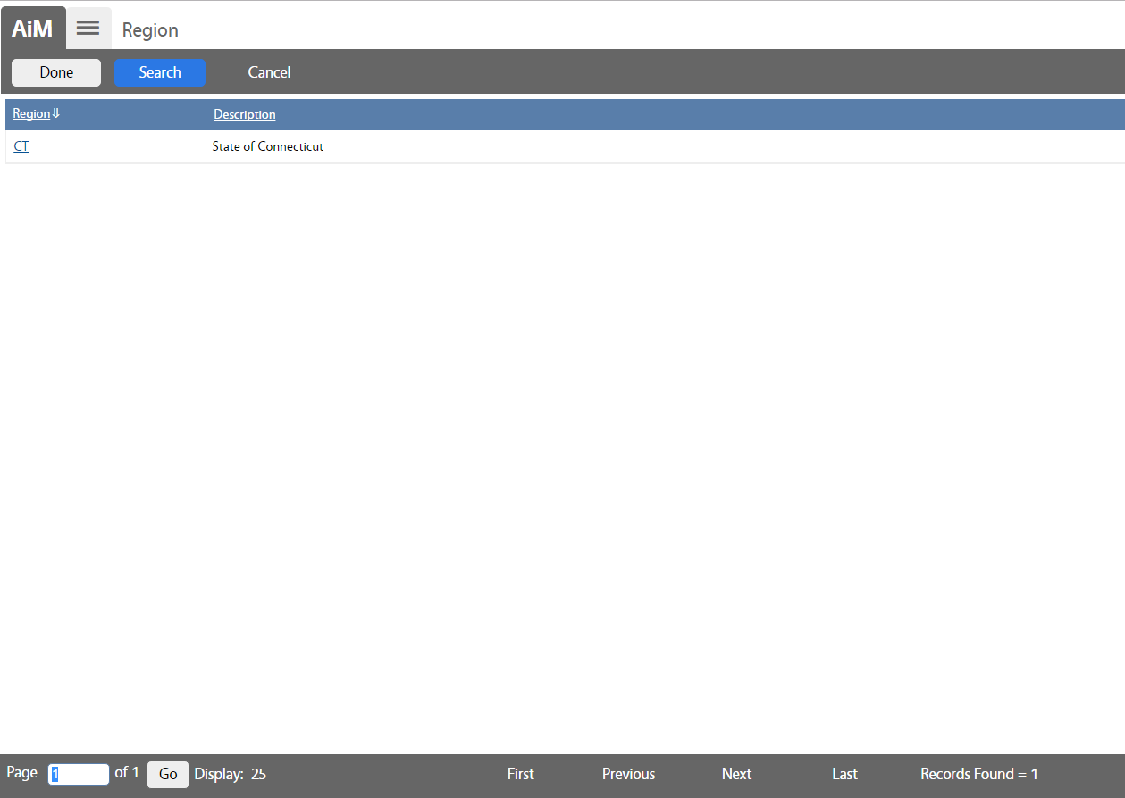
Click on CT region
New Key or Card Access Request – Create a Key Request

Slide 15
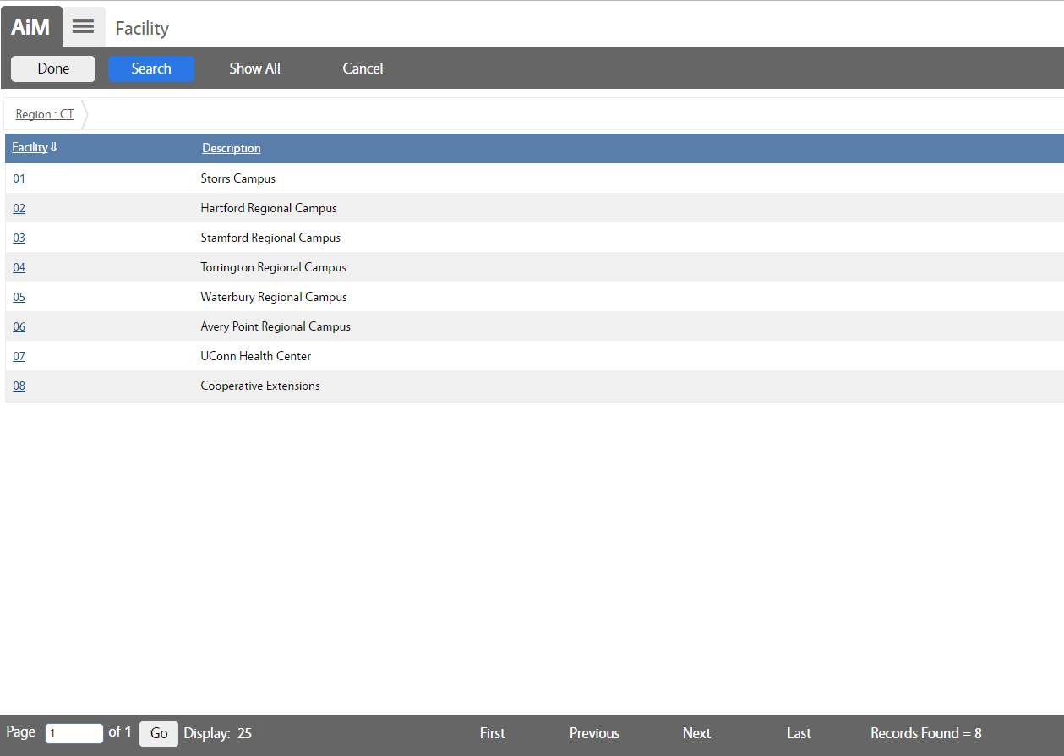
Click on Facility ID
New Key or Card Access Request – Create a Key Request

Slide 16
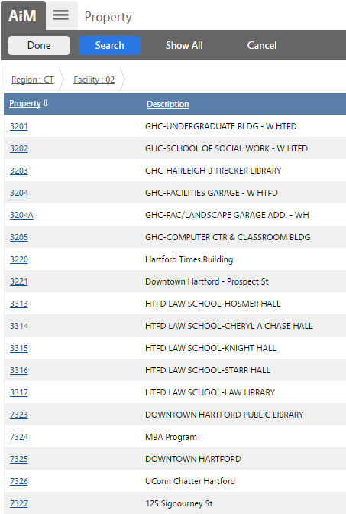
Click on Property ID
New Key or Card Access Request – Create a Key Request

Slide 17
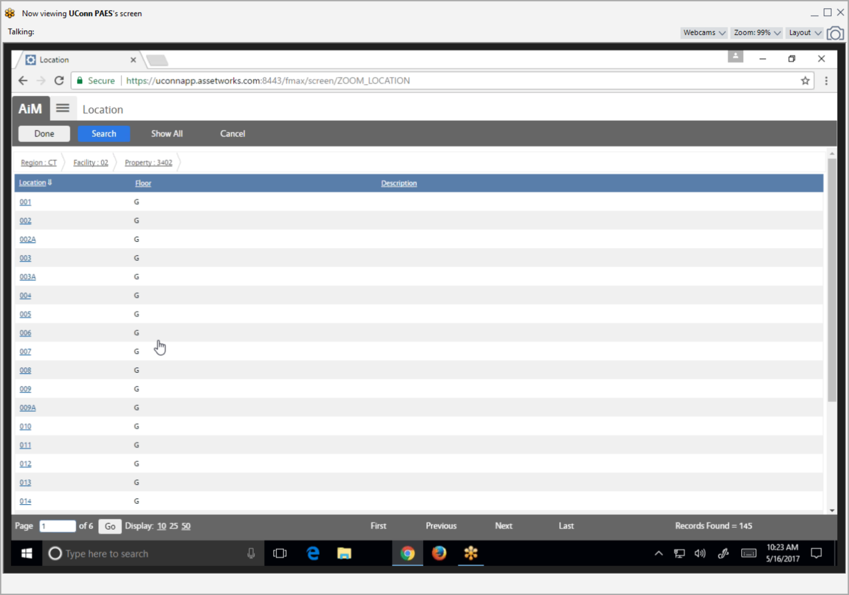
Click on Location ID
New Key or Card Access Request – Create a Key Request

Slide 18
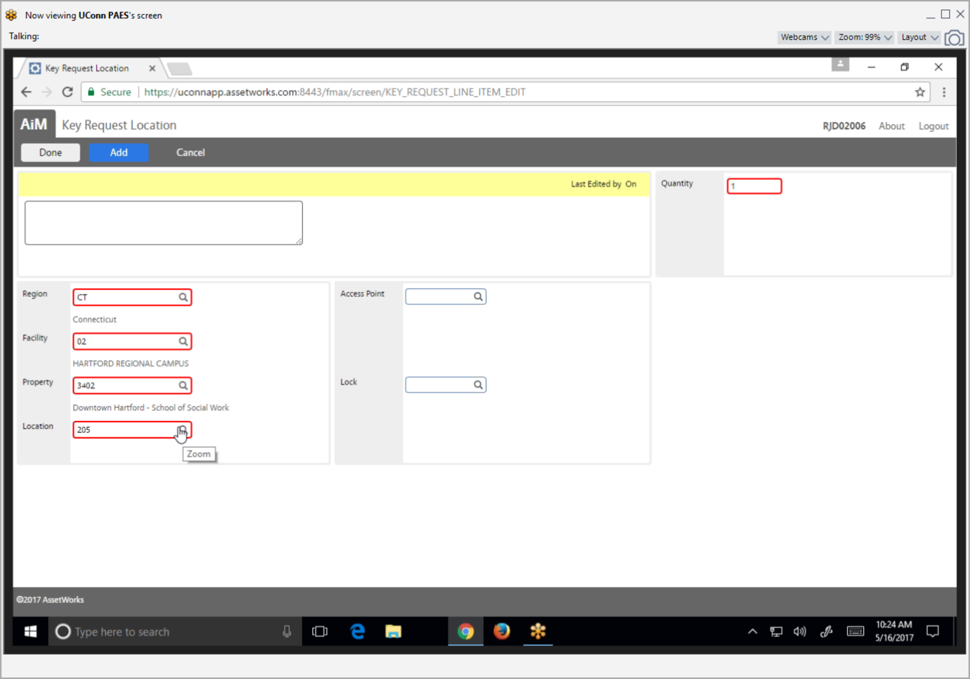
Search Access Point
New Key or Card Access Request – Create a Key Request

Slide 19
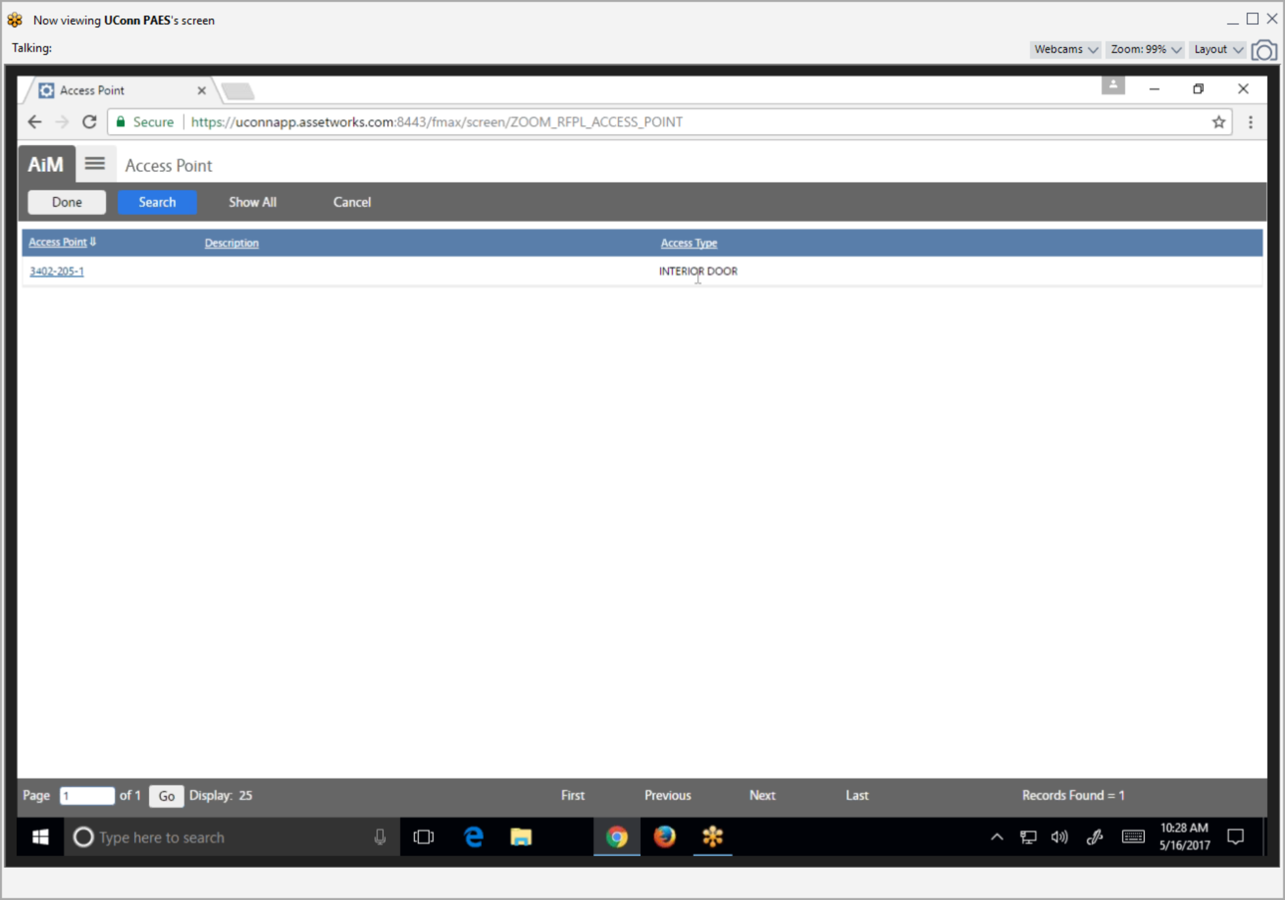
Select Access Point ID
New Key or Card Access Request – Create a Key Request

Slide 20
Search Lock field
New Key or Card Access Request – Create a Key Request

Slide 21
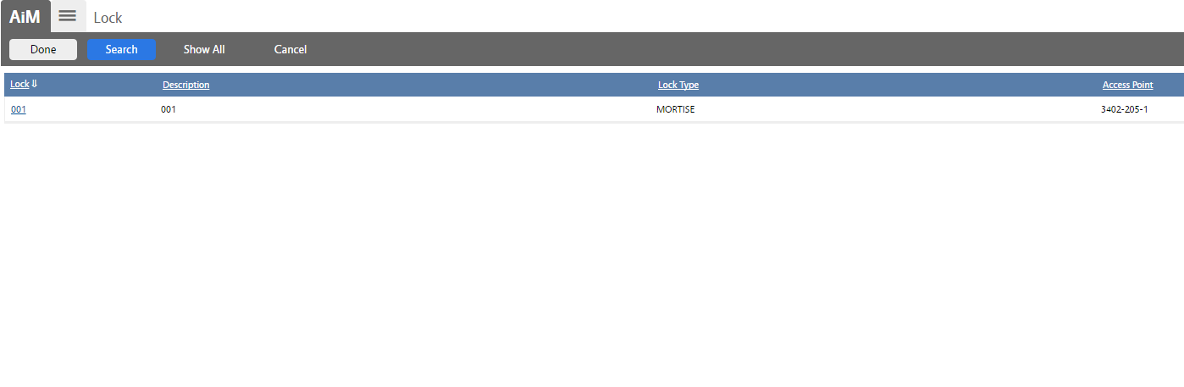
Select Lock ID
New Key or Card Access Request – Create a Key Request

Slide 22
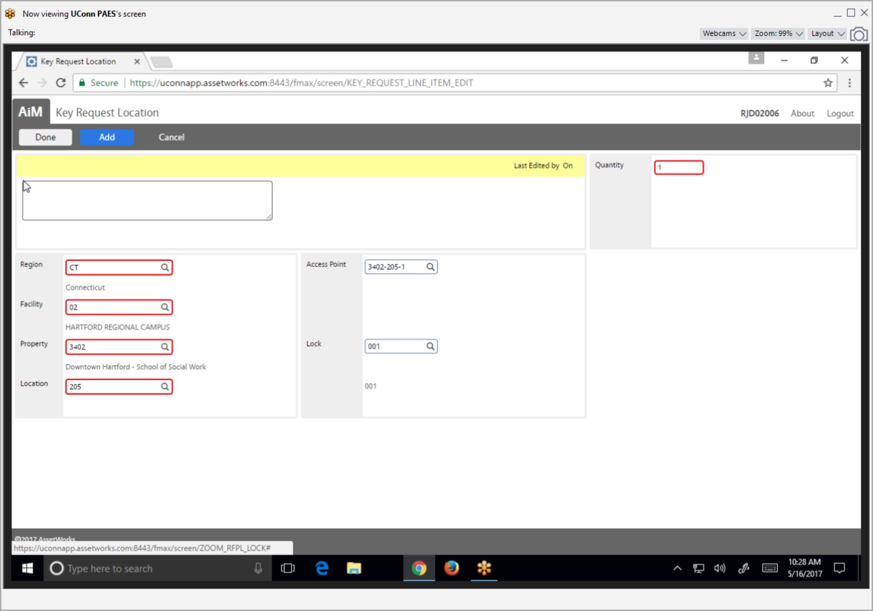
*
* Click Add to add more locations as needed.
Enter Quantity, then click Done.
New Key or Card Access Request – Create a Key Request

Slide 23
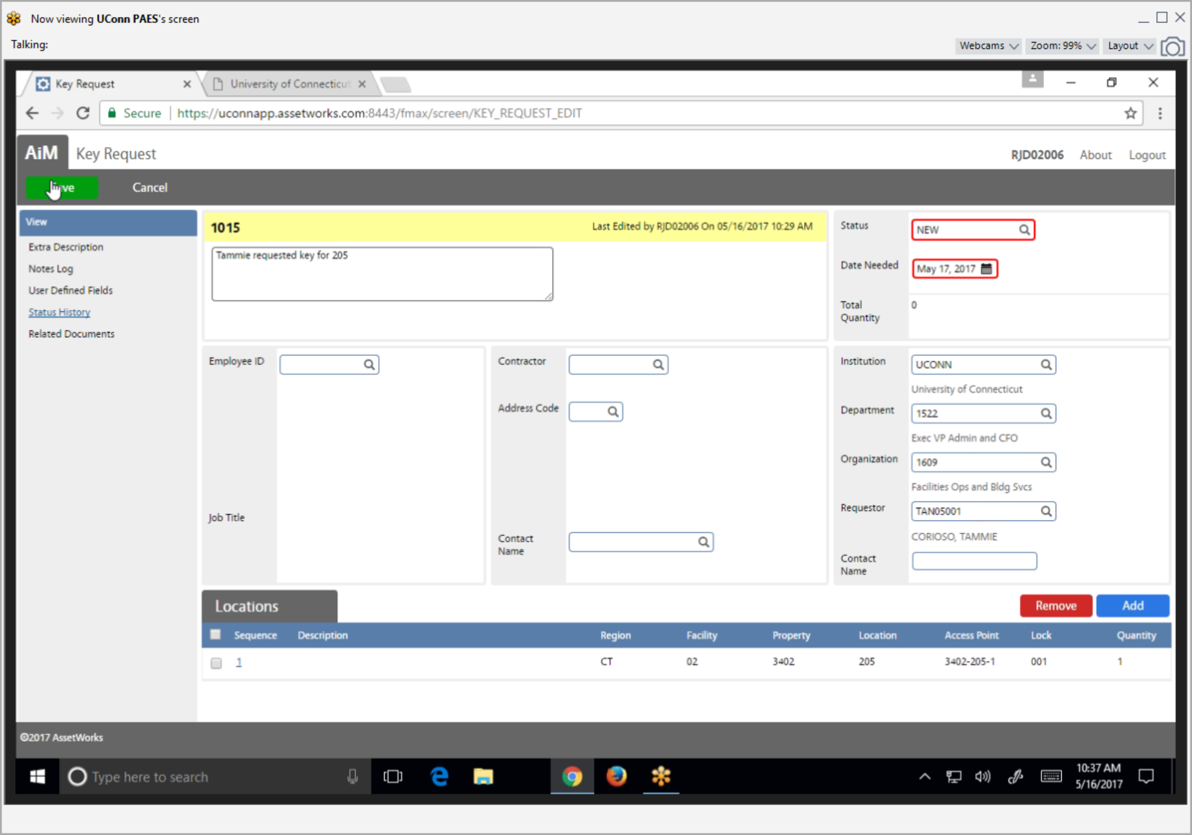
Click Save.
New Key or Card Access Request – Create a Key Request

Slide 24
Step 2: Approve Key Request

Slide 25
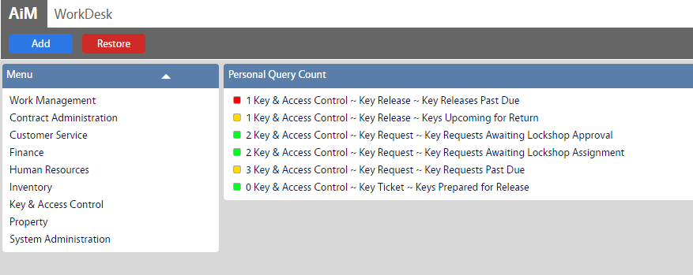
On WorkDesk under your Personal Query Count, click “Key Requests Awaiting Lockshop Approval”
New Key or Card Access Request – Approve Key Request

Slide 26
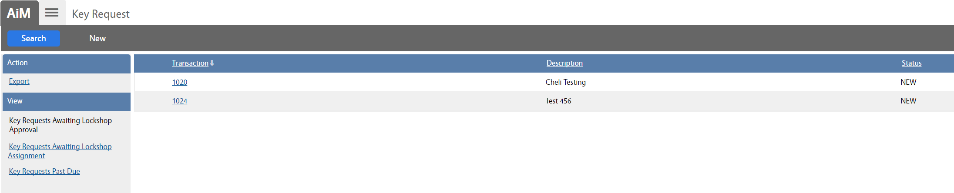
Select Key Request ID
New Key or Card Access Request – Approve Key Request

Slide 27
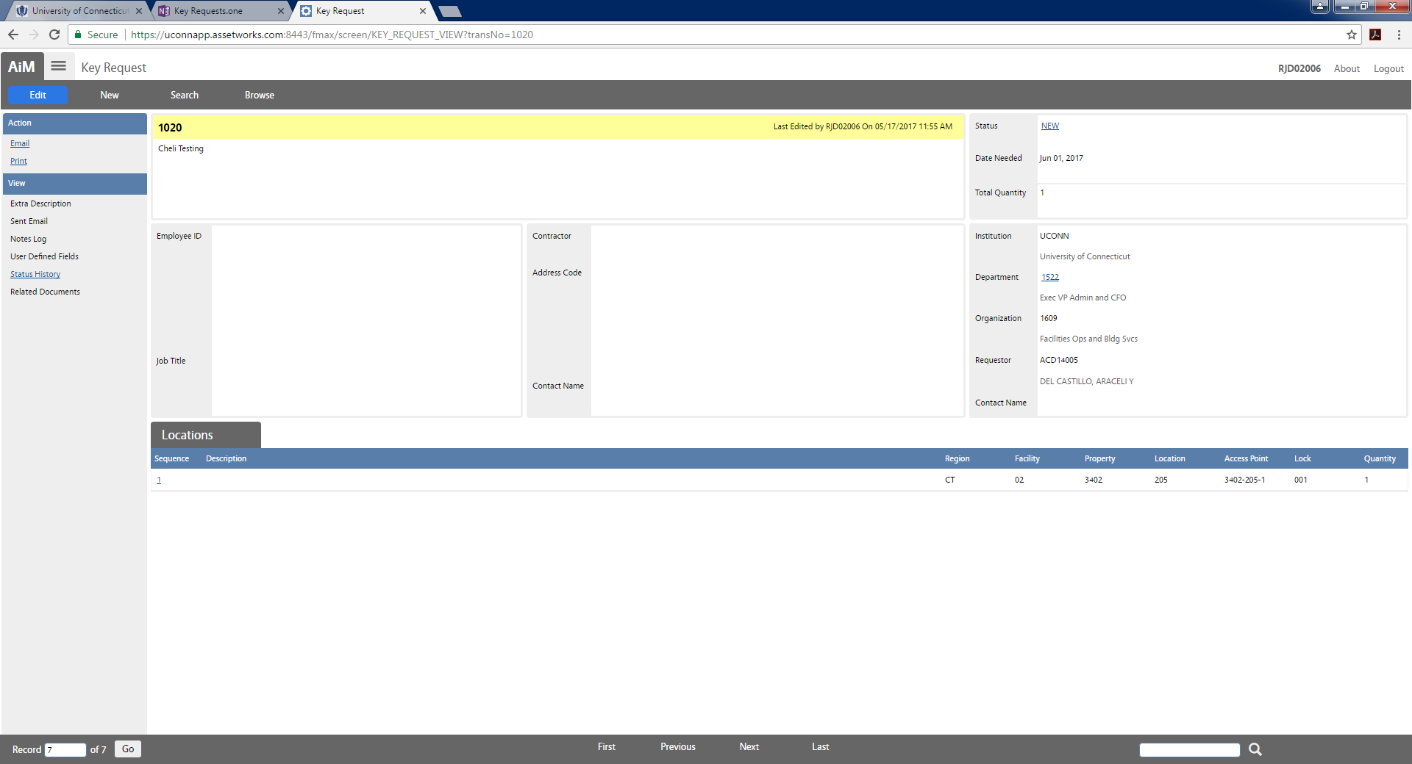
Click Edit, then click on Status
New Key or Card Access Request – Approve Key Request

Slide 28
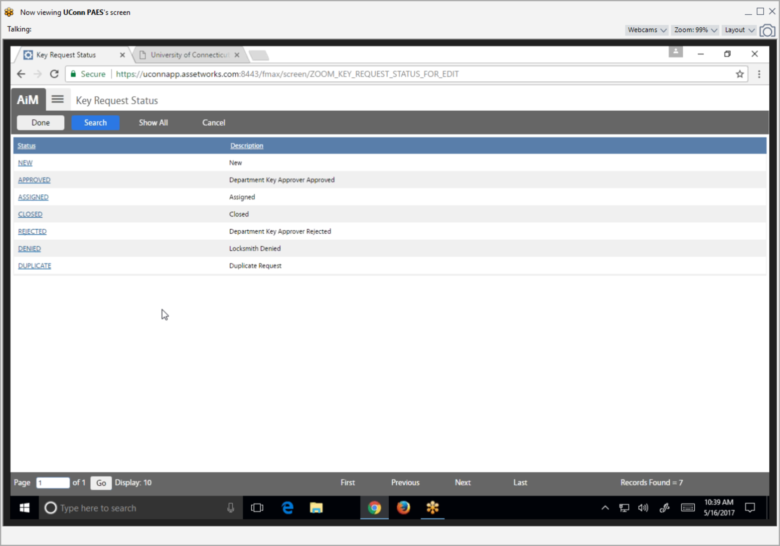
Update Status to “Approved”
New Key or Card Access Request – Approve Key Request

Slide 29
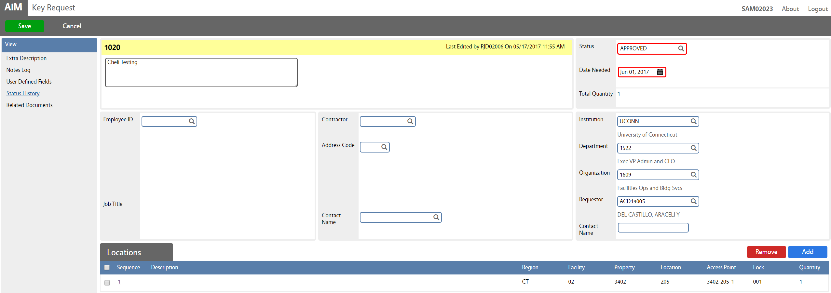
Click Save
New Key or Card Access Request – Approve Key Request

Slide 30
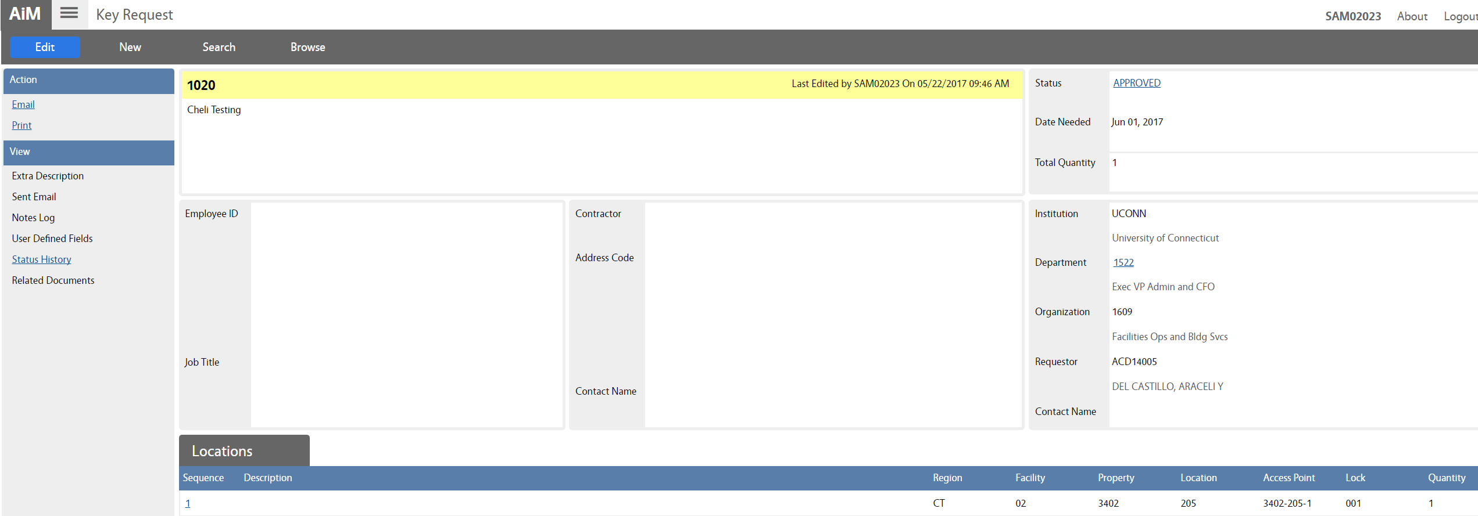
New Key or Card Access Request – Approve Key Request

Slide 31
Step 3: Assign Key Request

Slide 32
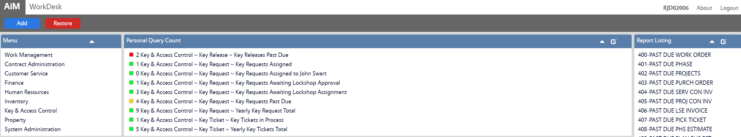
On WorkDesk, under your Personal Query Count, click “Key Requests Lockshop Assignment”
New Key or Card Access Request – Assign Key Request
Facilities and Operations

Slide 33
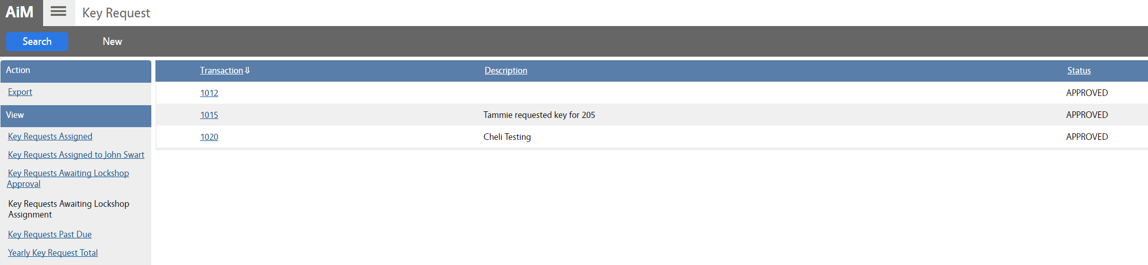
Select Key Request ID
New Key or Card Access Request – Assign Key Request
Facilities and Operations

Slide 34
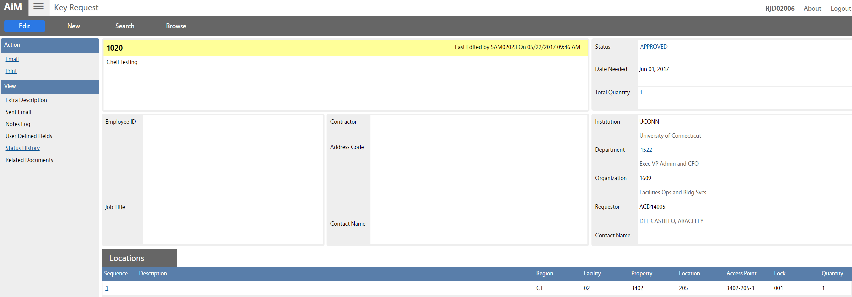
Click Edit
New Key or Card Access Request – Assign Key Request
Facilities and Operations

Slide 35
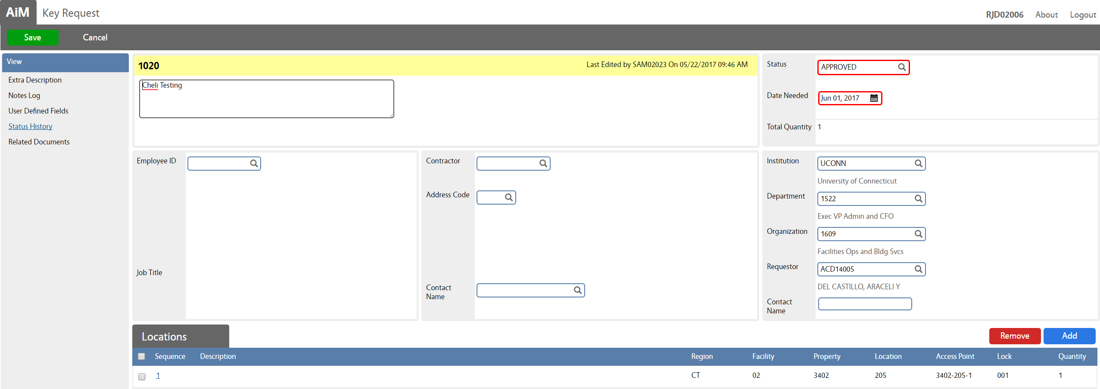
Click status to update it
New Key or Card Access Request – Assign Key Request

Slide 36
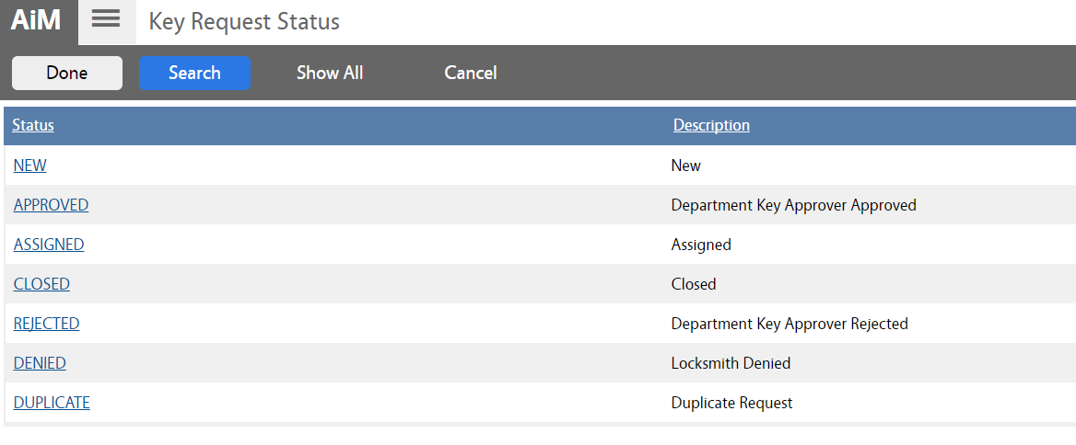
Click “Assigned”
New Key or Card Access Request – Assign Key Request

Slide 37
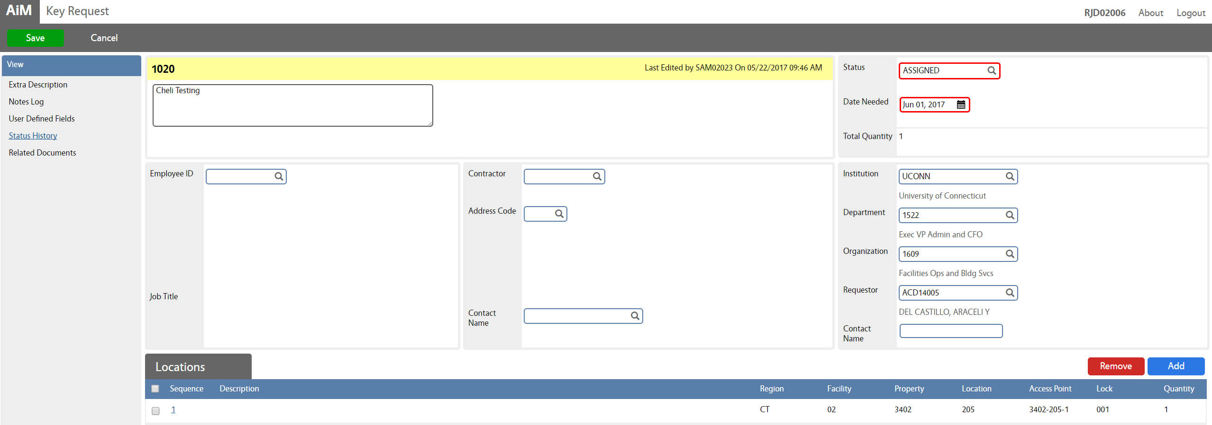
Click Notes Log link
New Key or Card Access Request – Assign Key Request

Slide 38
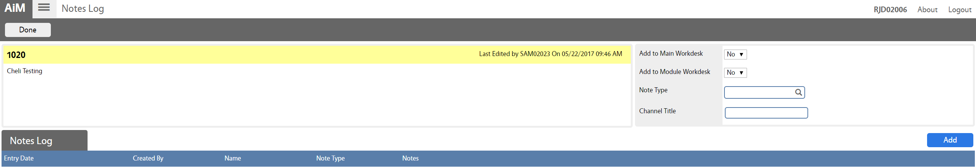
Click Add
New Key or Card Access Request – Assign Key Request

Slide 39
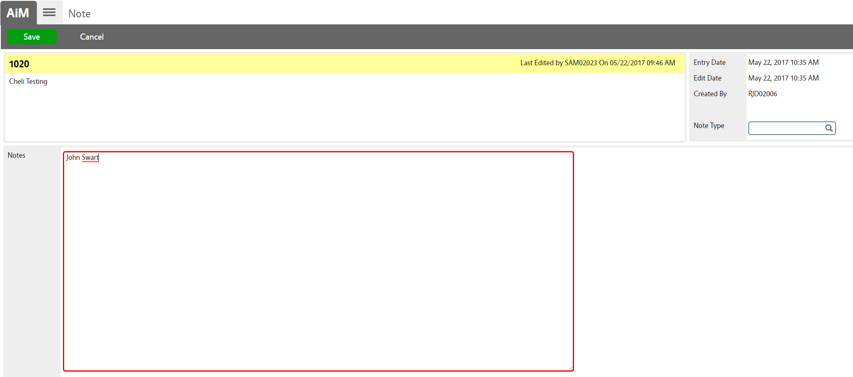
Enter name of the assignee in Notes box, then click Save
New Key or Card Access Request – Assign Key Request

Slide 40
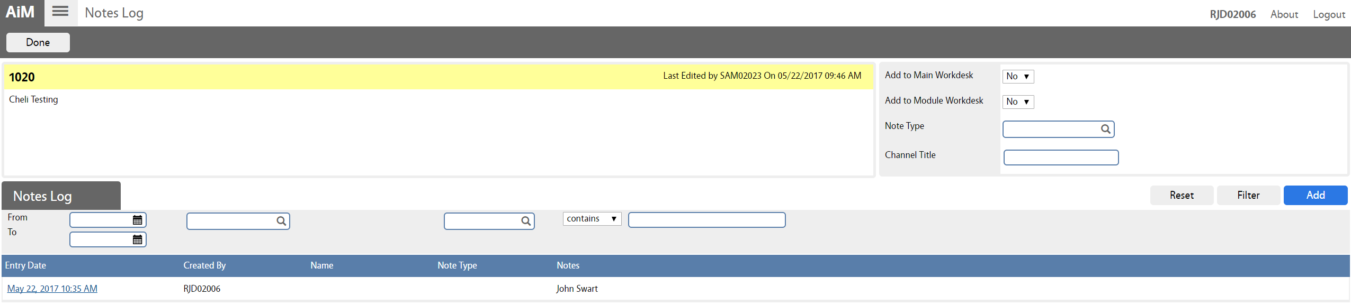
Click Done
New Key or Card Access Request – Assign Key Request

Slide 41
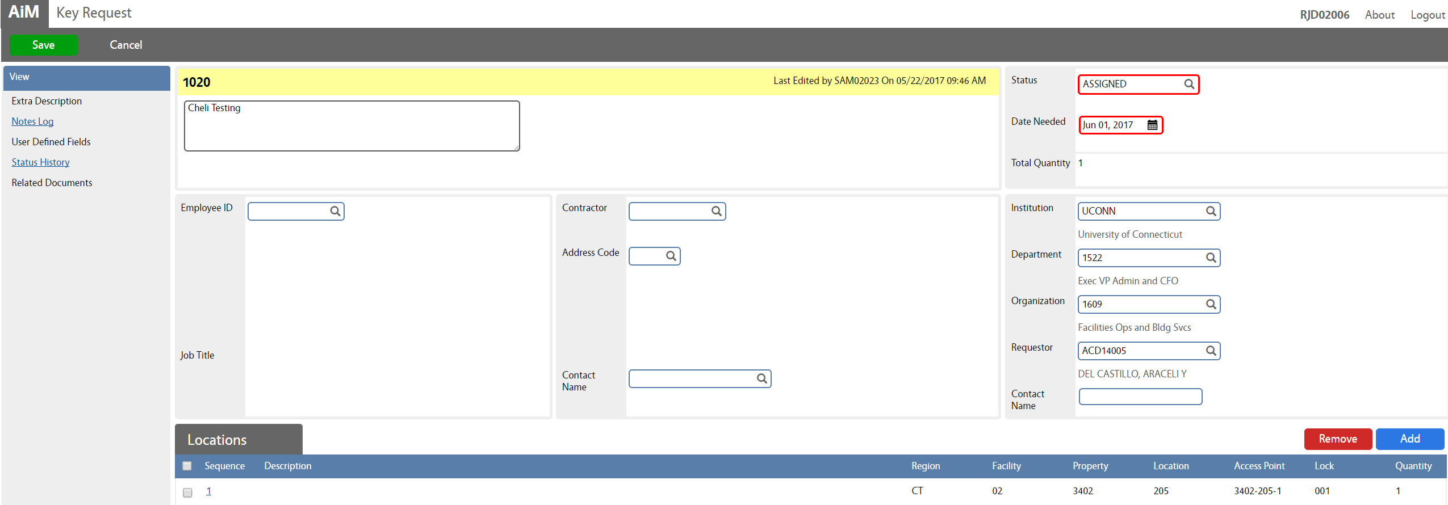
Click Save
New Key or Card Access Request – Assign Key Request

Slide 42

New Key or Card Access Request – Assign Key Request

Slide 43
New Key or Card Access Request
*Key Ticket*

Slide 44
Step 1: Create a Key Ticket

Slide 45
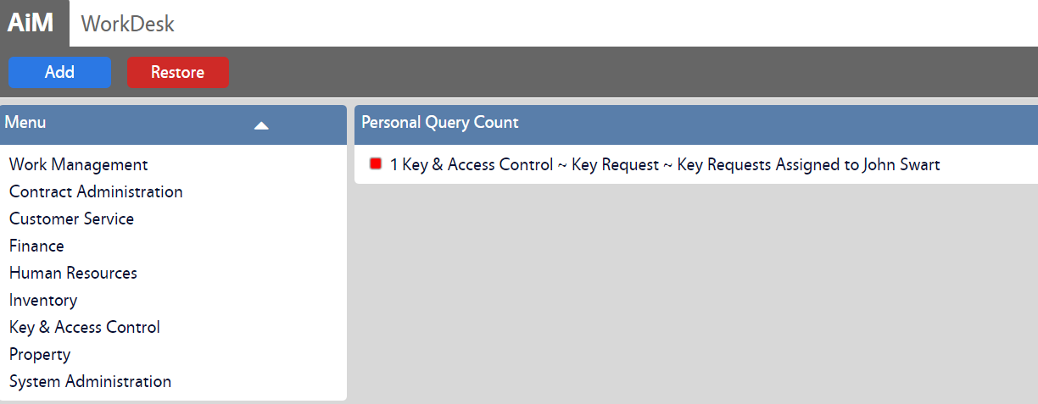
On WorkDesk, under your Personal Query Count, click “Key Requests Assigned to (your name)”
New Key or Card Access Request – Create Key Ticket
Facilities and Operations

Slide 46
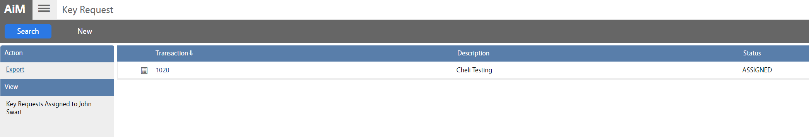
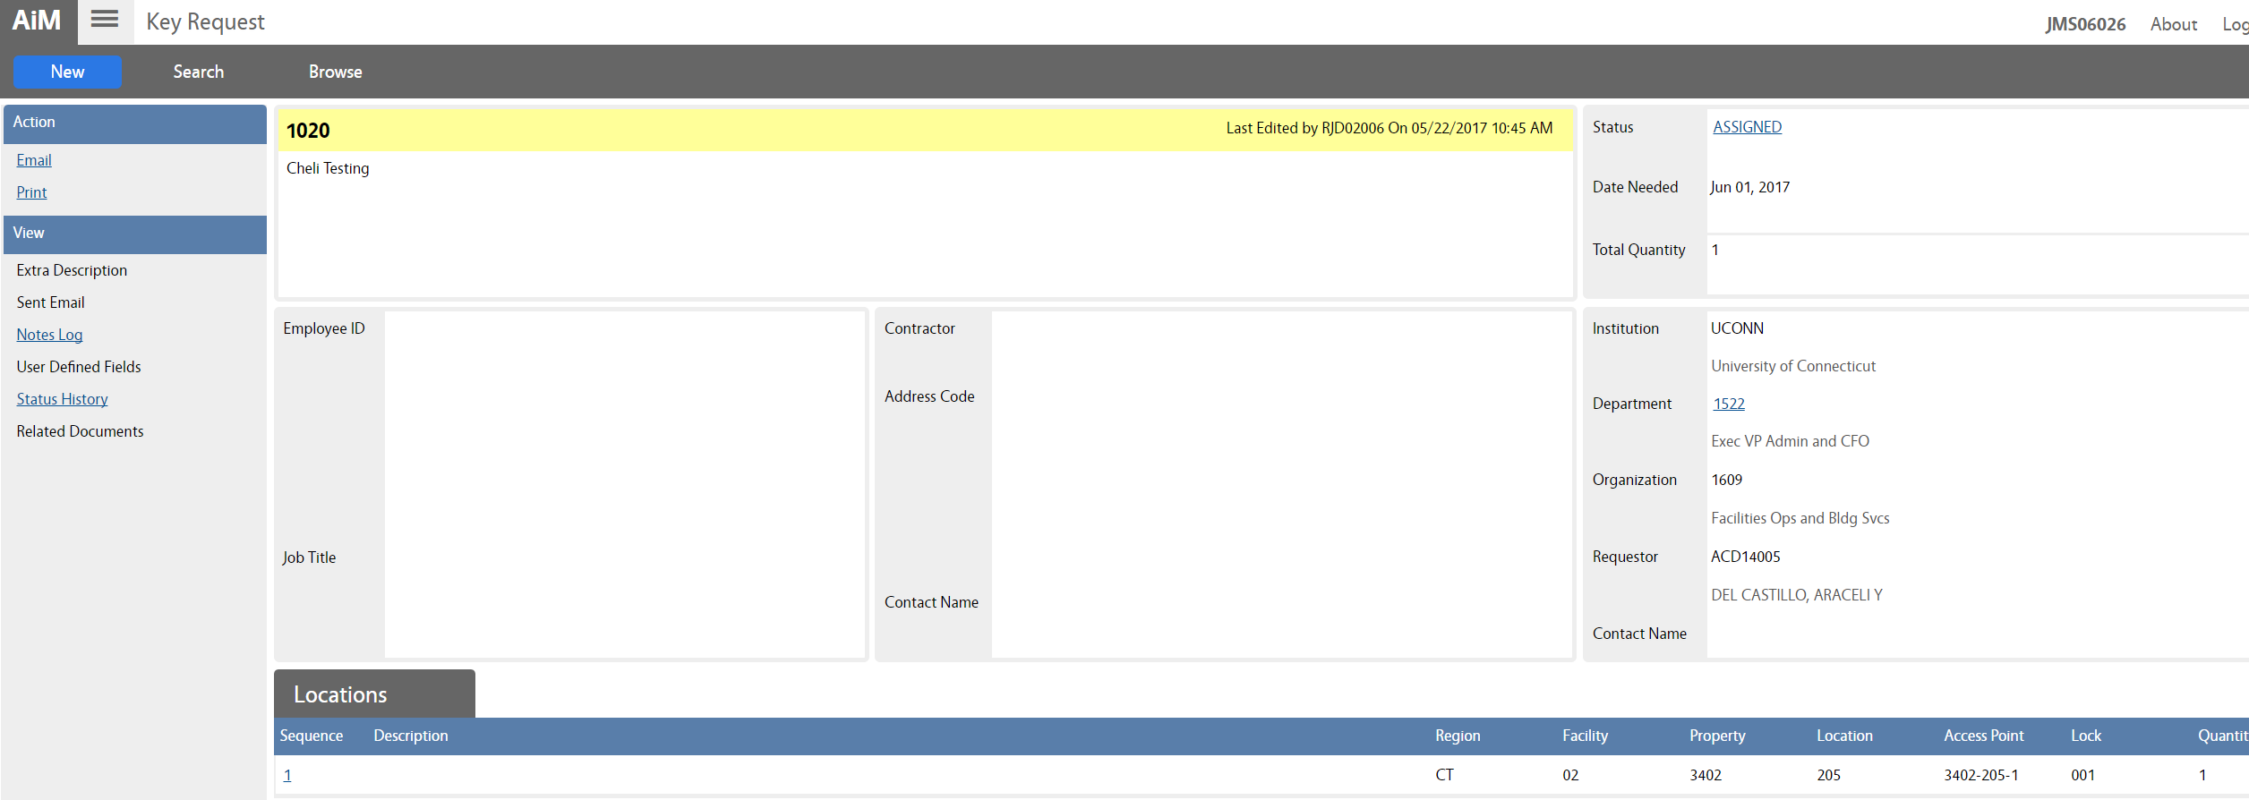
Select Key Request ID, take note of the number, then click on the hamburger menu
New Key or Card Access Request – Create Key Ticket
Facilities and Operations

Slide 47
On WorkDesk click Key Ticket
New Key or Card Access Request – Create Key Ticket

Slide 48
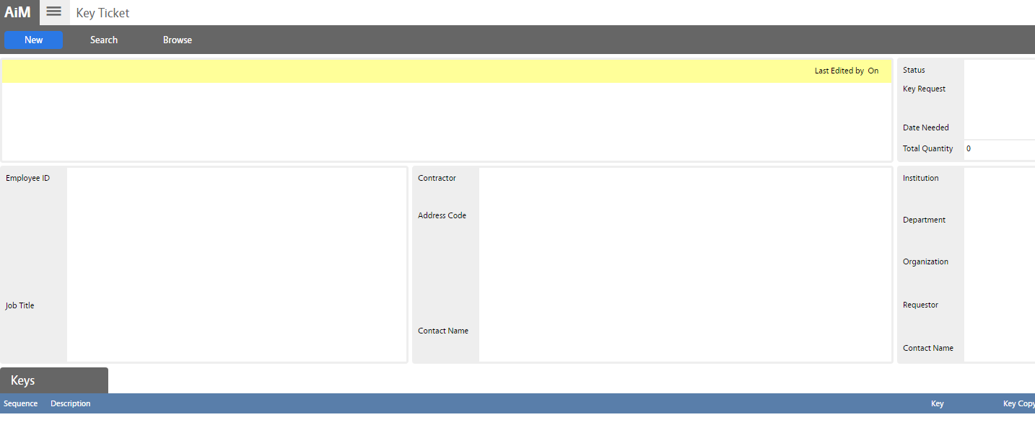
Click New
New Key or Card Access Request – Create Key Ticket

Slide 49
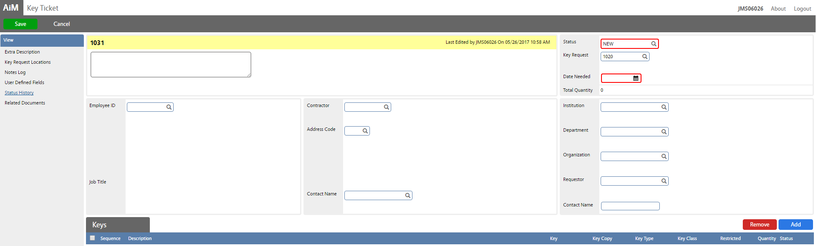
Enter/search Key Request number
New Key or Card Access Request – Create Key Ticket

Slide 50
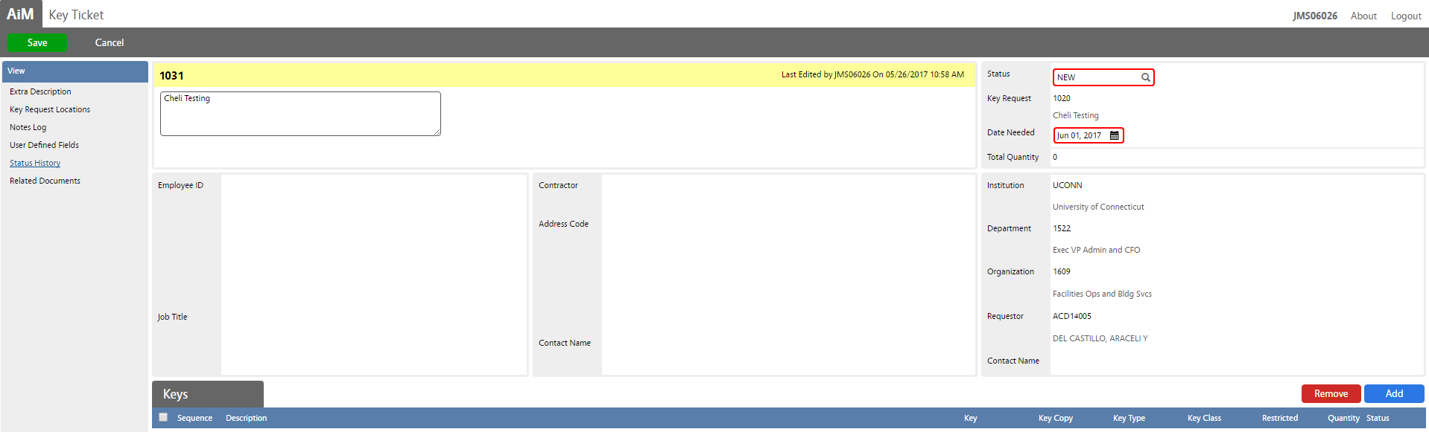
Note: Location information is automatically populated
Click Add
New Key or Card Access Request – Create Key Ticket

Slide 51
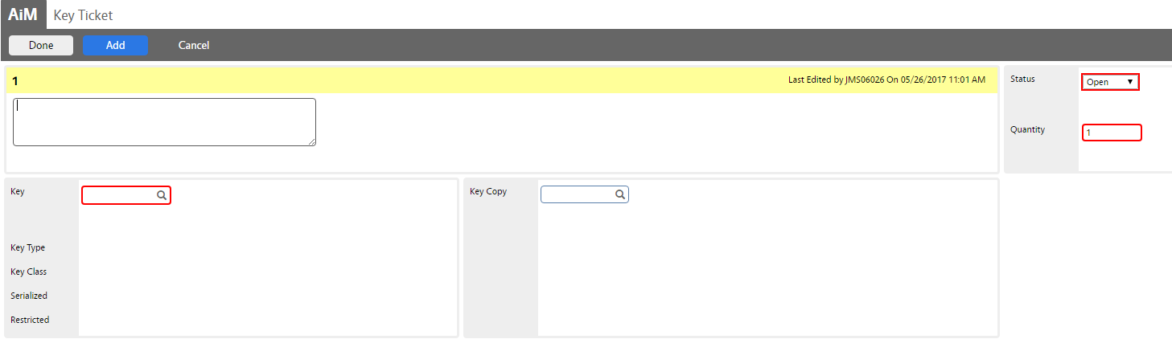
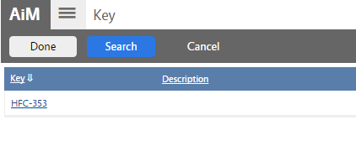
Search/Select Key
New Key or Card Access Request – Create Key Ticket
Facilities and Operations

Slide 52
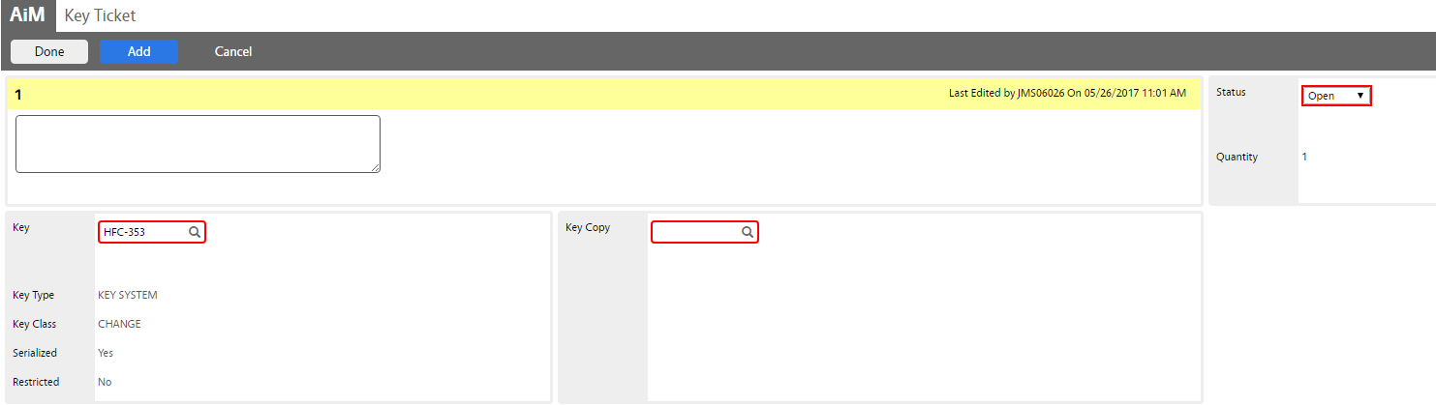
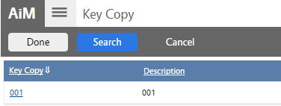
Search/Select Key Copy
New Key or Card Access Request – Create Key Ticket
Facilities and Operations

Slide 53

Click Add to add more keys as needed, then click Done
New Key or Card Access Request – Create Key Ticket
Facilities and Operations
Notes:
If a Key/Key Copy is not available for such location, then there is a pause in the process and the New Key/Key Copy process needs to be initiated.

Slide 54
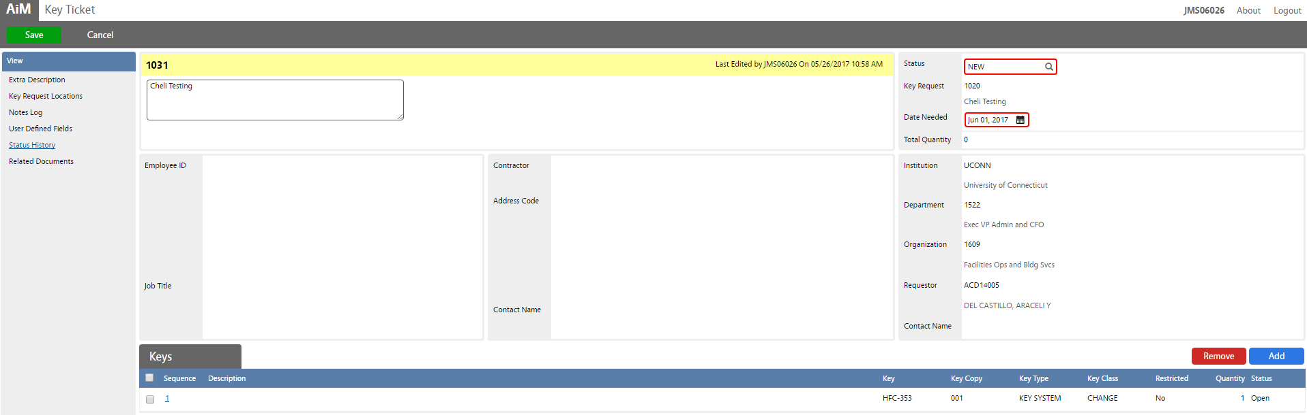
Click Notes Log link
New Key or Card Access Request – Create Key Ticket
Facilities and Operations

Slide 55
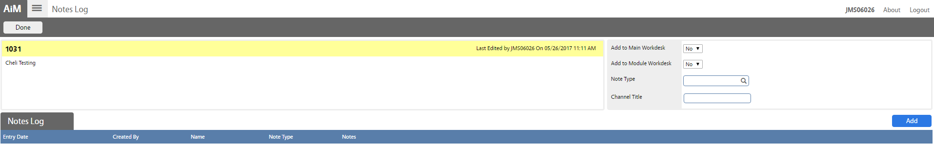
Click Add to enter assignee name
New Key or Card Access Request – Create Key Ticket
Facilities and Operations

Slide 56
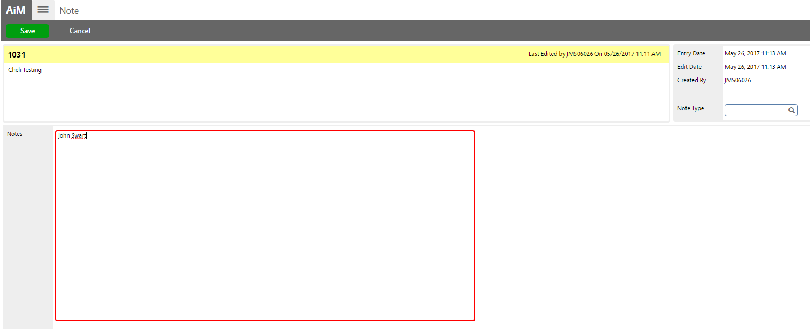
Enter assignee name,
then click Save
New Key or Card Access Request – Create Key Ticket
Facilities and Operations

Slide 57
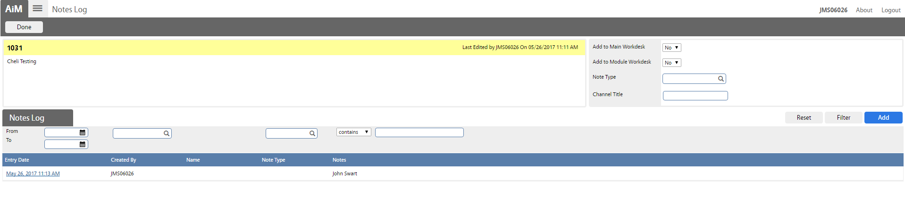
Click Done
New Key or Card Access Request – Create Key Ticket
Facilities and Operations

Slide 58
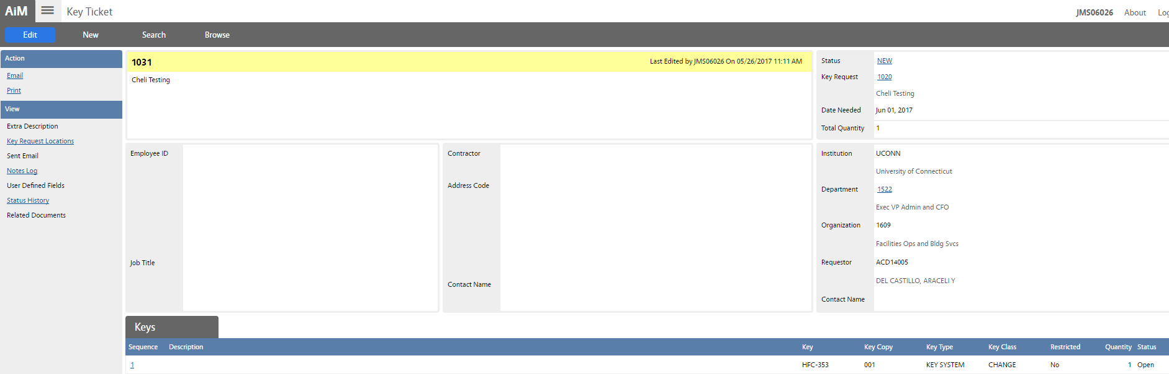
New Key or Card Access Request – Create Key Ticket
Facilities and Operations

Slide 59
Step 2: Update Key Ticket Status

Slide 60
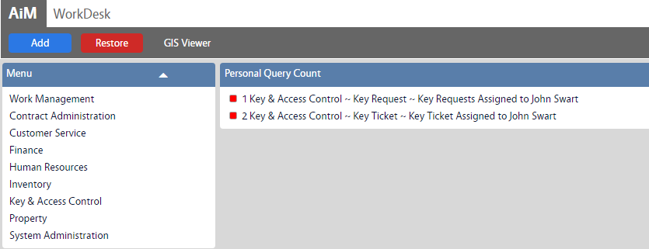
On WorkDesk, under your Personal Query Count, click “Key Ticket Assigned to (your name)”
New Key or Card Access Request – Update Key Ticket Status

Slide 61

Select Key Ticket ID
New Key or Card Access Request – Update Key Ticket Status
Facilities and Operations

Slide 62

Click Edit
New Key or Card Access Request – Update Key Ticket Status
Facilities and Operations

Slide 63

Click on New Status
New Key or Card Access Request – Update Key Ticket Status
Facilities and Operations

Slide 64

Select Key Ticket Status
New Key or Card Access Request – Update Key Ticket Status
Facilities and Operations

Slide 65

Click Save
New Key or Card Access Request – Update Key Ticket Status
Facilities and Operations

Slide 66

New Key or Card Access Request – Update Key Ticket Status
Facilities and Operations

Slide 67
New Key or Card Access Request
*Key Release*

Slide 68

On WorkDesk click Key & Access Control module
New Key or Card Access Request – Key Ticket Release
Facilities and Operations

Slide 69

Click Key Release
New Key or Card Access Request – Key Ticket Release
Facilities and Operations

Slide 70

Click New
New Key or Card Access Request – Key Ticket Release
Facilities and Operations

Slide 71

Search Shop
New Key or Card Access Request – Key Ticket Release
Facilities and Operations

Slide 72

Select “Locksmith”
New Key or Card Access Request –Key Ticket Release
Facilities and Operations

Slide 73

Enter/search Net ID on Release By field
New Key or Card Access Request – Key Ticket Release
Facilities and Operations

Slide 74

Enter/Search Requestor (Net ID)
New Key or Card Access Request – Key Ticket Release
Facilities and Operations

Slide 75

Select Net ID
New Key or Card Access Request – Key Ticket Release
Facilities and Operations

Slide 76

Note: Location information is automatically populated
Click Load
New Key or Card Access Request – Key Ticket Release
Facilities and Operations

Slide 77
Select Key Ticket ID, then click Done
New Key or Card Access Request – Key Ticket Release
Facilities and Operations

Slide 78

Under Line Items section, click on the key to be released
New Key or Card Access Request – Key Ticket Release
Facilities and Operations

Slide 79

Enter Expiration Date and Cost if applicable
New Key or Card Access Request – Key Ticket Release
Facilities and Operations

Slide 80

If there is a cost, go to Account Set-Up link, select Account and click Done
New Key or Card Access Request – Key Ticket Release
Facilities and Operations

Slide 81

You can load more keys and add signature images
on Related Document section
New Key or Card Access Request – Key Ticket Release
Facilities and Operations

Slide 82

Click Attach
New Key or Card Access Request – Key Ticket Release
Facilities and Operations

Slide 83

Search for attachment
New Key or Card Access Request – Key Ticket Release
Facilities and Operations

Slide 84

Select attachment
New Key or Card Access Request – Key Ticket Release
Facilities and Operations
Notes:
This is a signed release page attachment.

Slide 85

Click Done
New Key or Card Access Request – Key Ticket Release
Facilities and Operations

Slide 86

Click Save
New Key or Card Access Request – Key Ticket Release
Facilities and Operations

Slide 87

New Key or Card Access Request – Key Ticket Release
Facilities and Operations

Slide 88
New Key or Card Access Request
*Key Return/Renewal*

Slide 89
Key Return

Slide 90


On WorkDesk,
click Key & Access Control, then click Key Return/Renewal
New Key or Card Access Request – Key Ticket Return
Facilities and Operations

Slide 91

Click New
New Key or Card Access Request – Key Ticket Return
Facilities and Operations

Slide 92

Enter/search Requestor
New Key or Card Access Request – Key Ticket Return
Facilities and Operations

Slide 93

Note: Location information is automatically populated
Click Load
New Key or Card Access Request – Key Ticket Return
Facilities and Operations

Slide 94

Select key and click Save
New Key or Card Access Request – Key Ticket Return
Facilities and Operations

Slide 95

New Key or Card Access Request – Key Ticket Return
Facilities and Operations

Slide 96
Key Renewal

Slide 97
On WorkDesk,
click Key & Access Control, then click Key Return/Renewal
New Key or Card Access Request – Key Ticket Renewal
Facilities and Operations

Slide 98
Click New
New Key or Card Access Request – Key Ticket Renewal
Facilities and Operations

Slide 99
Enter/search Requestor
New Key or Card Access Request – Key Ticket Renewal
Facilities and Operations

Slide 100
Note: Location information is automatically populated
Click Load
New Key or Card Access Request – Key Ticket Renewal
Facilities and Operations

Slide 101

Select Key and click “Return/Renew” link
New Key or Card Access Request – Key Ticket Renewal
Facilities and Operations

Slide 102

Leave Blank
Verify/update Status, enter new Expiration Date and update Quantity, then click Done
Note: Return Date should be blank
New Key or Card Access Request – Key Ticket Renewal
Facilities and Operations

Slide 103

Click Save
New Key or Card Access Request – Key Ticket Renewal
Facilities and Operations

Slide 104

New Key or Card Access Request – Key Ticket Renewal
Facilities and Operations

Slide 105
New Key or Card Access Request
*Key Ring*

Slide 106
On WorkDesk,
click Key & Access Control, then click Key Ring
New Key or Card Access Request – Create Key Ring
Facilities and Operations

Slide 107

Click New
New Key or Card Access Request – Create Key Ring
Facilities and Operations

Slide 108

Enter Key Ring name and description, then search Ring Type
New Key or Card Access Request – Create Key Ring
Facilities and Operations

Slide 109

Select Ring Type
New Key or Card Access Request – Create Key Ring
Facilities and Operations

Slide 110

Search Cabinet
New Key or Card Access Request – Create Key Ring
Facilities and Operations

Slide 111

Select Cabinet
New Key or Card Access Request – Create Key Ring
Facilities and Operations

Slide 112

Select Slot
New Key or Card Access Request – Create Key Ring
Facilities and Operations

Slide 113

Select Add
New Key or Card Access Request – Create Key Ring
Facilities and Operations

Slide 114

Search Key
New Key or Card Access Request – Create Key Ring
Facilities and Operations

Slide 115

Select Key
New Key or Card Access Request – Create Key Ring
Facilities and Operations

Slide 116

Search Key Copy
New Key or Card Access Request – Create Key Ring
Facilities and Operations

Slide 117

Select Key Copy
New Key or Card Access Request – Create Key Ring
Facilities and Operations

Slide 118

Note: Add more keys as needed, then click Done
New Key or Card Access Request – Create Key Ring
Facilities and Operations
Notes:
Optionally, you could add another key to show that multiple keys reside on a ring.

Slide 119

Click Save
New Key or Card Access Request – Create Key Ring
Facilities and Operations

Slide 120

New Key or Card Access Request – Create Key Ring
Facilities and Operations

Slide 121
New Key or Card Access Request
*Key Ring Release*

Slide 122
On WorkDesk,
click Key & Access Control, then click Key Ring Release
New Key or Card Access Request – Key Ring Release
Facilities and Operations

Slide 123

Click New
New Key or Card Access Request – Key Ring Release
Facilities and Operations

Slide 124

Search/select Locksmith Shop
New Key or Card Access Request – Key Ring Release
Facilities and Operations

Slide 125

Search/enter Released By and Requestor information then, search Ring ID field
New Key or Card Access Request – Key Ring Release
Facilities and Operations

Slide 126

Select Locksmith Key Ring ID
New Key or Card Access Request – Key Ring Release
Facilities and Operations

Slide 127

Enter Estimated Return Date and time, then click Save
New Key or Card Access Request – Key Ring Release
Facilities and Operations

Slide 128

New Key or Card Access Request – Key Ring Release
Facilities and Operations

Slide 129
New Key or Card Access Request
*Key Ring Return*

Slide 130

Click Search
New Key or Card Access Request – Key Ring Return
Facilities and Operations

Slide 131

Enter search criteria, then click Execute
New Key or Card Access Request – Key Ring Return
Facilities and Operations

Slide 132

Select transaction number
New Key or Card Access Request – Key Ring Return
Facilities and Operations

Slide 133

Click Edit
New Key or Card Access Request – Key Ring Return
Facilities and Operations

Slide 134

Search Return To and enter Return Date and Time, then click Save
New Key or Card Access Request – Key Ring Return
Facilities and Operations

Slide 135

New Key or Card Access Request – Key Ring Return
Facilities and Operations

Slide 136
Add Access Points
Facilities and Operations

Slide 137
On WorkDesk,
click Key & Access Control, then click Access Point
Add Access Points
Facilities and Operations

Slide 138

Click New
Add Access Points
Facilities and Operations

Slide 139

Enter Access Point, then search Access Type
Add Access Points
Facilities and Operations

Slide 140

Select Access Type
Add Access Points
Facilities and Operations

Slide 141

Search location information
Add Access Points
Facilities and Operations

Slide 142

Click Add
Add Access Points
Facilities and Operations

Slide 143

Enter Lock ID & description, then search Lock Type
Add Access Points
Facilities and Operations

Slide 144

Select Lock Type
Add Access Points
Facilities and Operations

Slide 145


Search Manufacturer
Add Access Points
Facilities and Operations

Slide 146


Click User Defined Fields and enter Entry Function, Finish, Trim and Handle Type information, then click Done
Add Access Points
Facilities and Operations

Slide 147

Click Done
Add Access Points
Facilities and Operations

Slide 148

Click Save
Add Access Points
Facilities and Operations

Slide 149

Add Access Points
Facilities and Operations

Slide 150
Add Cores
Facilities and Operations

Slide 151
On WorkDesk,
click Key & Access Control, then click Core
Add Access Points
Facilities and Operations

Slide 152

Click New
Add Cores
Facilities and Operations

Slide 153

Enter Core label and description, then search Core Type
Add Cores
Facilities and Operations

Slide 154

Select Core Type
Add Cores
Facilities and Operations

Slide 155

Search Location information, then search Access Point and Lock
Add Cores
Facilities and Operations

Slide 156
Select Access Point
Add Cores
Facilities and Operations

Slide 157

Note: Lock information is automatically populated
Click Save
Add Cores
Facilities and Operations
Notes:
Locks won’t automatically populate if there are multiple active locks for that Access Point.

Slide 158

Add Cores
Facilities and Operations

Slide 159
Add New Key
Facilities and Operations

Slide 160
On WorkDesk,
click Key & Access Control, then click Key
Add New Key
Facilities and Operations

Slide 161

Click New
Add New Key
Facilities and Operations

Slide 162

Enter Key ID, Description, Reference Number , then search Key Type and Class
Determine if Serialized and/or Restricted
Note: Status is Active by default
Add New Key
Facilities and Operations

Slide 163


Select Key Type and Key Class
Add New Key
Facilities and Operations

Slide 164

Click Key Codes link
Add New Key
Facilities and Operations

Slide 165

Enter Keyway and Key Bitting, then Click Done
Add New Key
Facilities and Operations

Slide 166

Click Done
Add New Key
Facilities and Operations

Slide 167

Click Storage link
Add New Key
Facilities and Operations

Slide 168

Click Add
Add New Key
Facilities and Operations

Slide 169

Select Cabinet and Slot
Add New Key
Facilities and Operations

Slide 170

Click on Cabinet ID
Add New Key
Facilities and Operations

Slide 171

Click on Slot ID
Add New Key
Facilities and Operations

Slide 172

Click Done
Add New Key
Facilities and Operations

Slide 173

Click Done
Add New Key
Facilities and Operations

Slide 174

Click Load
Add New Key
Facilities and Operations

Slide 175



Select Location, click Next
Enter search criteria, then click Execute
Select Location ID(s), then click Done
Add New Key
Facilities and Operations

Slide 176

Click Load
Add New Key

Slide 177



Select Core, click Next
Enter search criteria, then click Execute
Select Core ID(s), then click Done
Add New Key
Facilities and Operations

Slide 178

Click Load
Add New Key

Slide 179



Enter search criteria, then click Execute
Select Access Point, click Next
Enter search criteria, then click Execute
Select Access Point, click Next
Select Access Point ID(s), then click Done
Add New Key

Slide 180

Click Load
Add New Key

Slide 181



Select Lock, click Next
Enter search criteria, then click Execute
Select Lock ID(s), then click Done
Add New Key

Slide 182

Click Save
Add New Key

Slide 183

Add New Key

Slide 184
New Schedule
Facilities and Operations

Slide 185
On WorkDesk,
click Key & Access Control, then click Key
New Schedule
Facilities and Operations

Slide 186
Click New
New Schedule
Facilities and Operations

Slide 187

Enter Key ID, Description, set Key Type to Electronic, Key Class is populated, status is Active by default
Set Serialized and Restricted to "No”
New Schedule
Facilities and Operations

Slide 188

Select Electronic
New Schedule
Facilities and Operations

Slide 189

Click Storage link
New Schedule
Facilities and Operations

Slide 190

Click Add
New Schedule
Facilities and Operations

Slide 191

Enter Schedule System and Schedule Name
New Schedule
Facilities and Operations

Slide 192

Select Schedule ID
New Schedule
Facilities and Operations

Slide 193

Select Schedule Name ID
New Schedule
Facilities and Operations

Slide 194

Click Done
New Schedule
Facilities and Operations

Slide 195

Click Done
New Schedule
Facilities and Operations

Slide 196

Click Load
New Schedule
Facilities and Operations

Slide 197
Select Lock, click Next
Enter search criteria, then click Execute
Select Lock ID(s), then click Done
New Schedule

Slide 198

Click Save
New Schedule
Facilities and Operations

Slide 199

New Schedule
Facilities and Operations

Slide 200
New Key Copy
Facilities and Operations

Slide 201
On WorkDesk,
click Key & Access Control, then click Key
New Key Copy
Facilities and Operations

Slide 202


Click Search
Enter search criteria, set Serialized to Yes, then click Execute
New Key Copy
Facilities and Operations

Slide 203


Select Key ID
Click Edit
New Key Copy
Facilities and Operations

Slide 204

Click Key Copies
New Key Copy
Facilities and Operations

Slide 205

Click Add
New Key Copy
Facilities and Operations

Slide 206

The system populate a sequence number automatically
Enter description, add more copies if desired, then click Done
New Key Copy
Facilities and Operations

Slide 207

Click Done
New Key Copy
Facilities and Operations

Slide 208

Click Save
New Key Copy
Facilities and Operations

Slide 209

New Key Copy
Facilities and Operations

Slide 210
Inactivating Key Original & Copy
Facilities and Operations

Slide 211


Click Search
Enter search criteria, then click Execute
Inactivating Key Original & Copy
Facilities and Operations

Slide 212


Click Edit
Inactivating Key Original & Copy
Facilities and Operations

Slide 213

Click Key Copies
Inactivating Key Original & Copy
Facilities and Operations

Slide 214

Click on each available Key Copy to inactivate it
Inactivating Key Original & Copy
Facilities and Operations

Slide 215


Click on the Key Copy status
Click Inactive
Inactivating Key Original & Copy
Facilities and Operations

Slide 216


Click Done
Click Done
Inactivating Key Original & Copy
Facilities and Operations

Slide 217

Click Status
Inactivating Key Original & Copy
Facilities and Operations

Slide 218


Click Inactive
Click Save
Inactivating Key Original & Copy
Facilities and Operations

Slide 219

Inactivating Key Original & Copy
Facilities and Operations

