Slide 1
CUSTODIAL Summer Turns 2019
Introduction and Training Documents
May 9th, 2019

Slide 2
Connect to Wi-Fi for Access
Look in the upper right hand corner of the screen to ensure the Wi-fi signal is present before you start
If you just enter a building, it may take 30-45 seconds to connect to the Wi-fi signal

Slide 3
Accessing the FIRE-AM App
Locate the FIRE-AM app on the home screen of the I-pad
The icon will look like a building
Click on the app once to launch

Slide 4
Sign-In to FIRE-AM
Sign in to FIRE-AM by entering your NetID in the top white box in the sign-on screen
Enter your NetID password in the second box below
Click on the Login button to sign in.
NetID
Password

Slide 5
Finding Your Inspection
The camera view will show up by default when first signing in
To find the correct inspection, click on the Inspection Icon on the bottom of the screen.

Slide 6
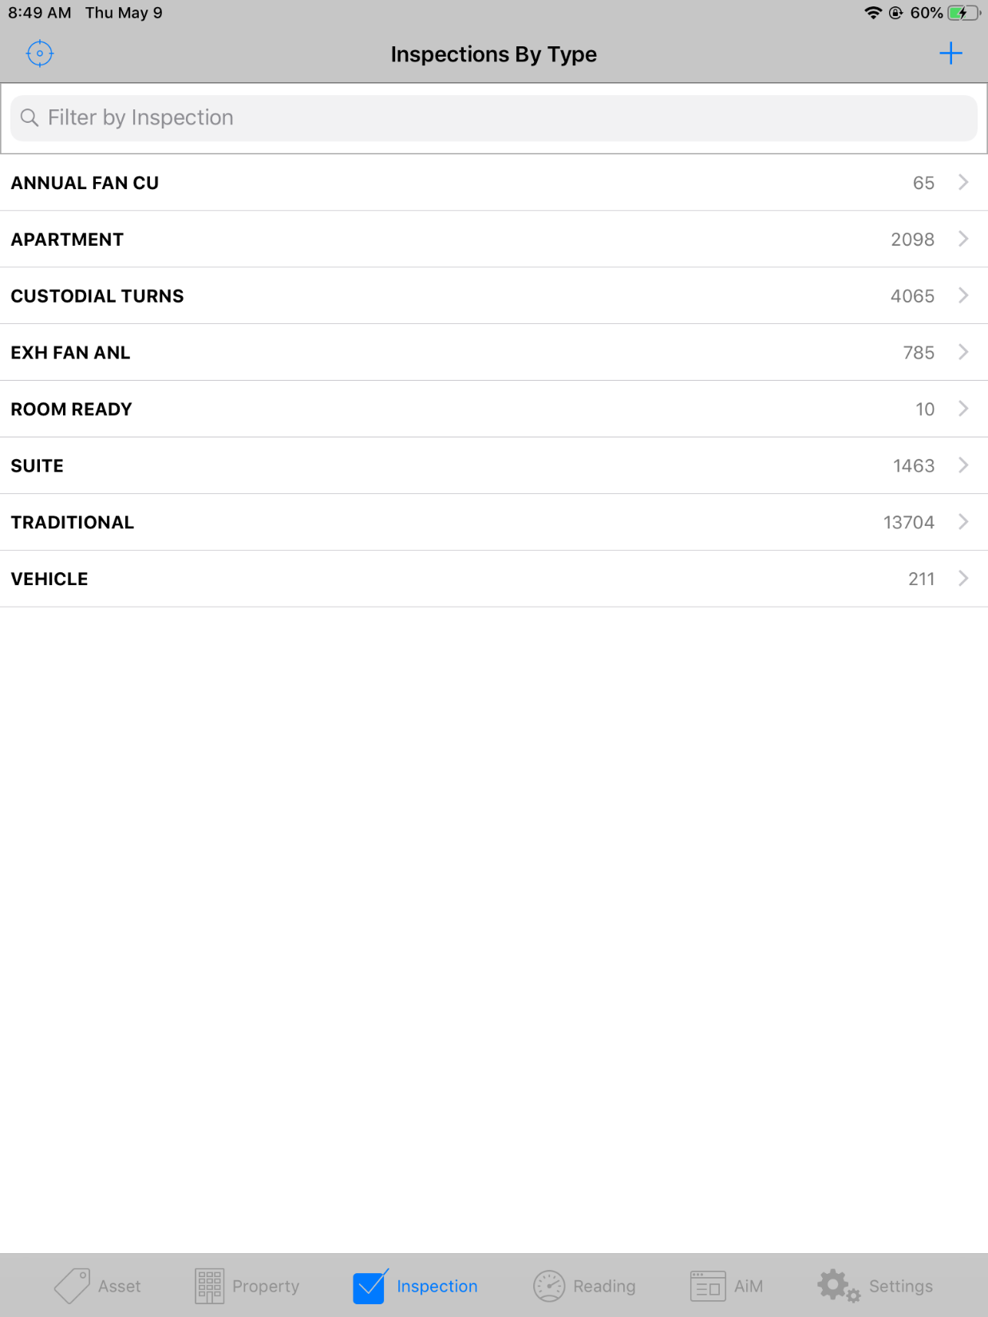
Finding Your Inspection
The Inspection screen will list all types of inspections that have been created in AiM.
Tap on the Filter by Inspection search box and enter the name of the building, then click the blue Search button

Slide 7
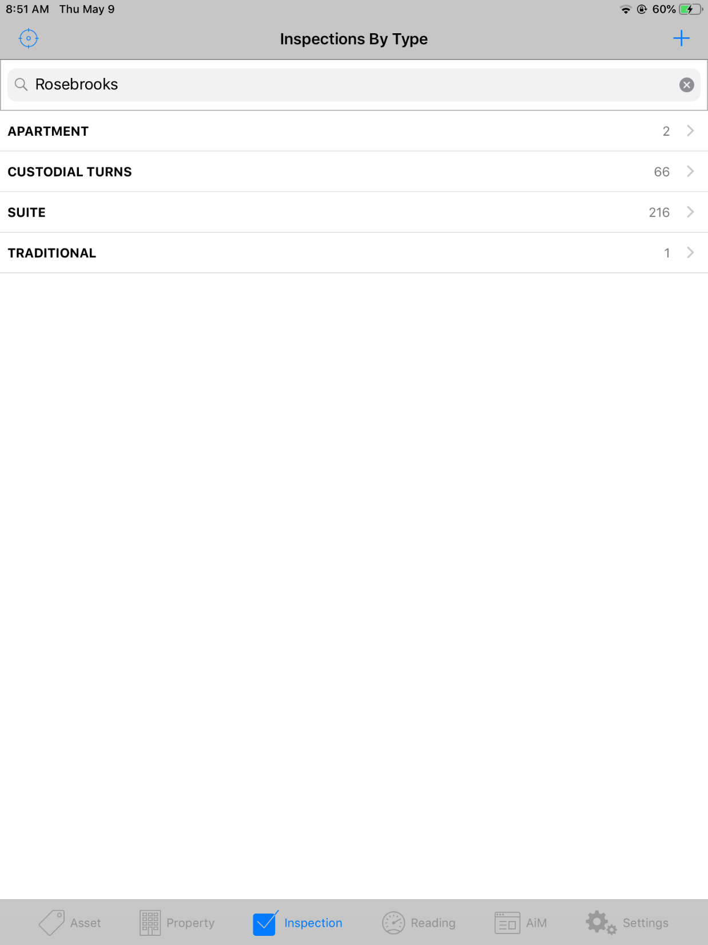
Finding Your Inspection
The list now shows just the available inspections in your specific building.
Click on the arrow on the right side of the screen in the row that says CUSTODIAL TURNS

Slide 8
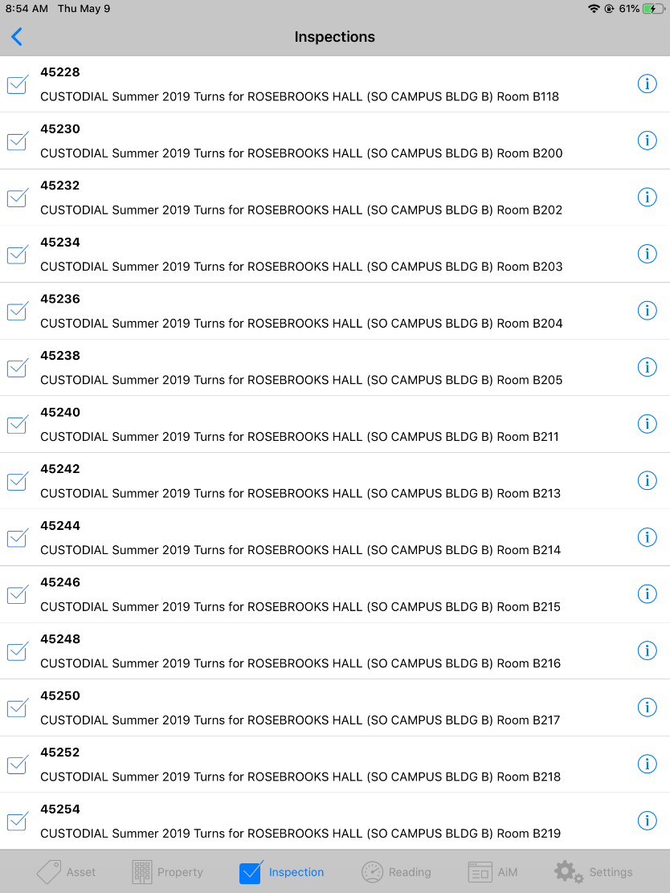
Finding Your Inspection
The list now shows all the available inspections for each room in that building.
Scroll through the list and click on the check box next to the description of the inspection that you want to complete.

Slide 9
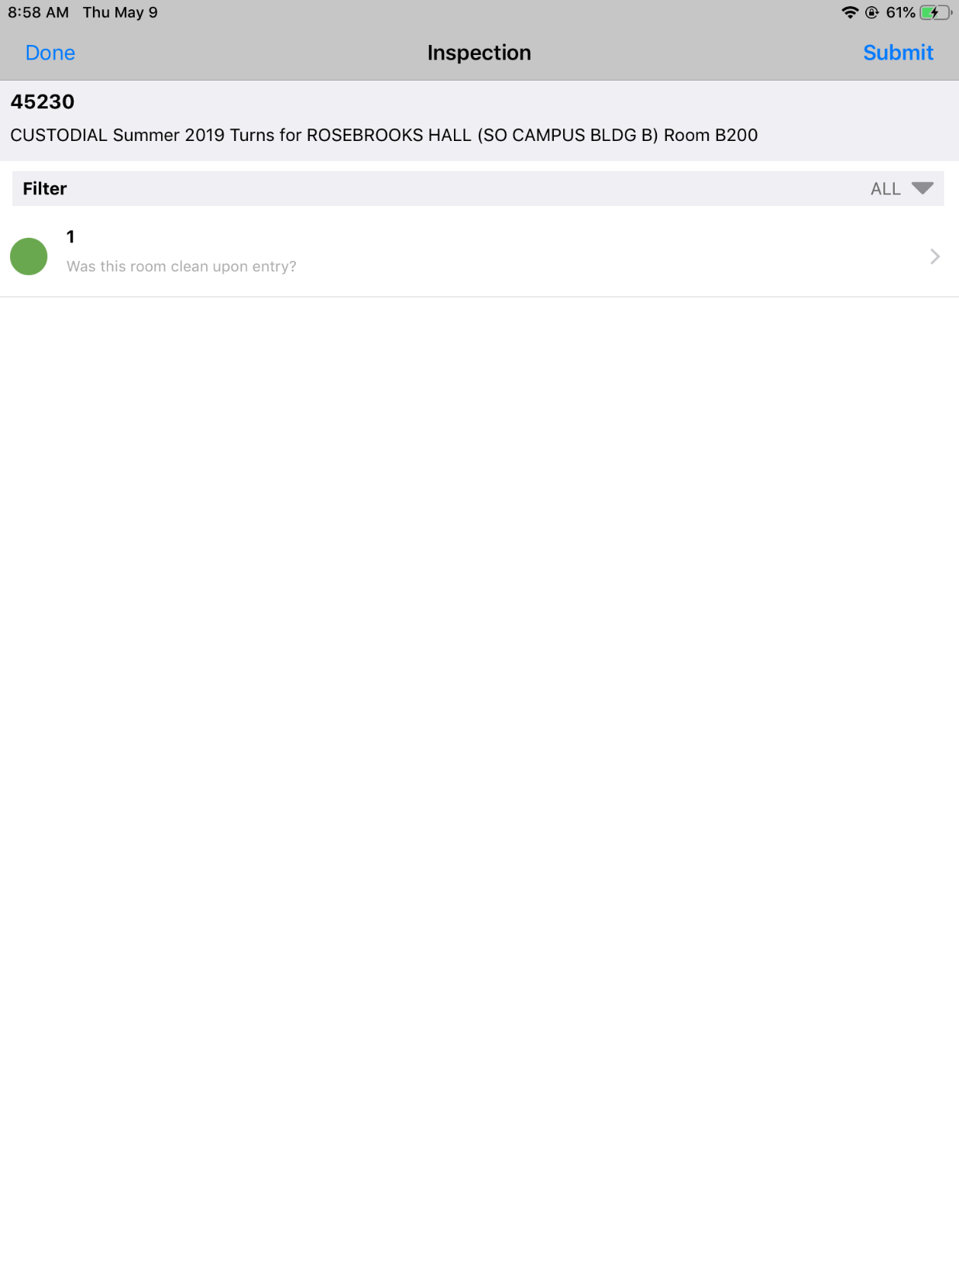
Viewing Your Inspection
Your inspection screen appears with one question on the entire inspection.
“Was this room clean upon entry?”
By default, there is a green circle that appears next to the question, which indicates that it was clean.

Slide 10
Submitting Inspections for Clean Rooms
It should be uncommon that the room needs no service, but in this case, no action is needed on the inspection.
Click on the Submit button in the upper right hand corner and a box will appear confirming that you want to submit.
Click Yes

Slide 11
Editing Your Inspection
If cleaning was performed in the room, click on the arrow on the right side of the screen in the row with the question.
This will allow you change the result to say that cleaning was also needed.
This will also allow you to indicate who performed the cleaning

Slide 12
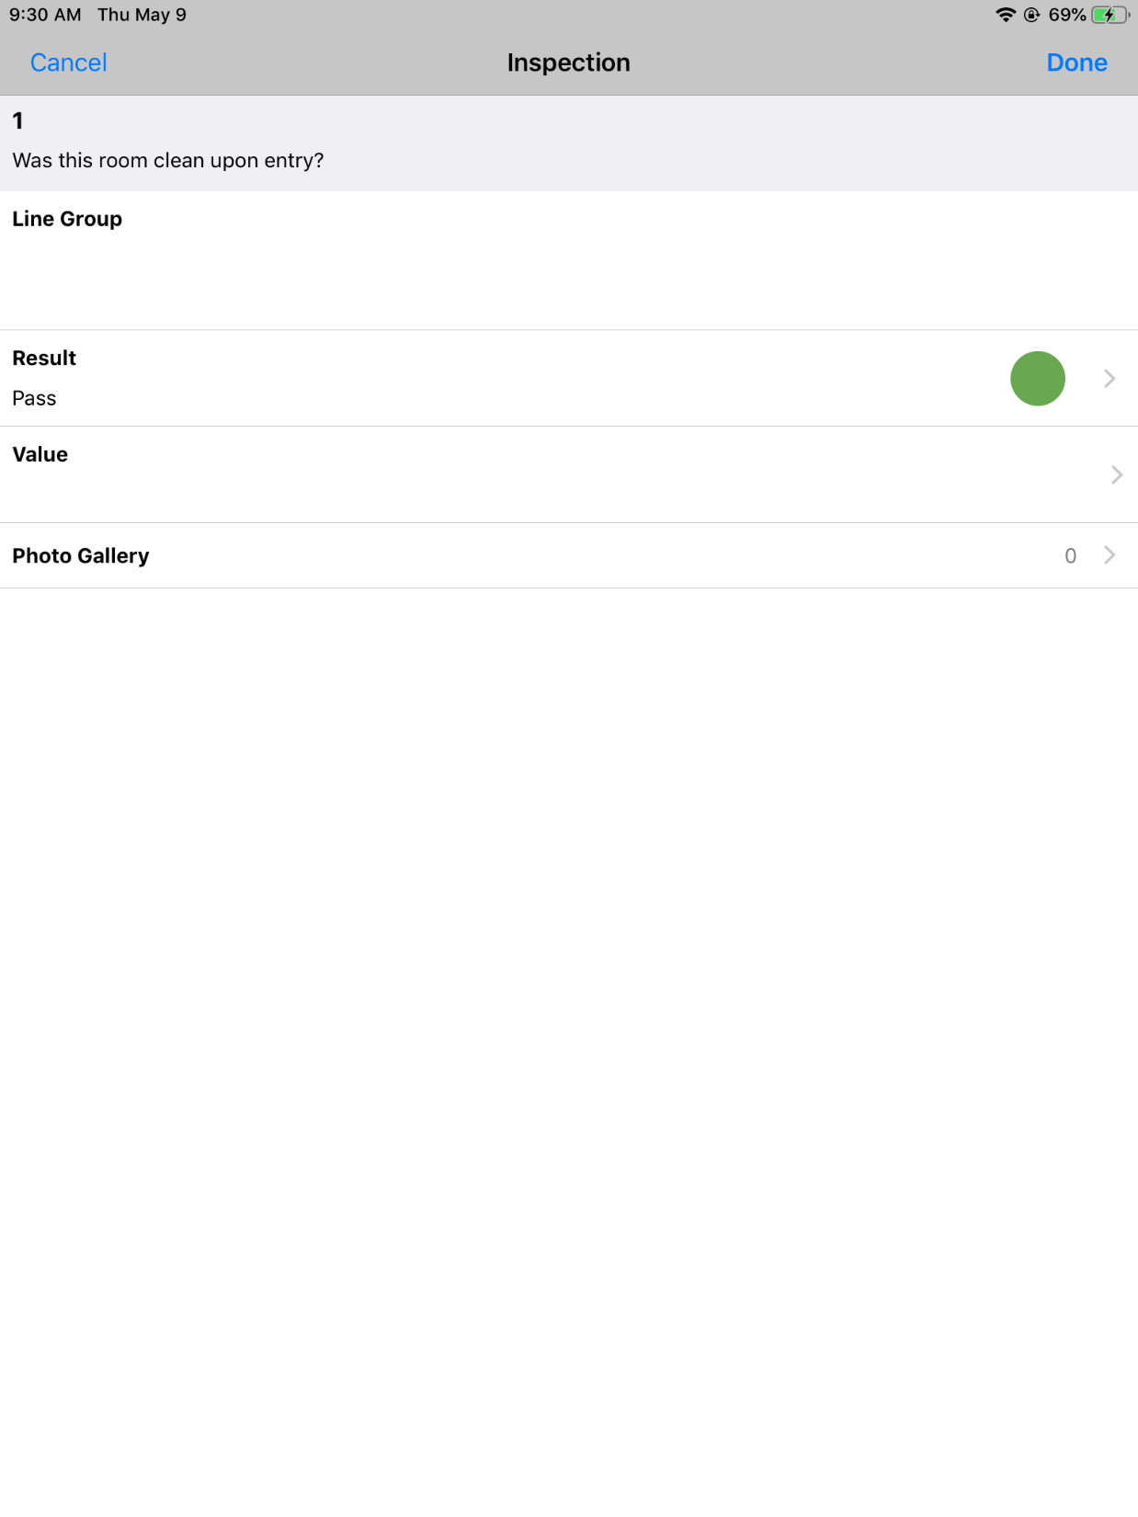
Updating Inspection Results
In the row labeled Results click on the arrow on the right side of the screen.
Three options appear to update the results: Pass, Fail, Not Applicable
Select Fail

Slide 13
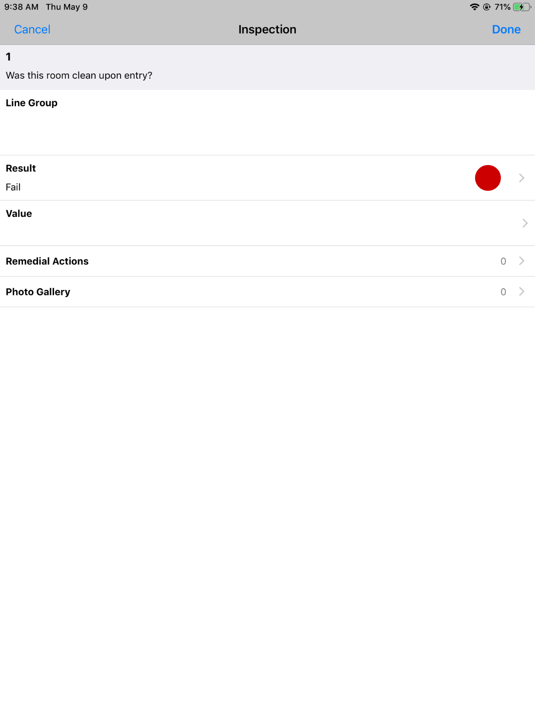
Adding Custodial Staff to Inspection
Your green circle now appears red and the Results have been updated to Fail
Next, you will click on the arrow in the row that says Value to select the staff that supported with the cleaning of the room.

Slide 14
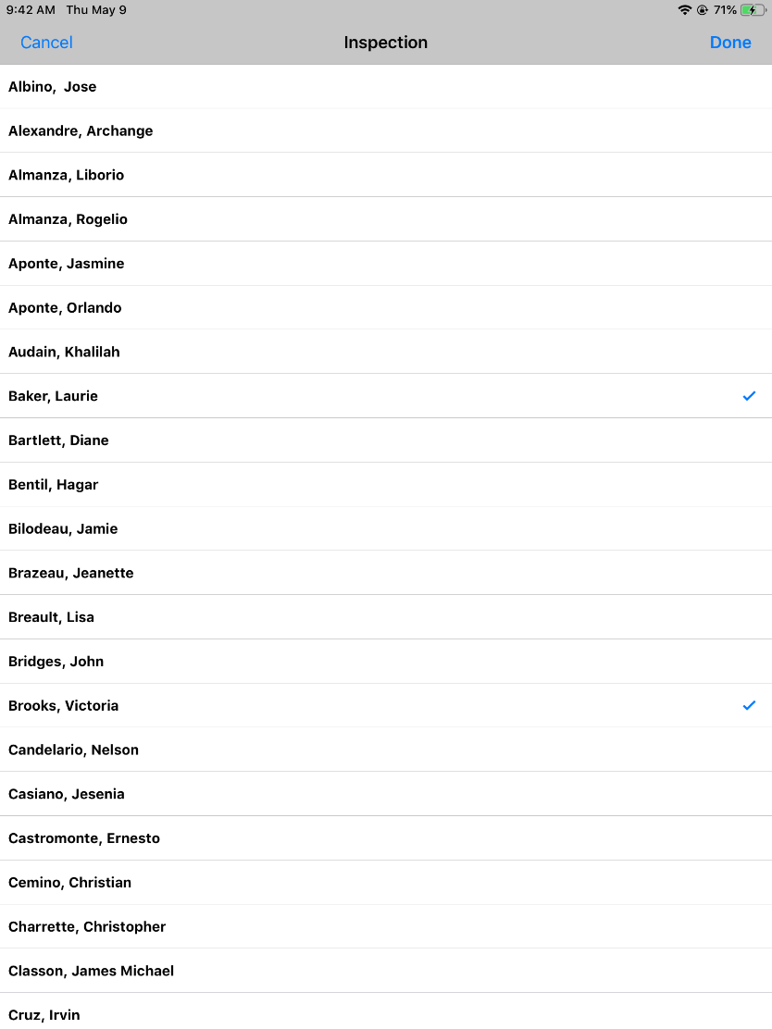
Adding Custodial Staff to Inspection
A list of all custodians appear that are part of the Building Services Group
Click on the names of the custodian(s) performing the work
Multiple custodians can be selected by clicking on more than one name

Slide 15
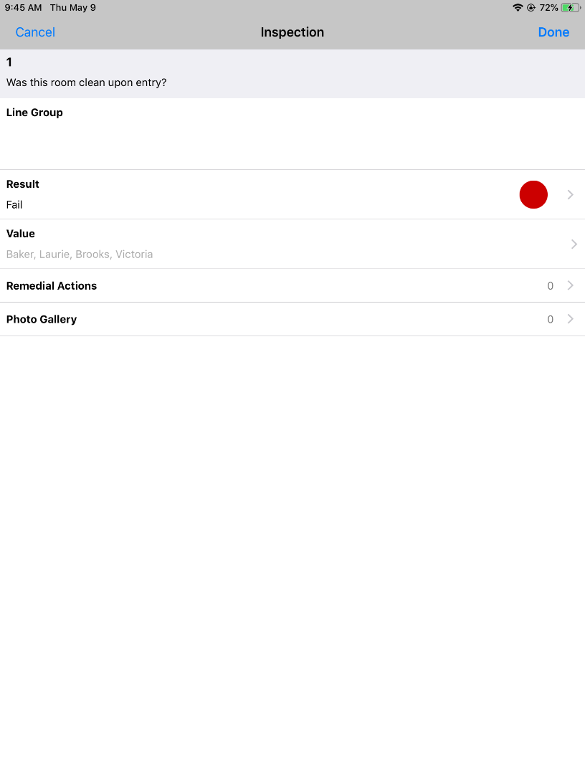
Adding Custodial Staff to Inspection
Click Done when all custodians have been selected.
It will return you to your inspection screen, but you will notice the custodians’ names now appear in the value row.

Slide 16
Submitting the Inspection
Click Done in the upper right hand corner to complete your inspection.
A box will appear that asks you if you would like to submit.
Click Yes

Slide 17
Returning to Search Screen
Once the inspection has been submitted, you will return to your list of CUSTODIAL inspections remaining in that building
You will notice that the last inspection you just completed is now off the list

